Slide 1
SMT-i6000 USB Easy Setup Guide
SEA

Slide 2
USB Easy Setup
Administrator can pre-configure all phone users into a Excel sheet and save it to an USB memory stick.
Just enter the user ID on each phone, the easy setup will automatically register the phone to the system
This process work for either SCM or OfficeServ system.
Required software phone software v1.17 and up.

Slide 3
4 Easy Steps
Step 1: Enter the phone user data into the given Excel sheet and save the file as .CSV format.
Step 2: Plug USB memory into the i6000 phone.
Step 3: Enter the USB easy set up mode. Powering up the phone and press the top right key within 3 seconds.
Step 4: Enter the phone user ID when prompt

Slide 4
Step 1. Program the users in a file
Detail description is in the Excel sheet.
Remark: can indicate extension number
Phone system IP address
Phone user ID and password
Network Type
1: DHCP
2: Static
3: WLAN static
4:WLAN DHCP
Server connect mode
1: Server mode
2: PnP mode
Sample file

Slide 5
Save the file as .CSV format

Slide 6
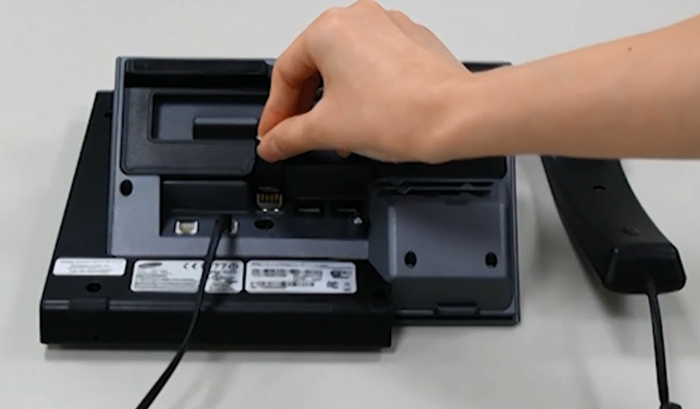
Step 2. Plug in the USB Memory

Slide 7
Step 3: Enter the USB Setup Mode

Slide 9
Step 4: Enter the phone user ID

Slide 10
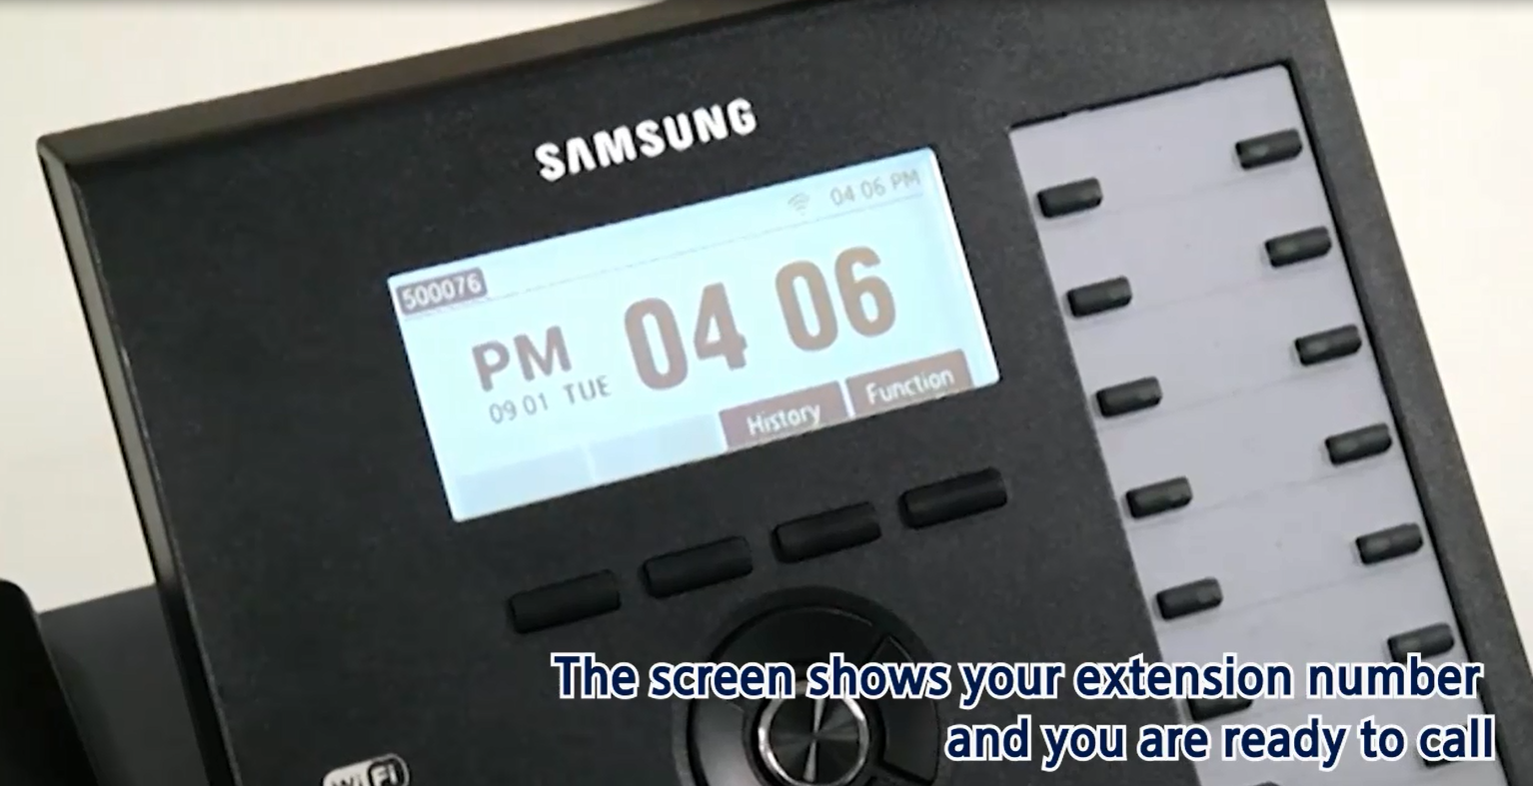
Phone will auto register

