Slide 1
OS7030 – How to upgrade the software to v4.93

Slide 2
| Restrictions & Cautions
| Overview
| Upgrade with DM

Slide 3
Restrictions & Cautions
Restrictions
OS7030 V4.93 or above is NOT compatible with V4.92 or below because of different file system.
So, upgrade and downgrade is NOT supported.
OS7030 V4.93 or above is NOT interoperable with DM V4.92 or below.
Mandatory
Most be onsite to do this upgrade, CAN NOT be done remotely.
You must have a TDM phone connected to monitor the system status. The only way to tell if upgrade is complete is by phone showing time and date. During the upgrade the lights on the system cabinet will give false indications of running system.
Cautions
Do NOT power off, while changing file system.

Slide 4
Overview
V4.93 requires new file system which requires new boot rom software.
There are two methods to upgrade software to v4.93.
Case #1: with OSDM. It takes about 45 minutes can be done in the field.
Case #2: with SIO. If system has crashed, this is the only method to recover. It takes about 20 minutes. Not recommended for the field upgrade. Consult with Samsung tech support if your system has crashed.
with OSDM (Case #1)
(Case #2) with SIO
Disable firewall
&
run TFTP server in windows
Need to run TFTP server in either DM or SIO method
2) Backup DB
3) Upgrade package (T4.93m with new bootrom)
3) Upgrade bootrom with SIO
4) Upgrade package (V4.93) with OSDM
4) Upgrade package (V4.93) with SIO
5) Upload VM LANG files
6) Restore DB
&
restart system

Slide 5
Changing filesystem with OSDM
1) Disable firewall & run TFTP server in windows
2) Backup data base file
3) Upgrade software package (T4.93m) to new boot rom
4) Upgrade software package (V4.93)
5) Upload voice mail language files
6) Restore DB & restart system

Slide 6
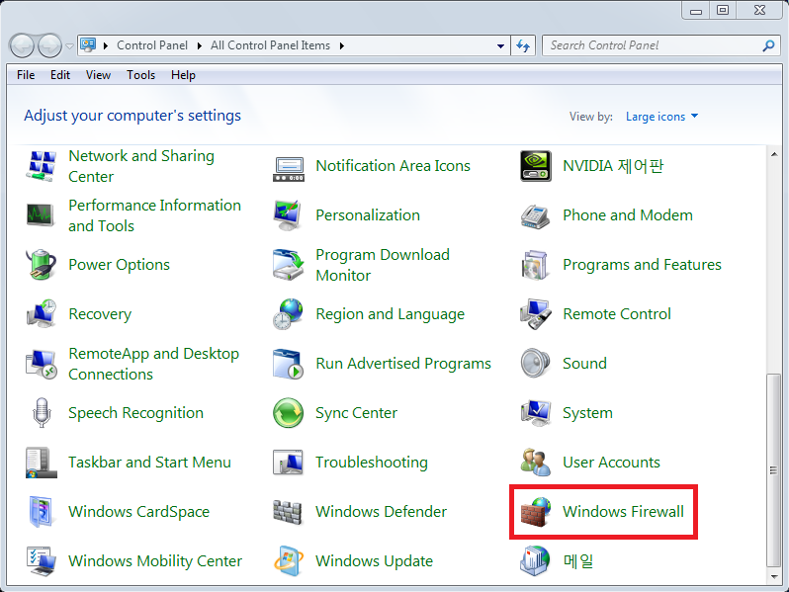
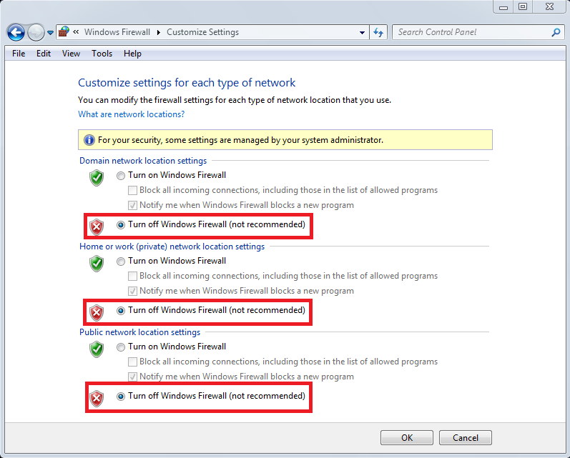
(1) Disable firewall & run TFTP server in windows
a) Check your firewall and Set to disable your firewall
b) Set your computer IP with same OS 7030 subnet IP
ex) OS7030 system IP : 10.0.10.10
Computer IP : 10.0.10.11

Slide 7
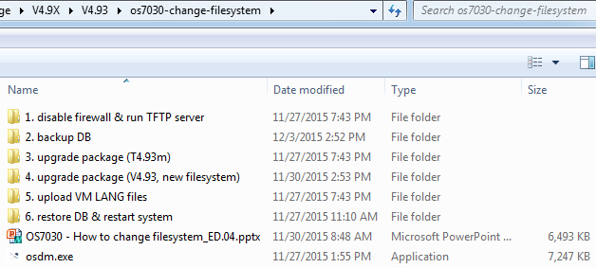
(1) Disable firewall & run TFTP server batch file in windows
c) Unzip os7030-change-filesystem.zip on your computer and click on RunStandAloneMT.bat under No.1 directory

Slide 8
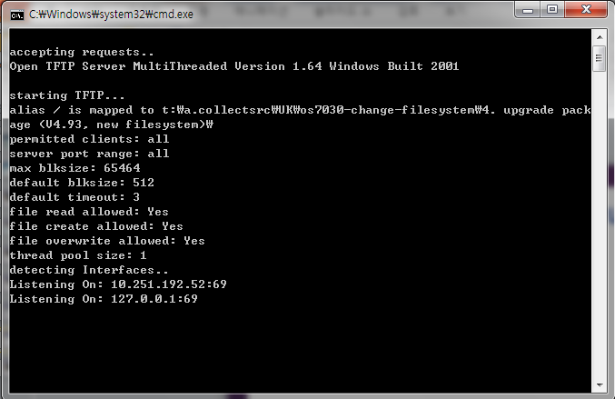
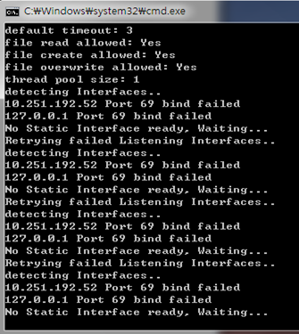
(1) Disable firewall & run TFTP batch file in windows
If TFTP server status shows the following, it is working fine.
Continue to step 2 to back up the DB file.
If TFTP server shows the following,
See next page for correction.

Slide 9
If TFTP server can’t bind the port, run the following three commands to correct it. Make sure TFTP server is successful operating before move to next step.
In PC, run “cmd” as administrator to open a command window.
>netstat –a –o –n | findstr 0.0:69
>netstat –a –o –n | findstr xx:69 (xx means the last ip address of your PC/TFTP server. In this example, it is 11 because the server ip address is 10.0.2.11)
>taskkill /F /PID yy (yy is the PID of your PC. It shows on you screen. This example is 9292. Your PC may have different PID)
Right Click on RunStandAloneMT.bat run as administrator under No.1 directory again.
PID

Slide 10
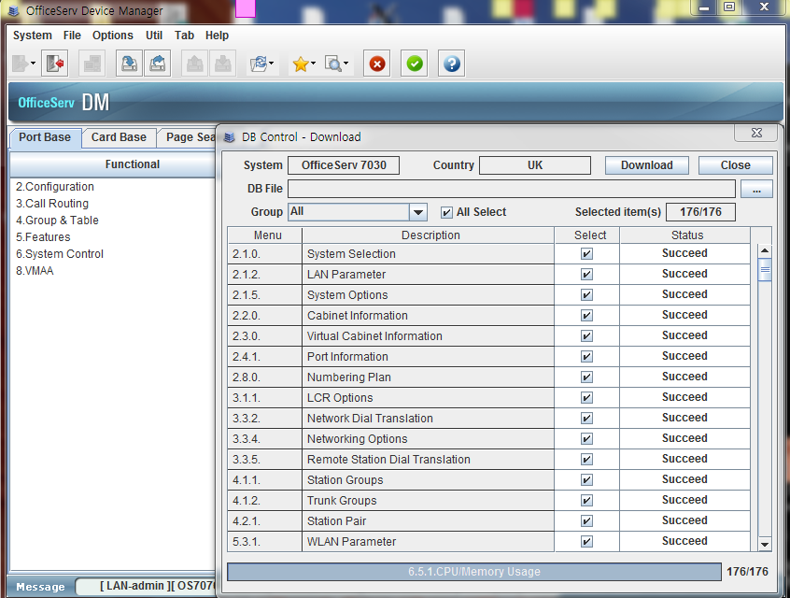
(2) Backup DB
a) Connect OS 7030 with v4.93 OSDM (osdm.exe) and download DB file at No2 directory
b) Make sure the backup DB file is created

Slide 11
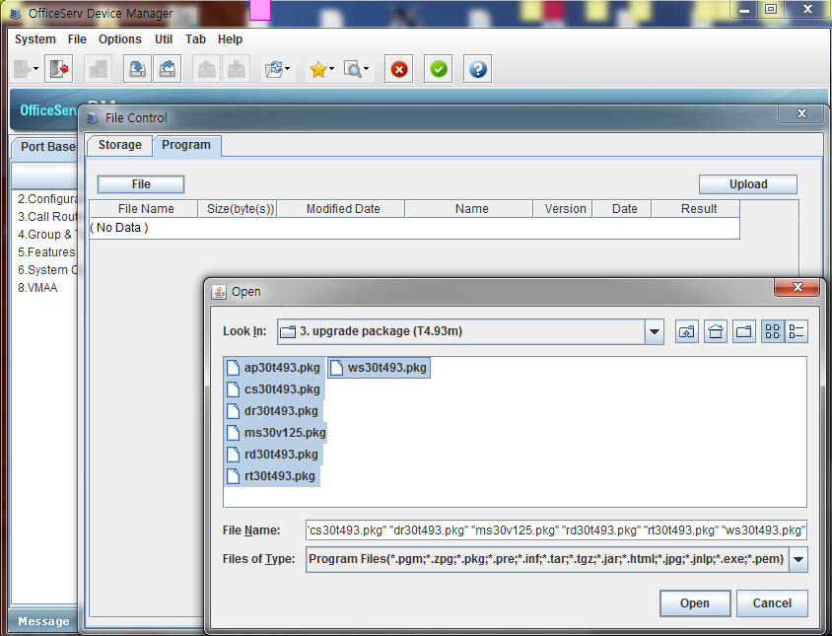
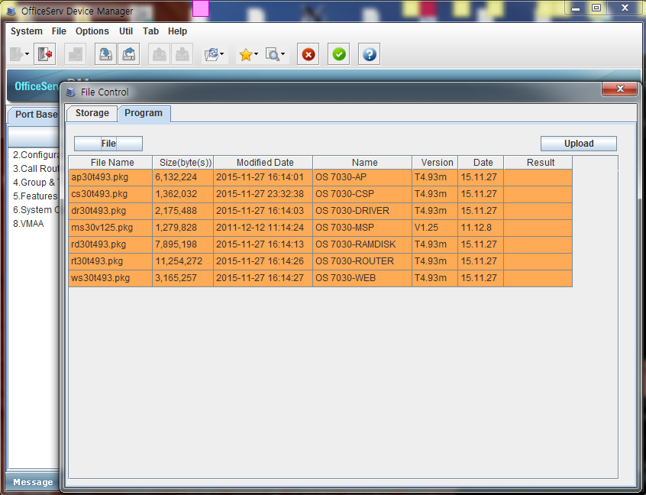
(3) Upgrade package (T4.93m)
a) Connect OS 7030 with OSDM(osdm.exe) and upload temporary package (T4.93m)
b) Check uploaded temporary package (T4.93m)

Slide 12
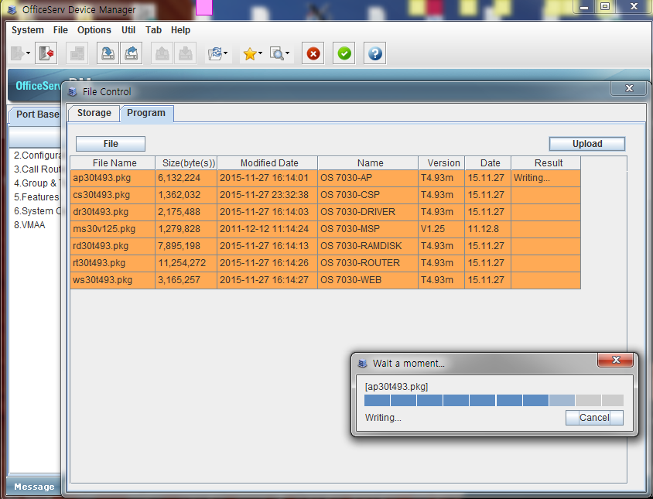
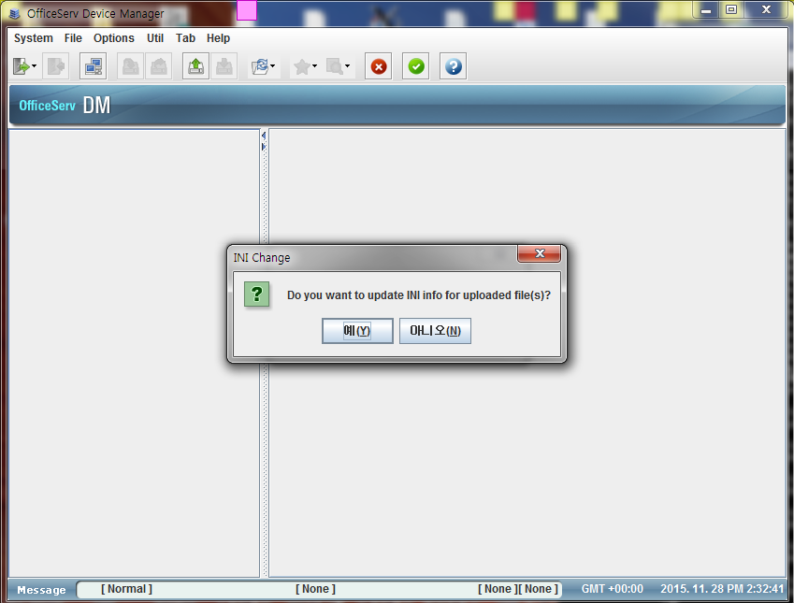
(3) Upgrade package (T4.93m)
c) Uploading temporary package (T4.93m)

Slide 13
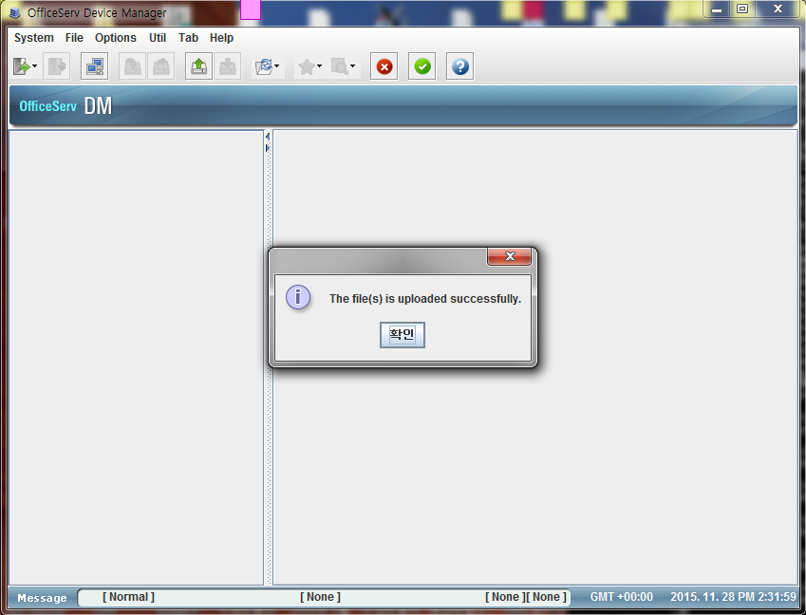
(3) Upgrade package (T4.93m)
d) Change INI file (see below picture)

Slide 14
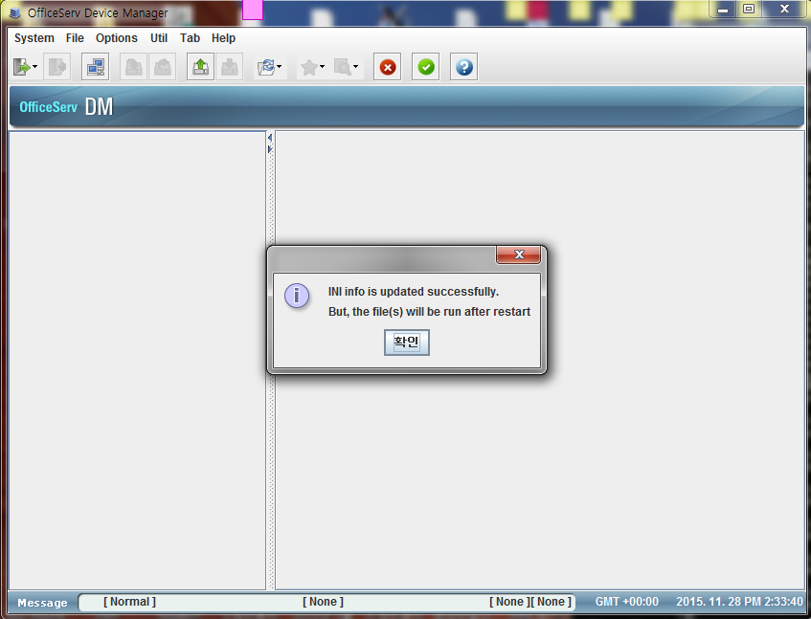
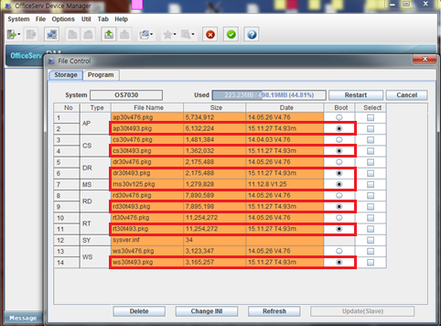
(3) Upgrade package (T4.93m)
e) Chang Boot field (see below picture) and click Restart button
f) It will take 25 minutes. After this time, Go to No.4 next page

Slide 15
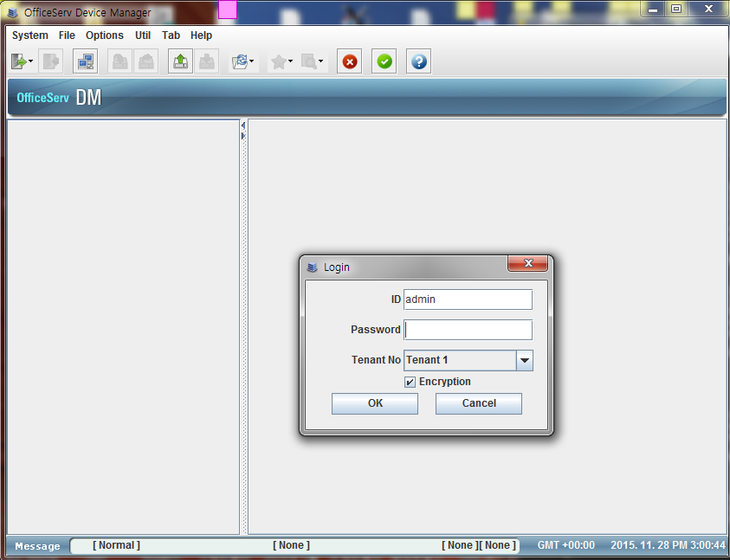
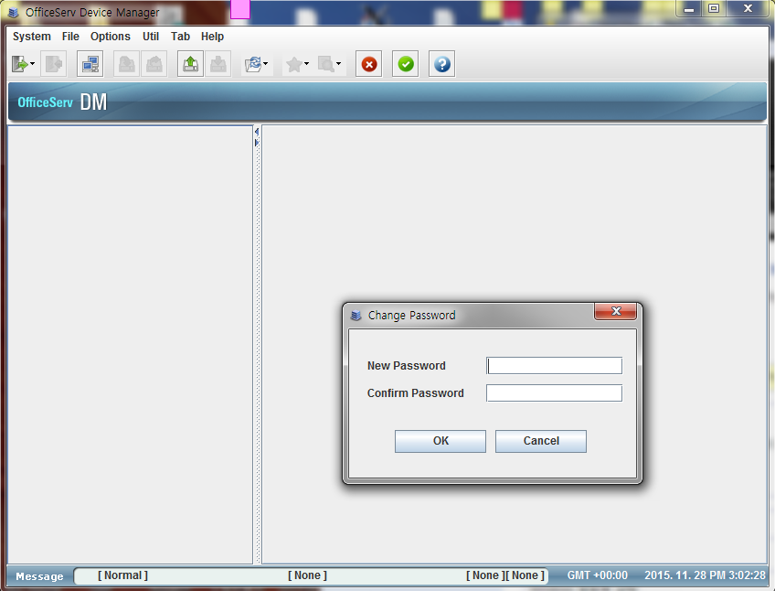
(4-1) Upgrade package (V4.93)
a) Connect OS 7030 system come back. OSDM login password has been changed to the default value (#PBX1357sec.com), need to change password

Slide 16
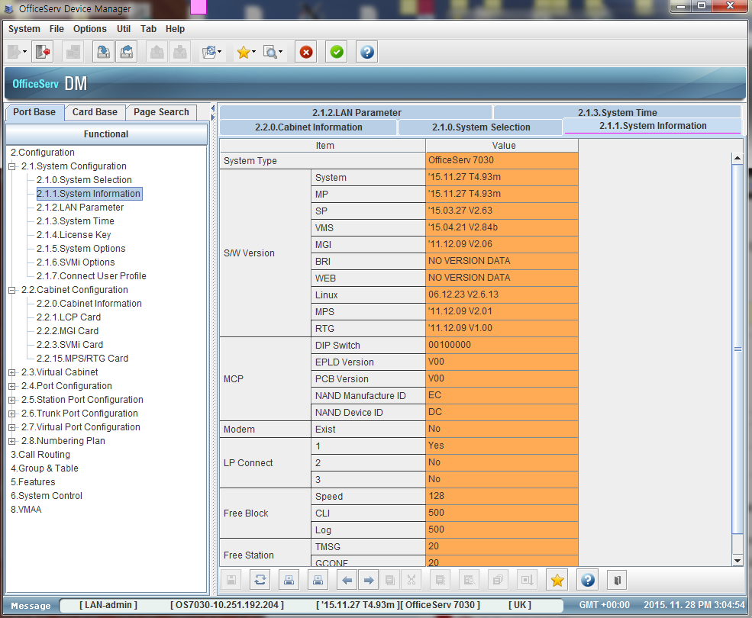
(4-1) Upgrade package (V4.93)
b) Check temporary package file version (T4.93m) to ensure the system has been upgraded to T4.93m.

Slide 17
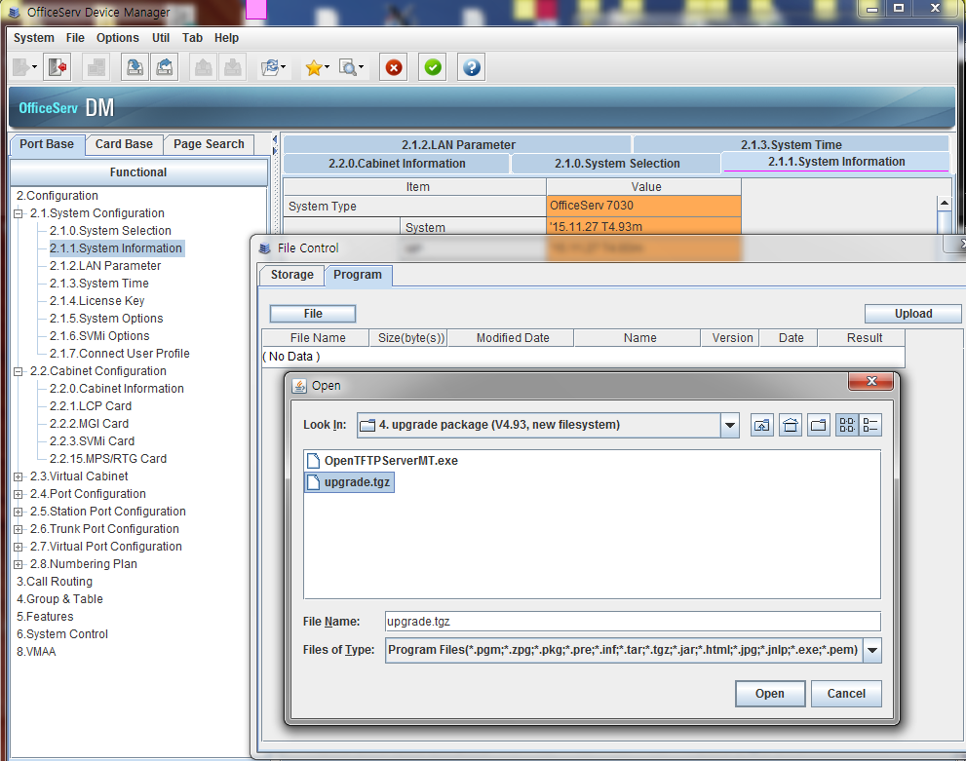
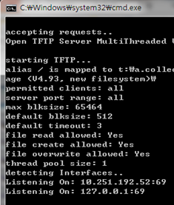
(4) Upgrade package (V4.93)
c) Select upgrade.tgz file. Make sure the TFTP server still running properly.
Make sure TFTP server is operating.

Slide 18
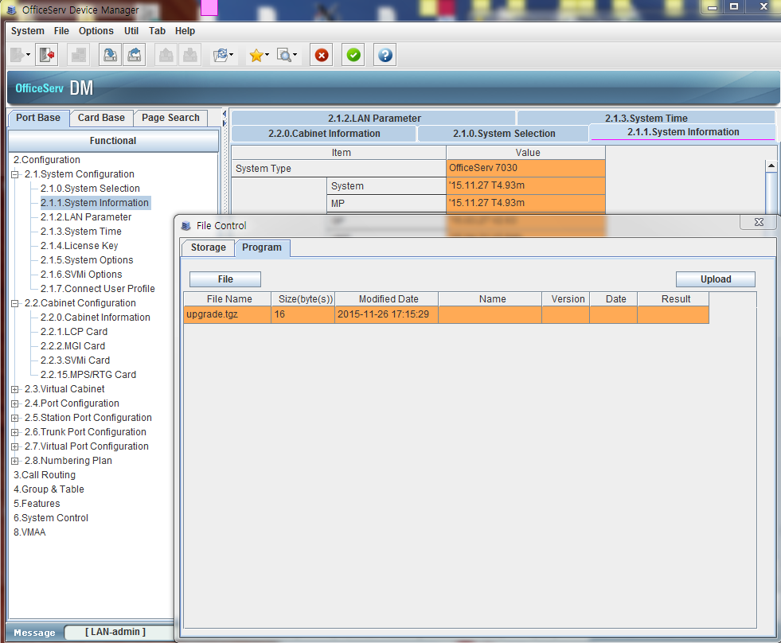
(4) Upgrade package (V4.93)
c) After you click upload button, the system will start upgrade automatically. The DM screen will not show the status. After system loading all files, it will restart by itself. Check TFTP server window to see the status.
d) It will take 20 minutes. Do not power down or restart the system manually.

Slide 19
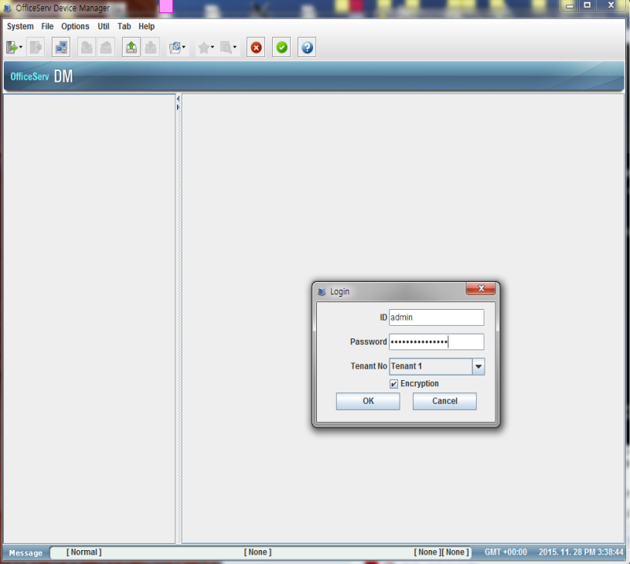
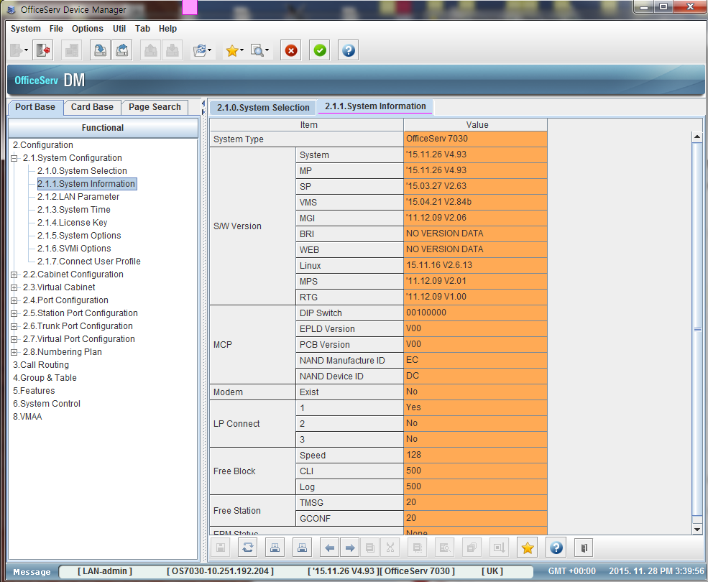
(5) Upload VM LANG files
a) After system comes back, connect OS 7030 with OSDM
b) login password is changed to the default value (#PBX1357sec.com) and need to change password
c) Check OS 7030 is running V4.93 version

Slide 20
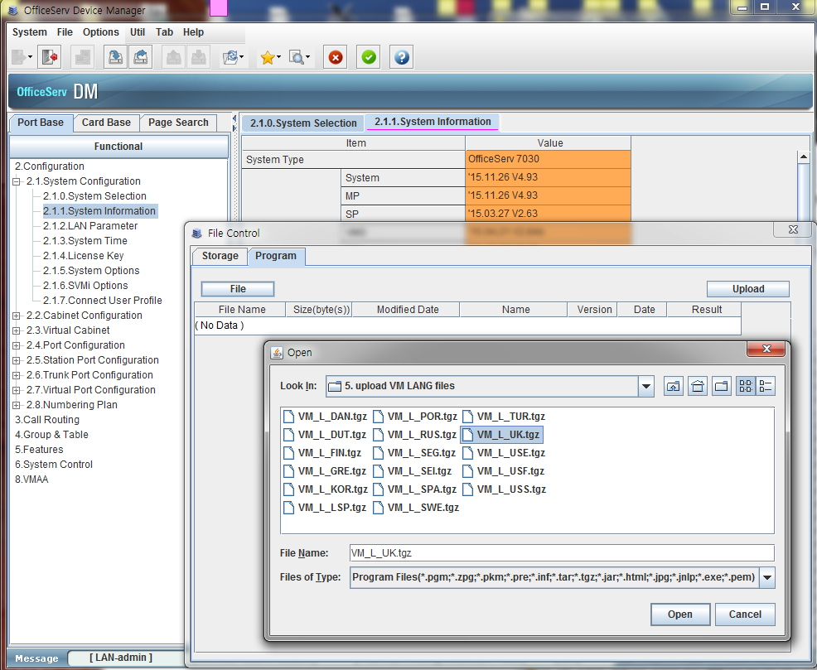
(5) Upload VM LANG files
d) Upload VM language files

Slide 21
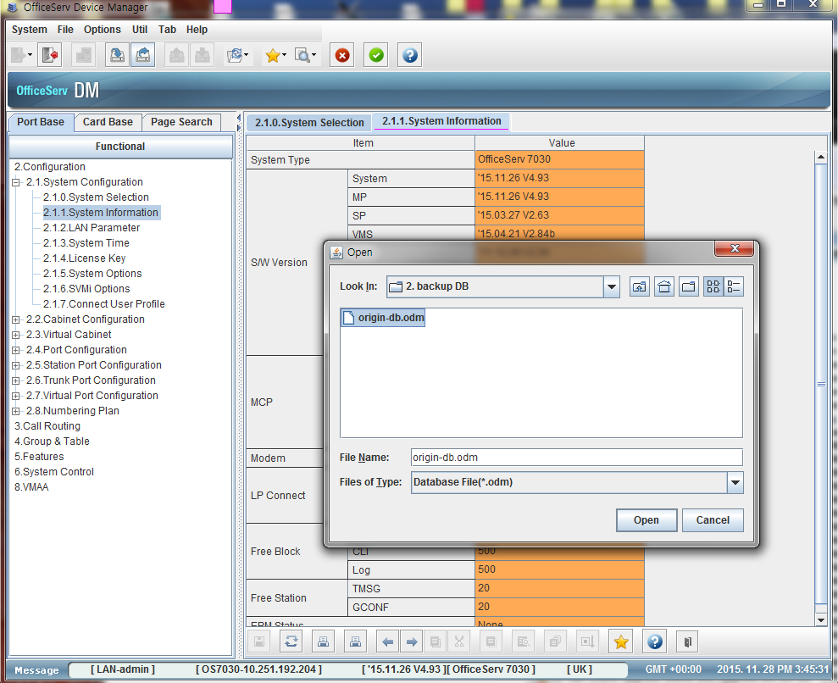
(6) Restore DB & restart system
a) Upload the previous saved DB file

Slide 22
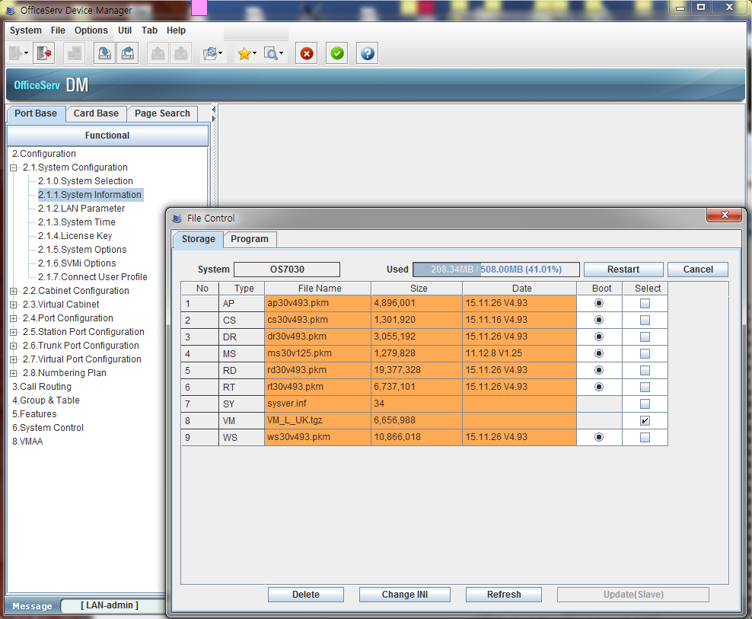
(6) Restore DB & restart system
b) Click Restart button in OSDM file control window
c) OS 7030 system is ready to serve

