Slide 1
NEC SV9100 Startup Technical Training
2018 (Session 1)
Sales Engineering

Slide 2
Sales SV9100 Startup Agenda
NEC Training and Certifications
NEC NTAC
Platform Overview
Licensing
SV9100 CPU Overview
System Startup (Need to Know)
Questions

Slide 3

NEC Training and Certifications
NEC SV9100

Slide 4

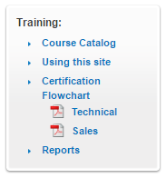
NEC Training (Sales and Technical)
https://training.necam.com/

Slide 5
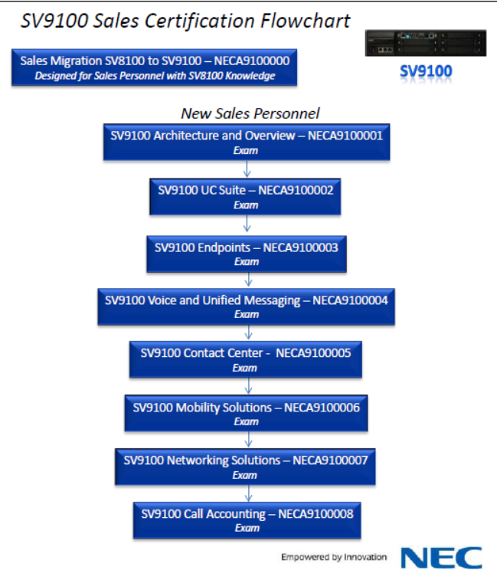
SV9100 Sales Certification Training
It is suggested that sales people and technicians take these courses.
High level overviews of the SV9100 and it’s applications
Great lead in for the technical courses
No charge classes.

Slide 6
SV9100 Technical Certification Courses

Slide 7

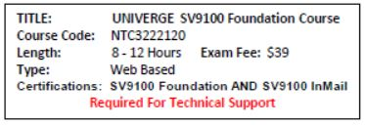
SV9100 Technical Certification Training
SV9100 Foundation Courses
IP Prerequisite Course
  Exam Fee $0
SV9100 Foundation Course
  8-12 Hours
  Exam Fee $39
  SV9100 and InMail Certifications
  Required For Technical Support

Slide 8

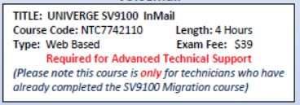

SV9100 Technical Certification Training
SV9100 Advanced Courses (Applications)
UC Suite Certification
  4 Hours
  Exam Fee $39
InMail Certification
  4 hours
  Exam Fee $39
Advanced SIP Trunking
  4 Hours
  Exam Fee $39
  Required For Technical Support

Slide 9

NEC Technical Support
NEC NTAC

Slide 10

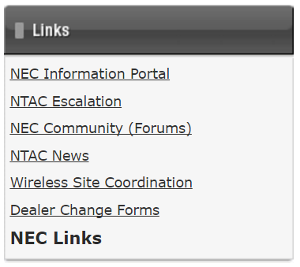
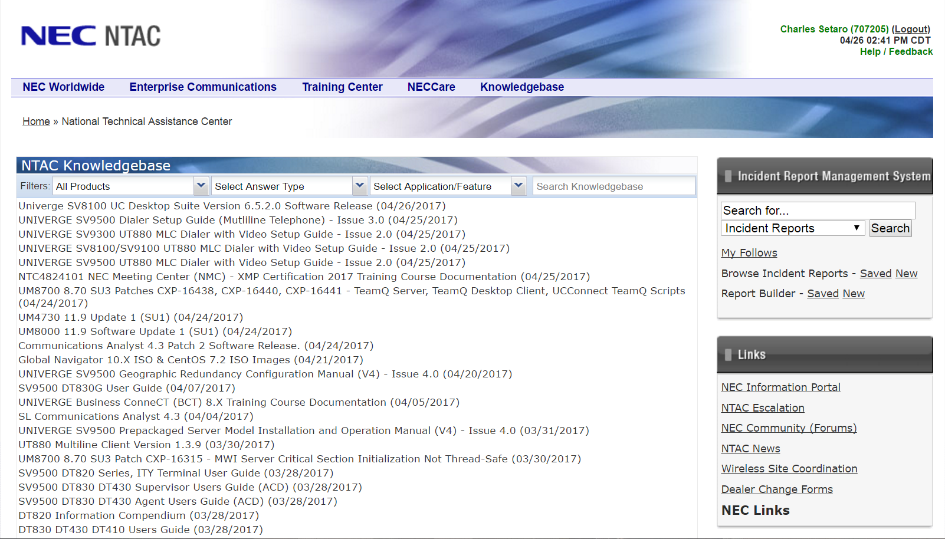
NEC NTAC (Technical Assistance)
https://necntac.com/
BREAK FIX!

Slide 11
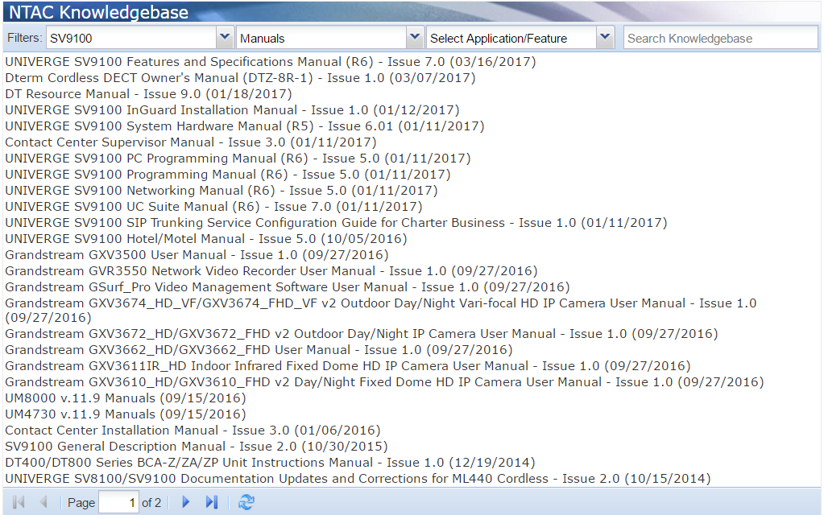
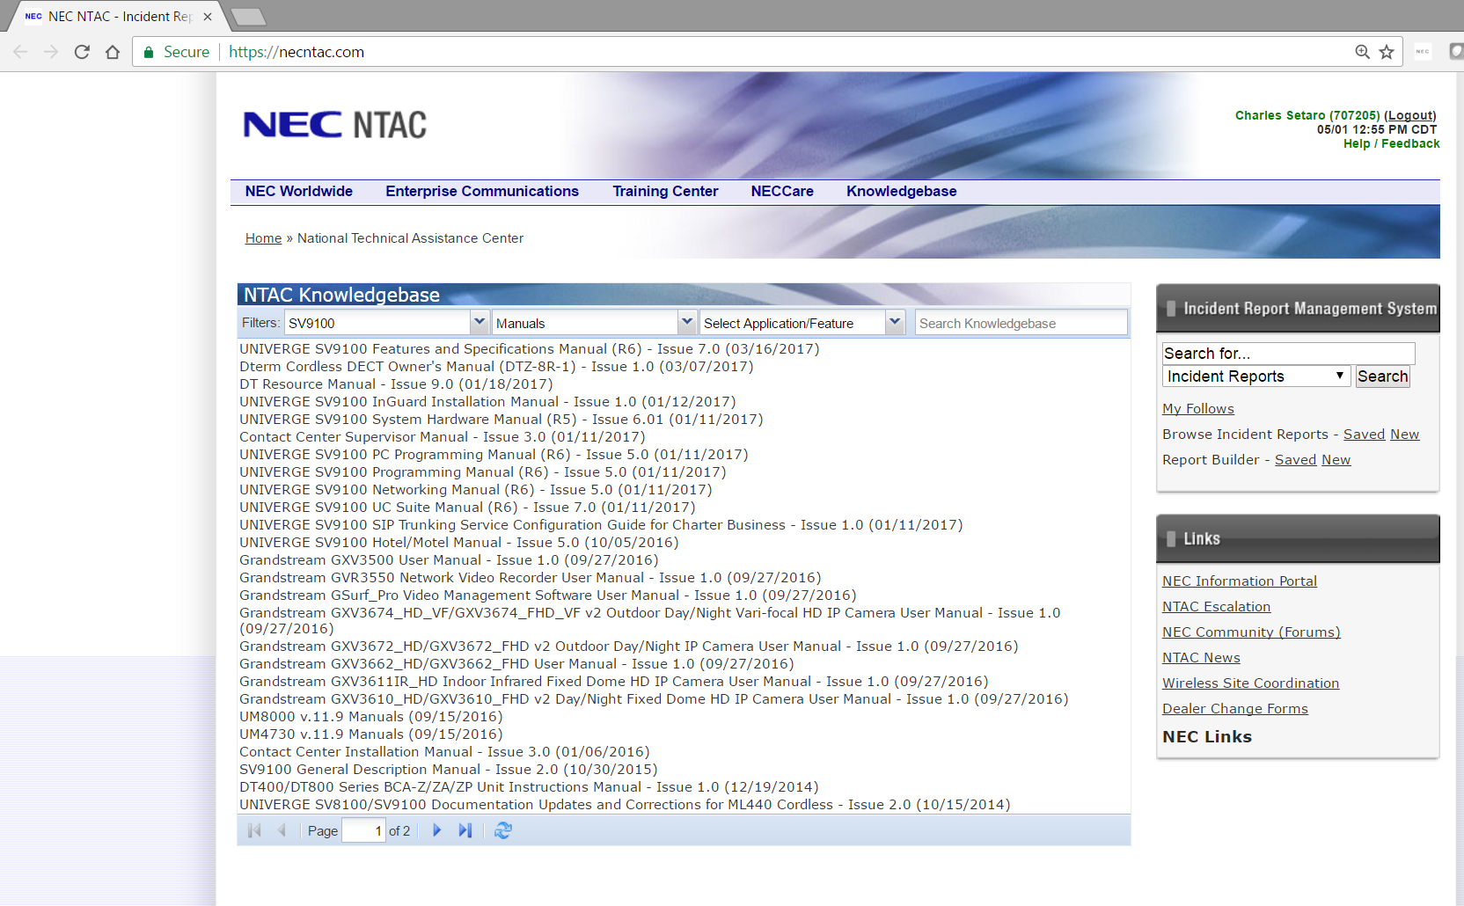
NEC NTAC (SV9100 Manuals)
SV9100 Manuals
Features and Specifications
System Hardware
PC Programming
Programming
InMail System Guide
Networking
General Description
UC Suite
Contact Center Installation
Contact Center Supervisor

Slide 12
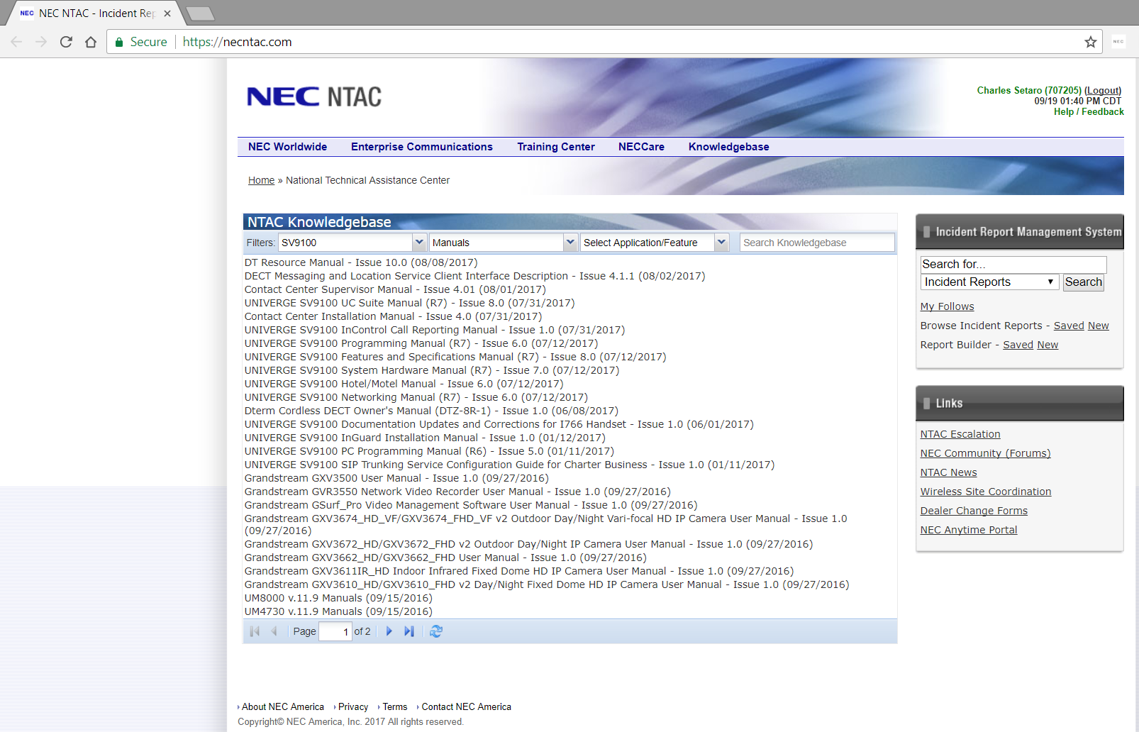
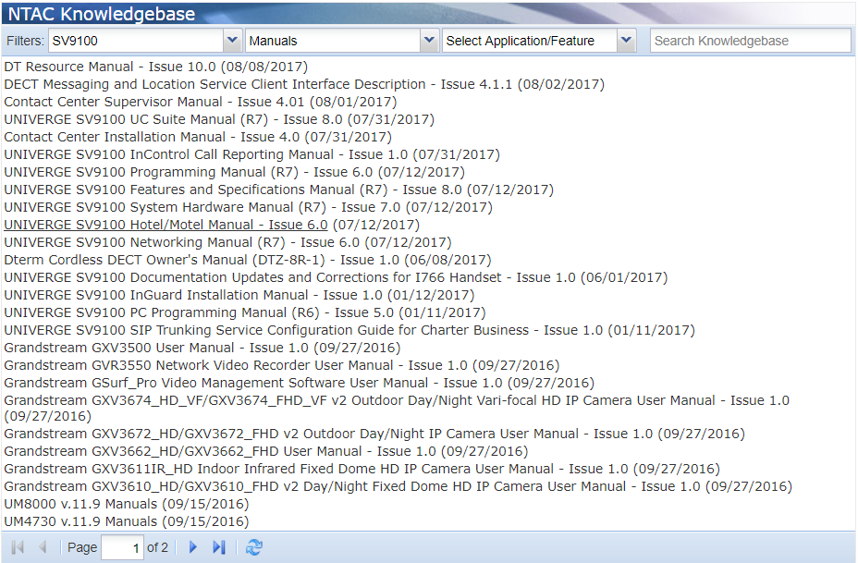
NEC NTAC (SV9100 Manuals)
SV9100 Manuals
Features and Specifications
System Hardware
PC Programming
Programming
InMail System Guide
Networking
General Description
UC Suite
Contact Center Installation
Contact Center Supervisor

Slide 13
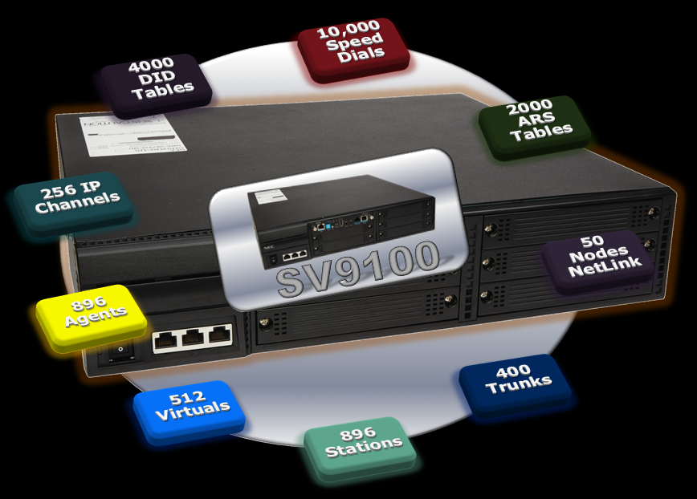
NEC SV9100
SV9100 Platform Overview

Slide 14
SV9100S & SV9100E
SV9100S – 48 Resources (Upgradable to E)
SV9100E – 1296 Resources
SV9100E
Support for up to 1,296 Resources
IP included
IP/UC Focus
VM/UM
SV9100S
Includes 48 System Resource Licenses
TDM
VM
UM/IP/UC Available
Upgradable…

Slide 15
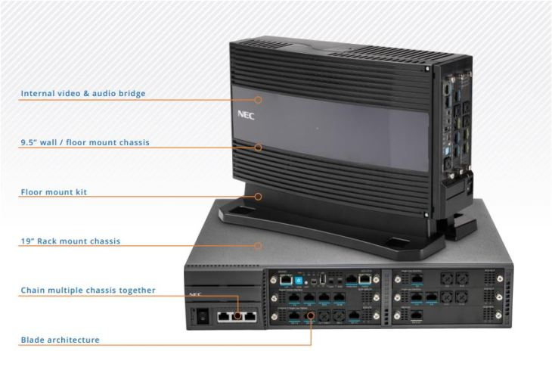
SV9100S Platform
Price Focused
  IP available via IPLE
  Activate UC via User Licenses
InMail
  16 voice channels with 15 hours storage
  UM available
  8 or 16 Subscriber Mailboxes included based on package selection
48 Resource Licenses included
Maximum 48 total resources
  Expandable through migration to SV9100E
Feature set same as SV9100E

Slide 16
SV9100E Platform
UC & IP Equipped
  IPLE included
  Embedded InMail (120 Hrs.)
  Activate UC via User Licenses
    8 or 16 User Licenses included based on package selection
UM8000 Option
  500+ hours storage
Maximum 1,296 total ports
  896 stations
  400 trunks

Slide 17
SV9100 Chassis Types
9.5” 3 Slot Chassis (SV9100S or SV9100E)
19” 6 Slot Chassis (SV9100S or SV9100E)
SV9100 9.5” Chassis
SV9100 19” Chassis

Slide 18

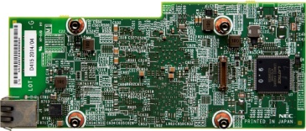
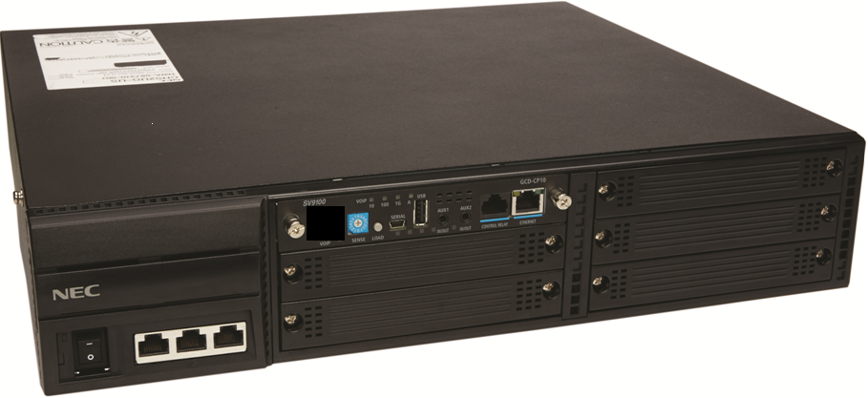
SV9100S to IP
IPLE
SV9100S
Need IP?
Remote Worker
SV9100S
48 Resources

Slide 19
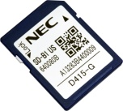
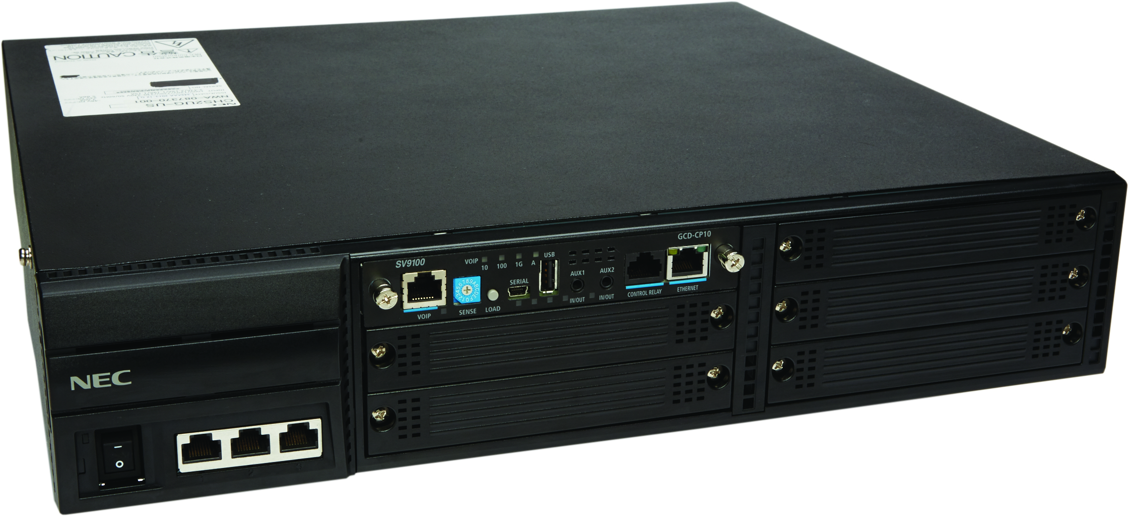
SV9100S to SV9100E (Migration Kit)
MIGRATION KIT
Migration License
SV9100E
1296 Resources
NetLink
Need NetLink/More Ports?
Expand S to SV9100E
SV9100S
48 Resources

Slide 20
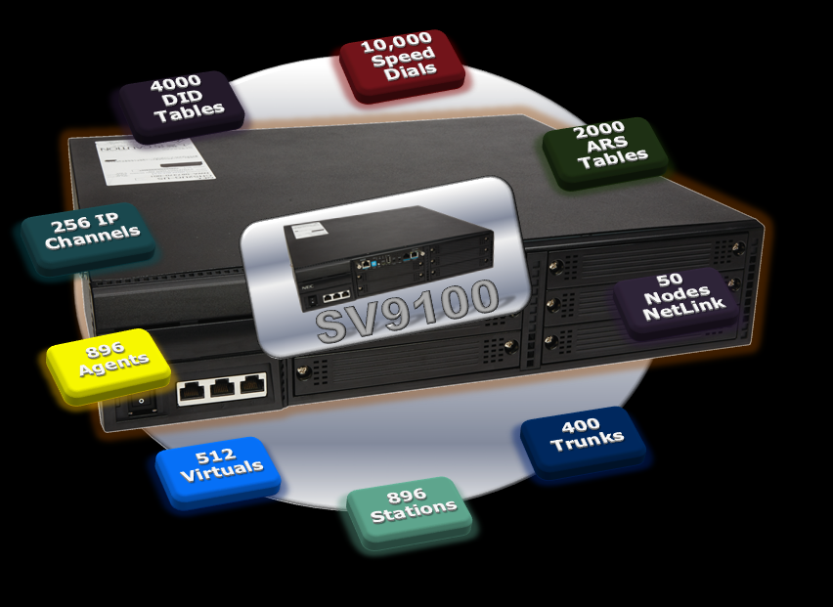

Slide 21
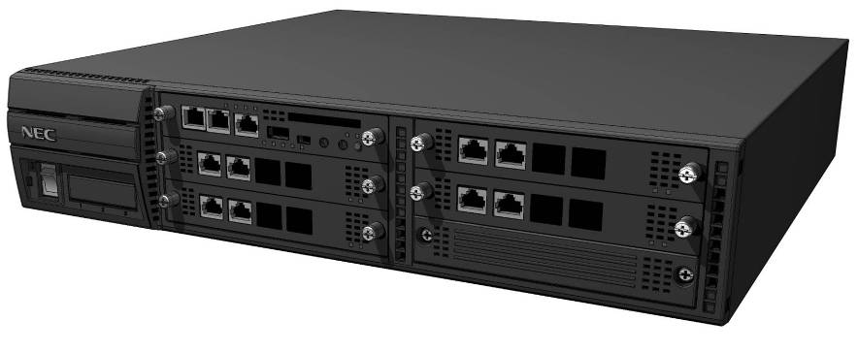

SV9100 Built Out
System Capacity
  Expandable to 1,296 total ports
  Easy to configure system capacity by adding Licenses, Chassis & Blades
NetLink
(IP Connection)
400 TRK + 896 EXT
Items |  |  |  | SV9100
Max Ports |  |  |  | 1,296
 | Max Trunks (Total) |  |  | 400
 |  | Analog |  | 400
 |  | ISDN |  | 400
 |  | IP |  | 400
 | Max Extensions (Total) |  |  | 896
 |  | Digital |  | 896
 |  | Analog |  | 896
 |  | IP |  | 896
 |  | Virtual |  | 512
Items |  | SV9100
InMail Hours |  | 15/120
Remote Node (NetLink) |  | 49
VoIP Channels |  | 256
ARS Tables |  | 2000
DID Tables |  | 4000
Speed Dial |  | 10,000
Phone Book |  | 110,000
Access Maps |  | 400
UC Clients |  | 256/512
Conference |  | 32x3 = 96

Slide 22
Terminology
Analog Station
Digital Station
IP Station
Mobile Extension
Ports
Resources
Analog Trunk
Digital Trunk
IP/SIP Trunk

Slide 23
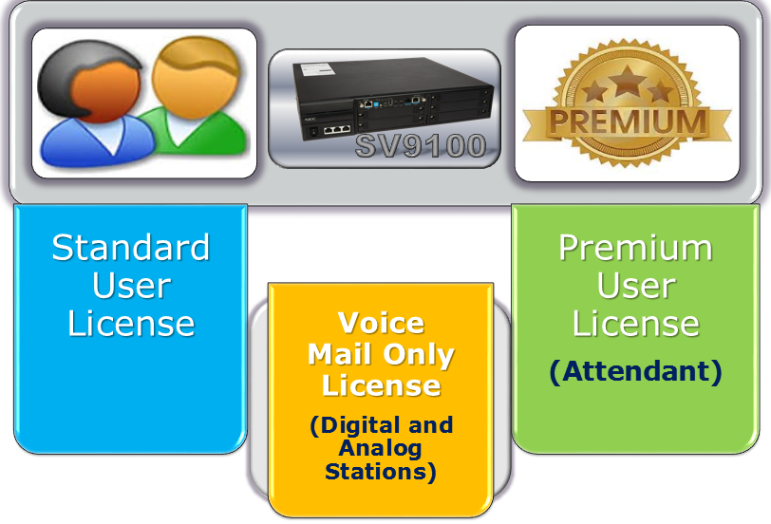
NEC SV9100
SV9100 Licenses

Slide 24


SV9100 User Licenses
SV9100
Standard User License
Premium User License
(Attendant)
Voice Mail Only License
(Digital and Analog Stations)

Slide 25
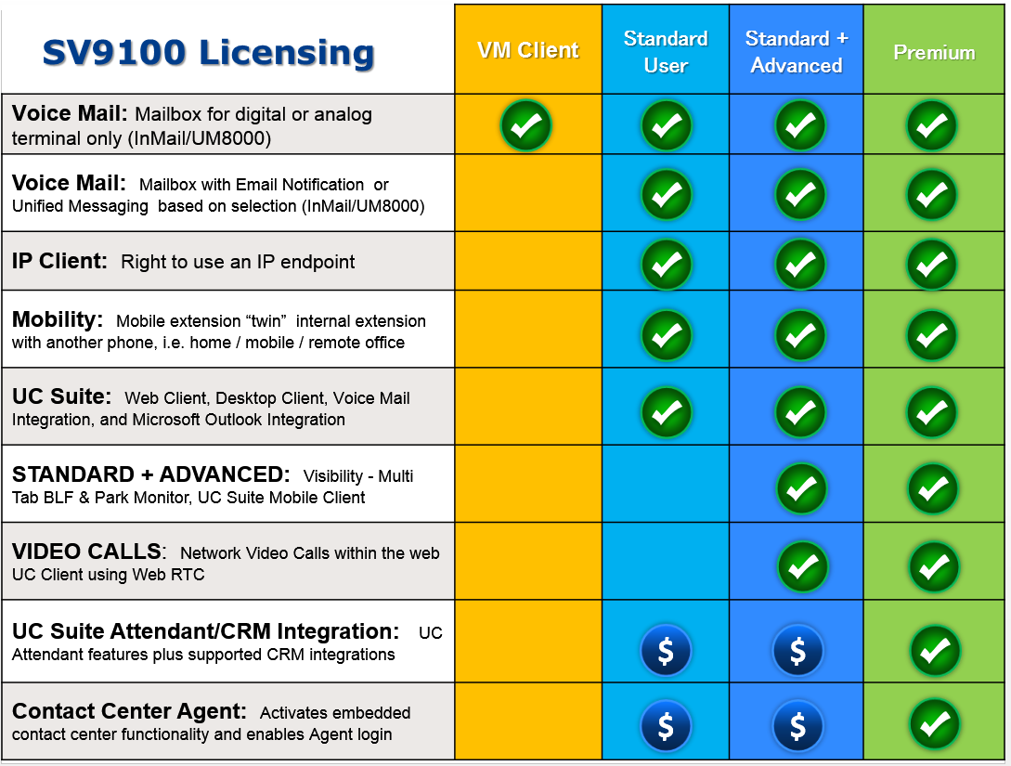
SV9100 License Features

Slide 26
SV9100 UC Suite License Overview
 | Feature name/description | Standard | Advanced | Premium | Ala carte
 | Standard telephony features | √ | √ | √
 | Single BLF view | √ | √ | √
 | Presence and Presence Profiles | √ | √ | √
 | Standard Outlook Addin | √ | √ | √
 | Headset mode | √ | √ | √
 | Chat/Messaging | √ | √ | √
 | Call history | √ | √ | √
 | Contacts database | √ | √ | √
 | Multi column view in BLF | √ | √ | √
 | Enhanced Outlook Addin | √ | √ | √
 | UC Inactivity timer | √ | √ | √
Release 4.1 | Multi tab/buddy list BLF |  | √ | √
 | Park Monitor |  | √ | √
 | Video Call (WebRTC) |  | √ | √
Release 4.5 | UC Mobile Client |  | √ | √
 | Directory Edit |  |  | √
 | Night Mode |  |  | √
 | Phone Messaging |  |  | √
 | BLF pop based on DNIS |  |  | √
 | Contact Center Integration |  |  | √ | √
 | CRM license |  |  | √ | √
 | Softphone |  |  |  | √

Slide 27
NEC SV9100 R7

Slide 28
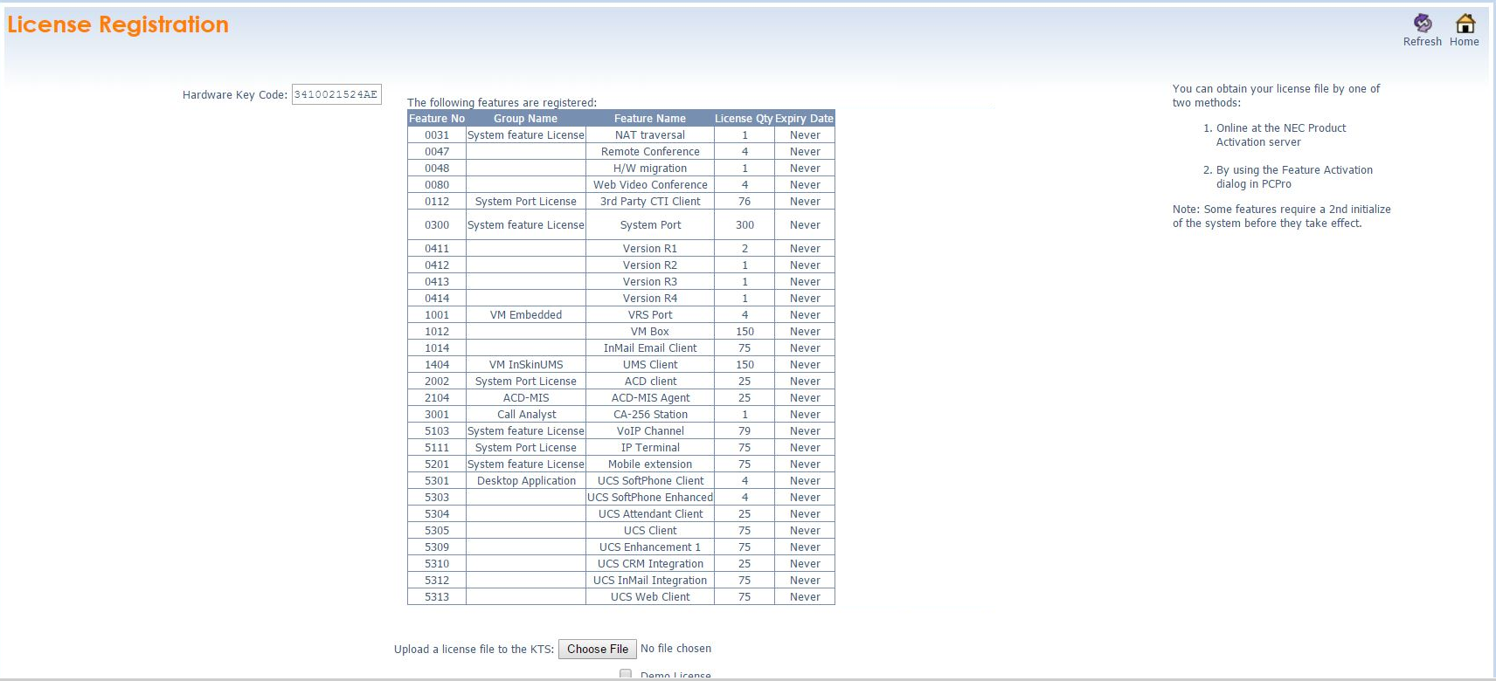
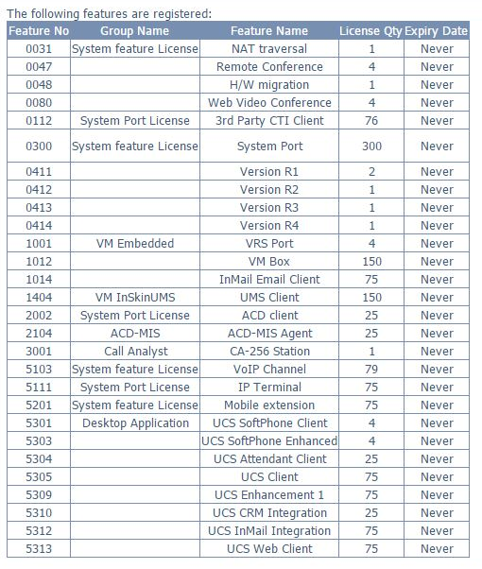
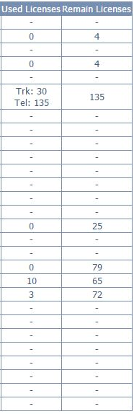

SV9100 R7 Ease of Installation and Maintenance
WebPro License Enhancement –
Track licenses
  Available quantity
  Quantity Used
  Remaining Licenses

Slide 29
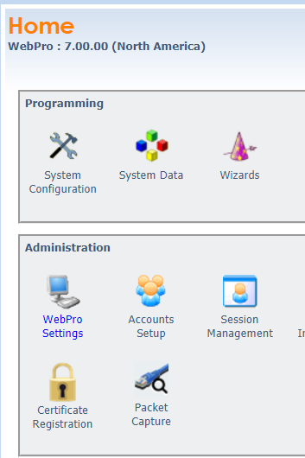
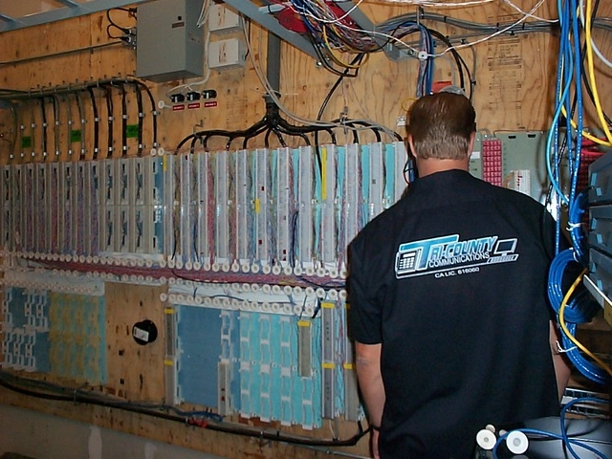
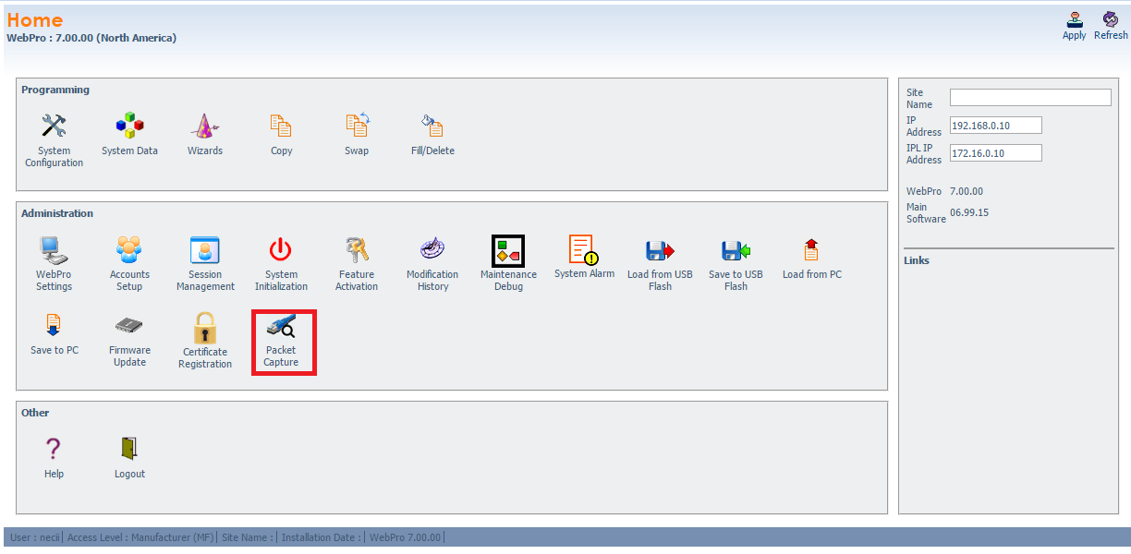
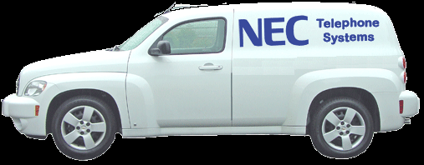

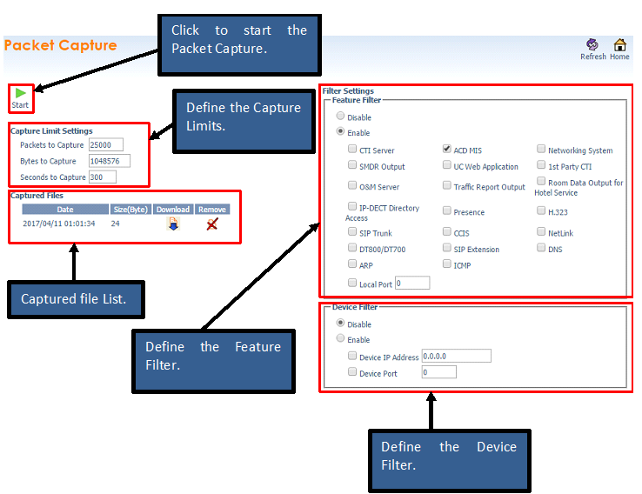


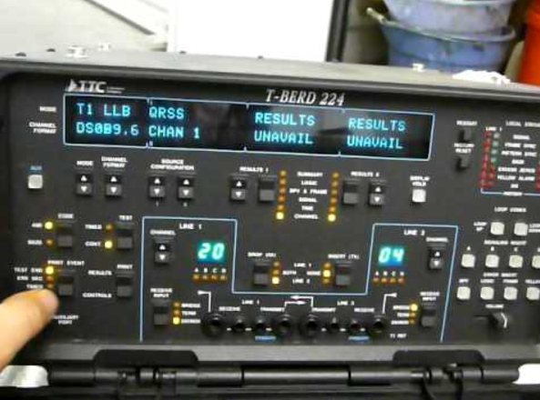
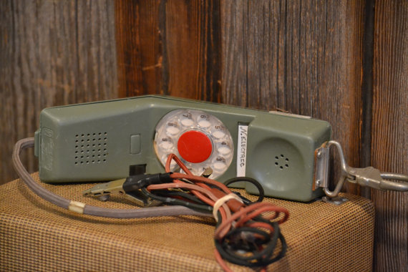
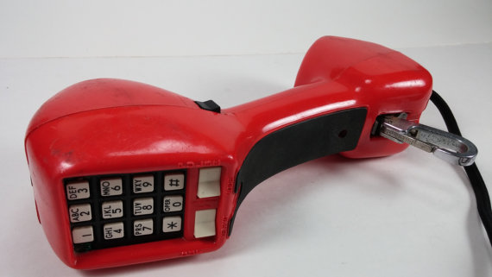

SV9100 R7 Ease of Installation and Maintenance
Webpro Capture Packets

Slide 30
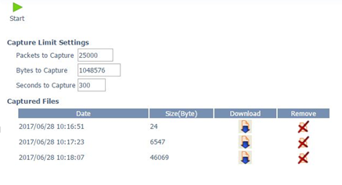
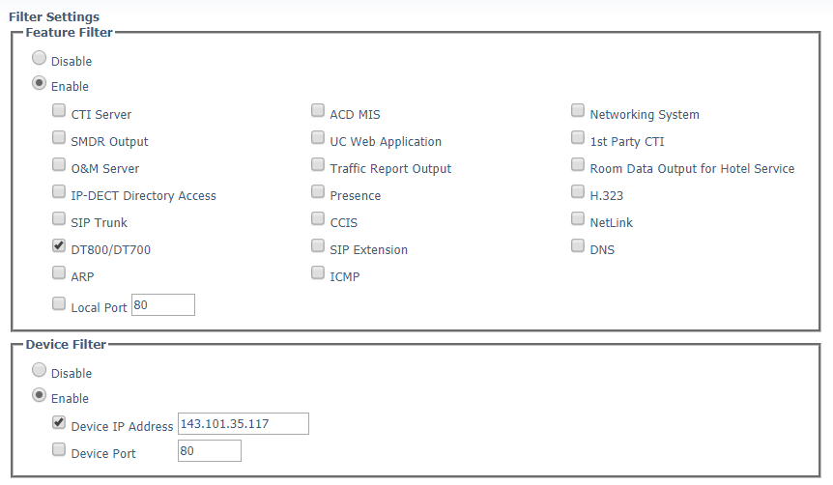
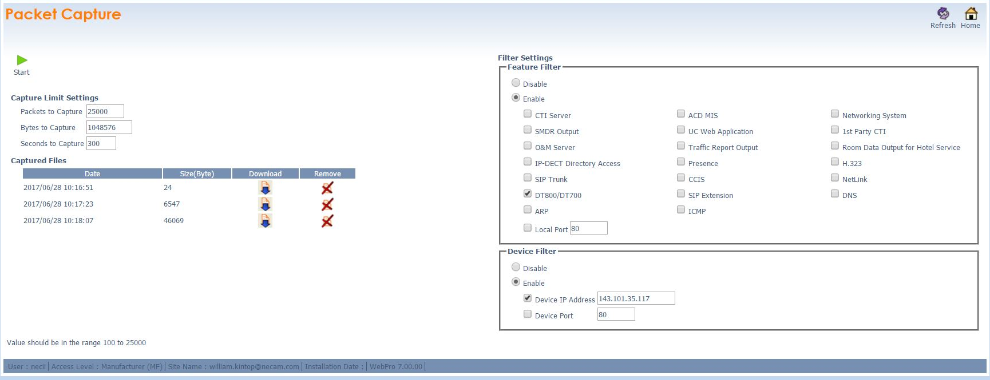
SV9100 R7 Ease of Installation and Maintenance
Webpro Capture Packets

Slide 31
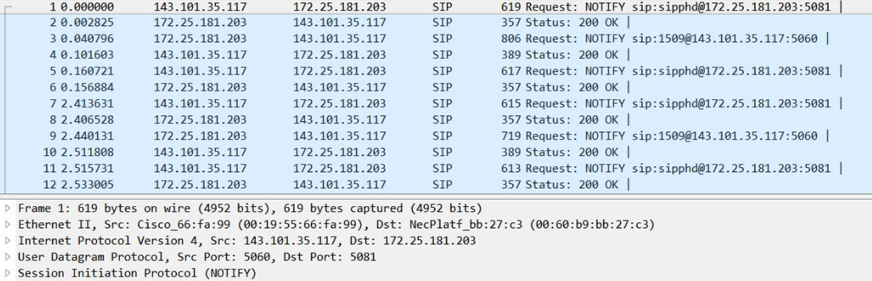
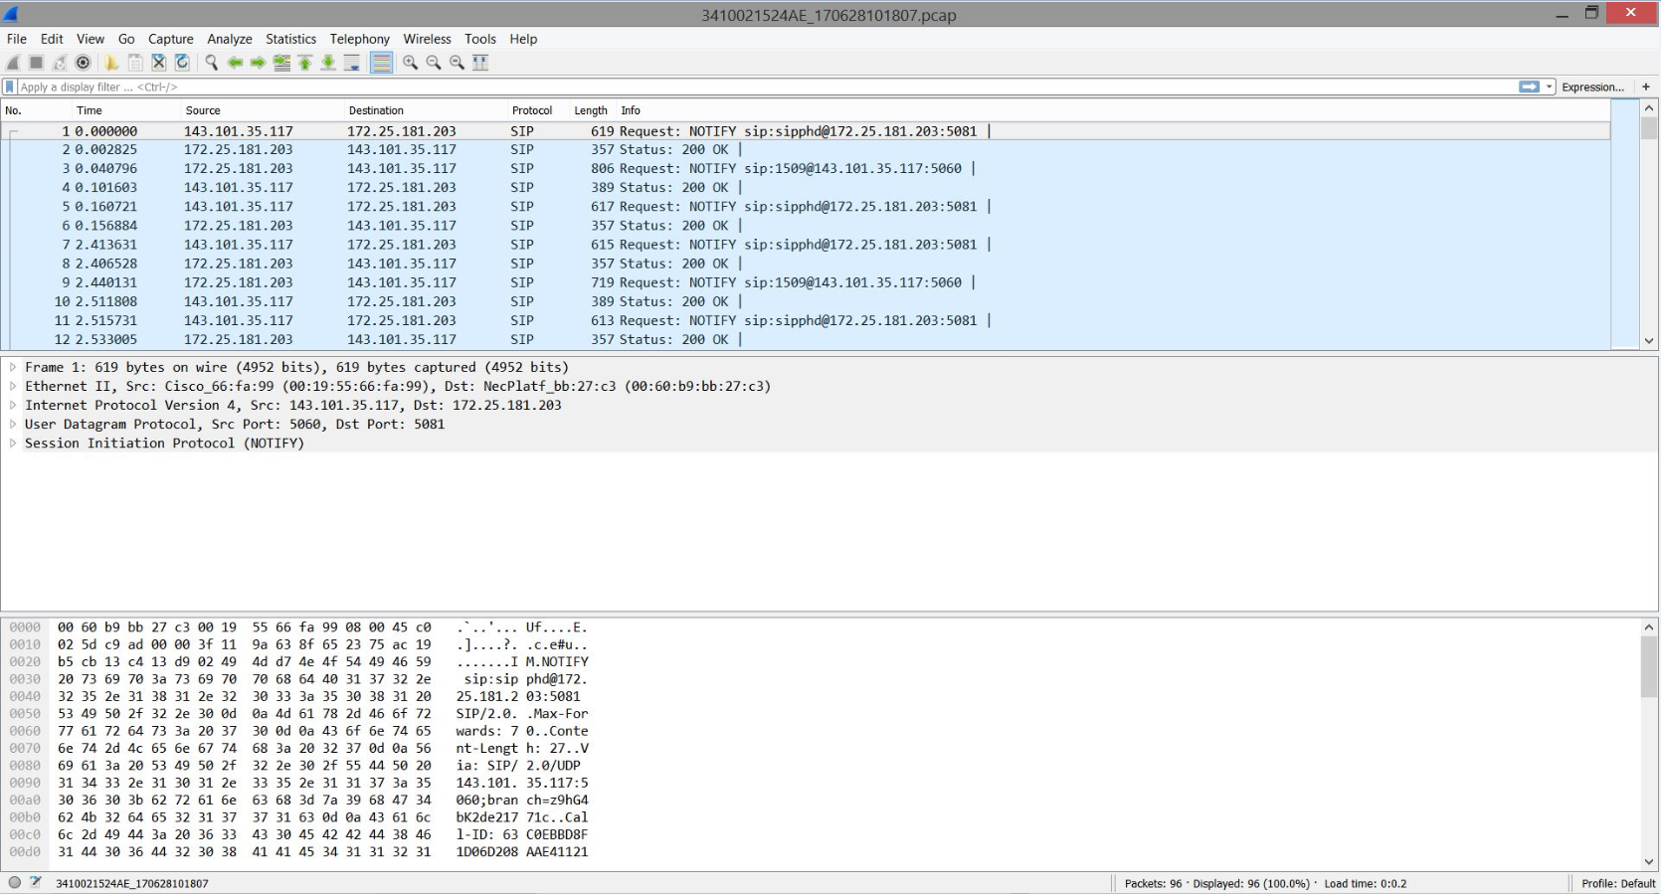
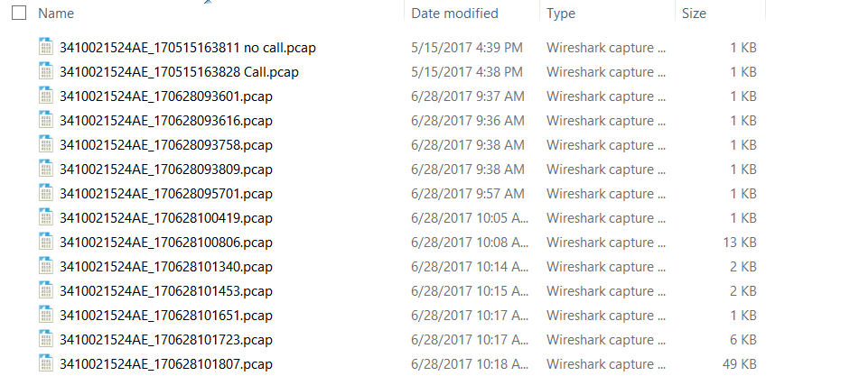
SV9100 R7 Ease of Installation and Maintenance
Webpro Capture Packets (Run the capture and open in Wireshark)

Slide 32

NEC SV9100
SV9100 CPU Hardware Key Code and Licenses

Slide 33
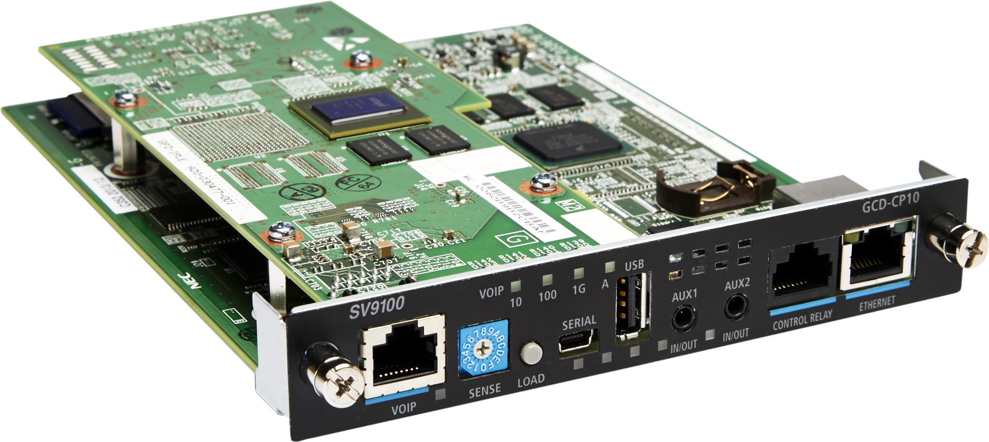
SV9100 CPU License Activation
The SV9100 CPU comes from the factory with no licenses on it. In order for any cards to come up and work there needs to be licenses installed.

Slide 34
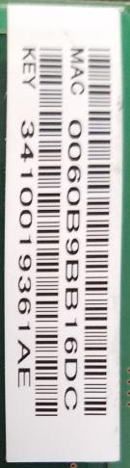
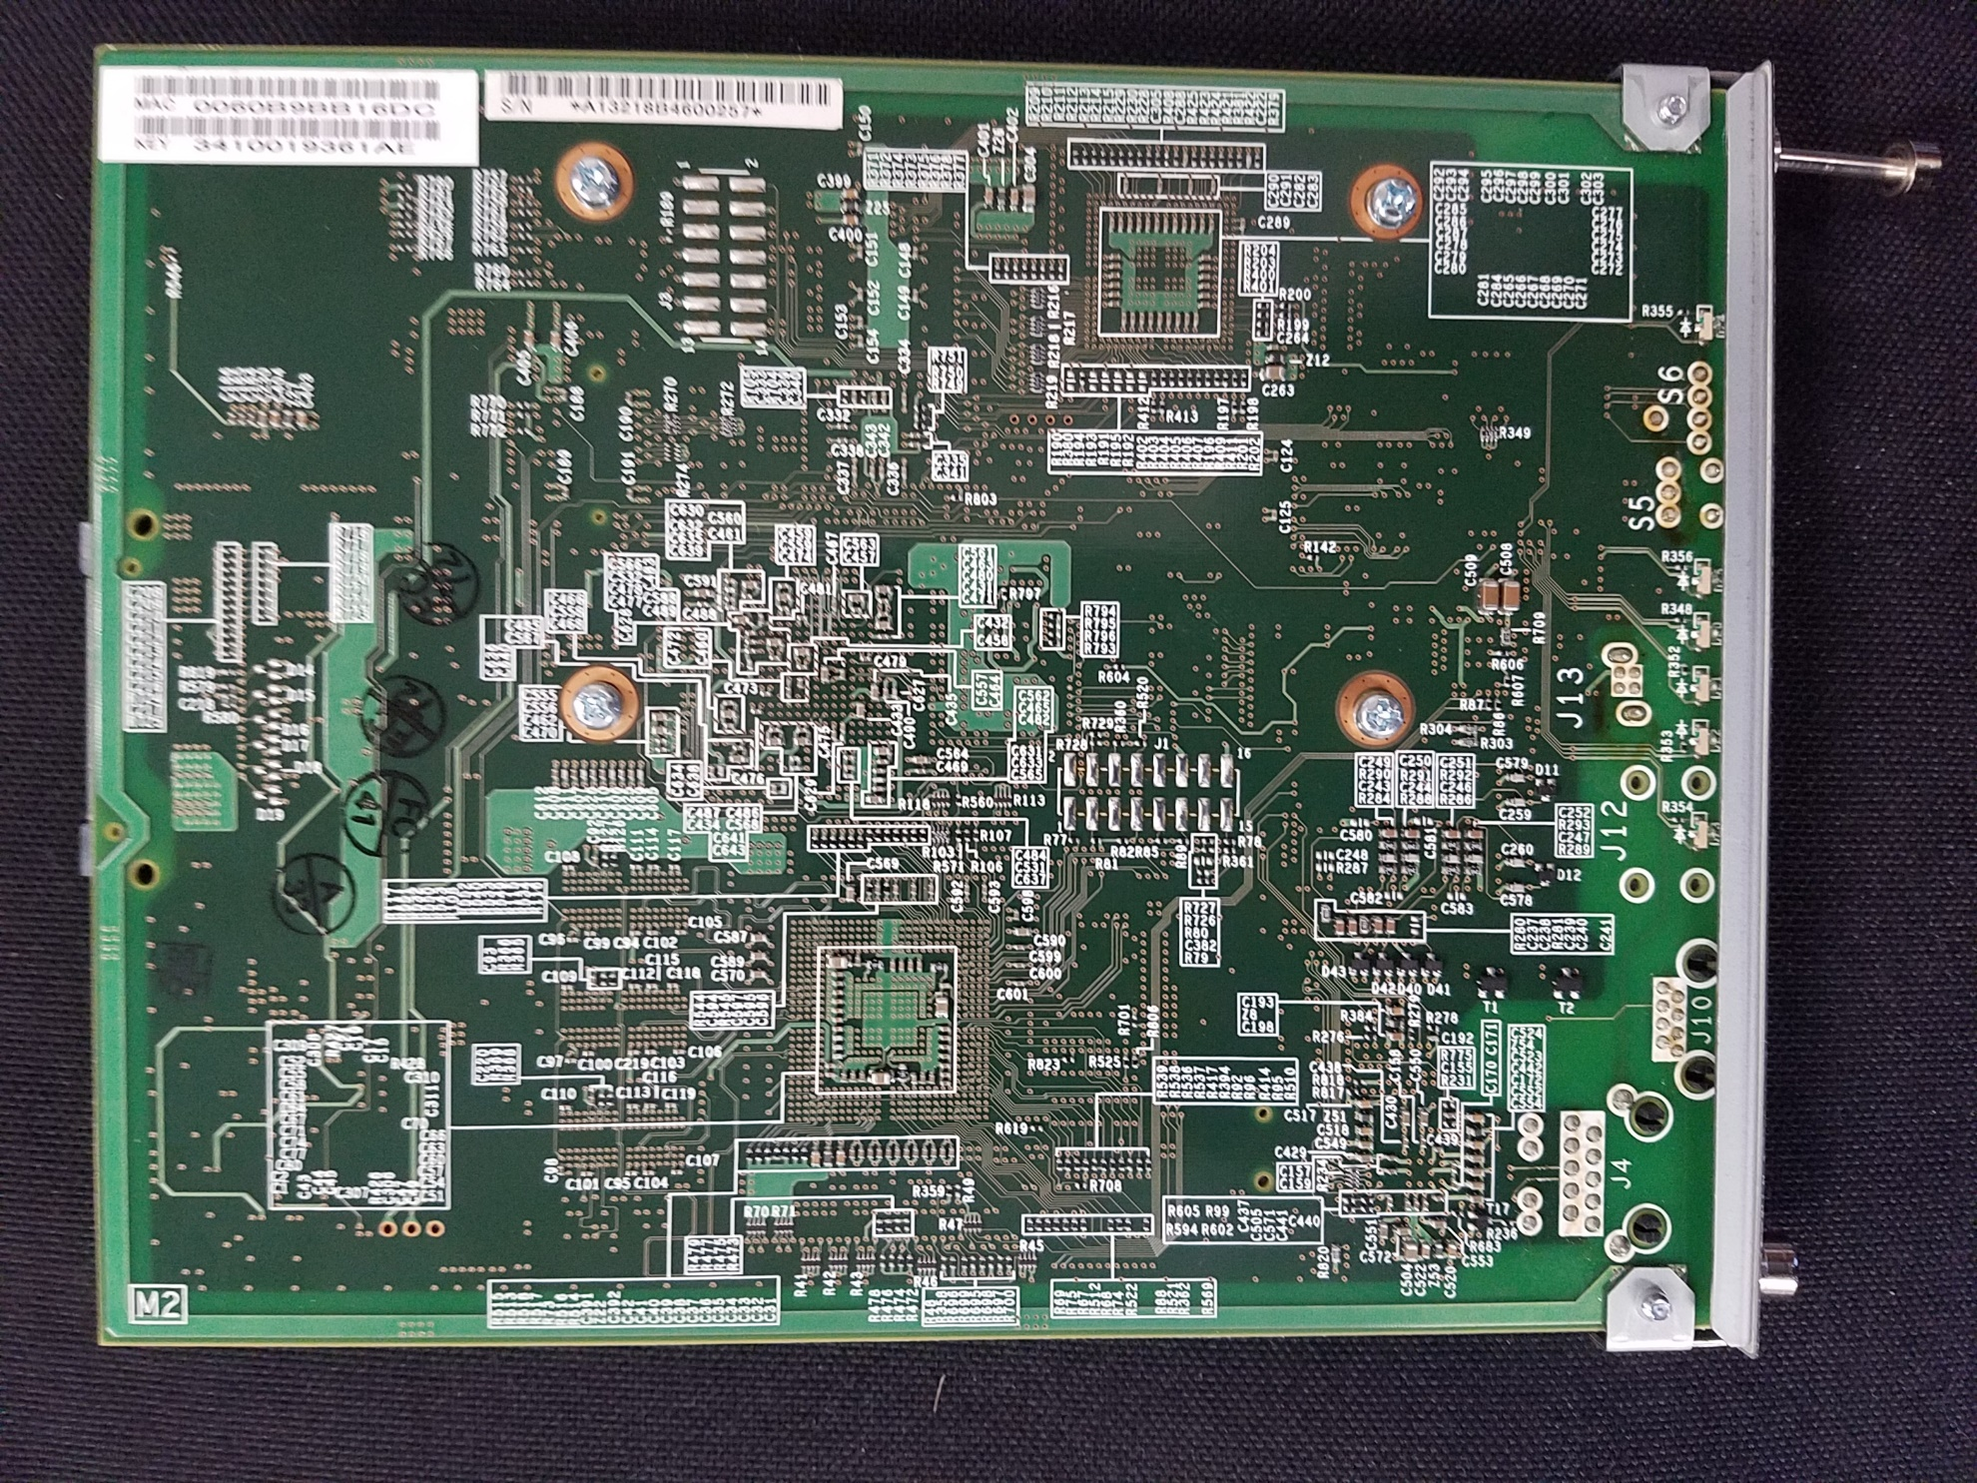
SV9100 CPU License Activation
The SV9100 CPU has a Hardware Key Code

Slide 35
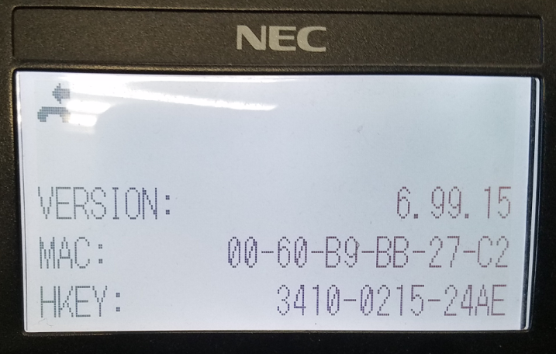
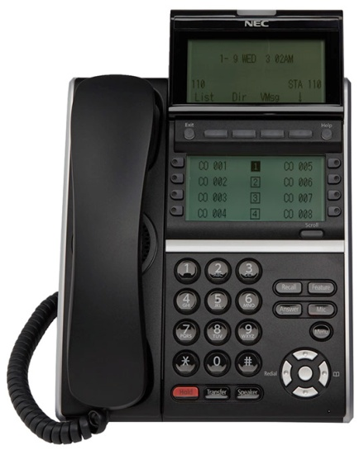
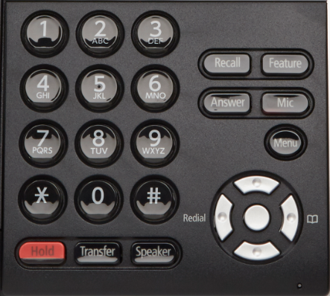
Checking The Hardware key Code and Software Level (Phone)
1. Go to any working display telephone
2. Do not lift the handset
3. Press the Feature Key and press the digit 3 on the dial pad
4. This will display the Hardware Key Code and
and software level of the CPU
5. You will register the HKC on the LMS
6. The HKC is associated with your customer and
A license file will be generated

Slide 36
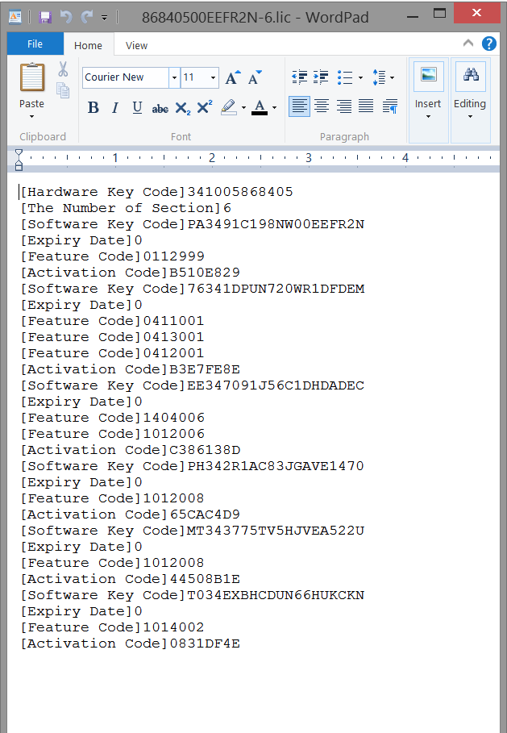
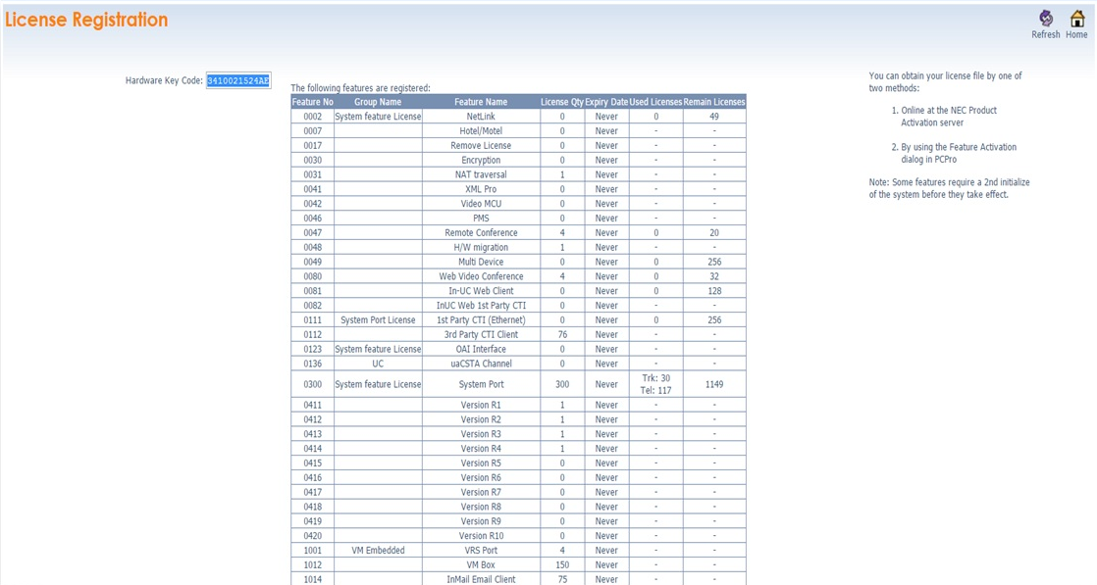
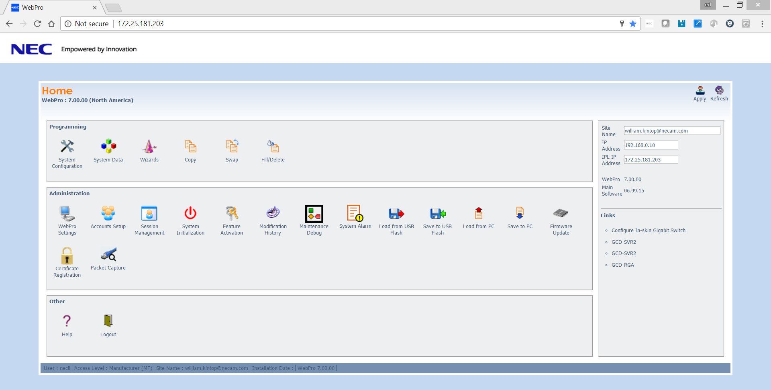
SV9100 Licensing (License File)
SV9100 WebPro Log In
Once Licenses are registered to the CPU and attach the licenses is when SWA starts!

Slide 37
SV9100 CPU Temporary License Activation
The SV9100 CPU comes from the factory with no licenses on it. In order for any cards to come up and work there needs to be licenses installed on the CPU. For start up of a new system and adding cards after the install, you can turn on the temporary license.
The SV9100 has 3 ways to activate temporary licenses
1.) 60 Day Free License
2.) 30 Day Recovery License
3.) 0-10 Day Temporary License

Slide 38

SV9100 60 Day Free License (Program 90-55)
60 Day Free License
The 60 Day Free License comes with the GCD-CP10. It allows for all features and all ports (except Encryption feature) to be active for 60 days.
The count down starts on the first power on and ends at midnight of the 60th day.
By default, the 60 Day Free License is set to disabled.
The 60 day count down starts when the system is initially powered on and continues if the 60 Day Free License is disabled or enabled.
The GCD-CP10 works for 1440 hours from the first time powered on.
The clock counts down only when the power supply in the chassis is ON.

Slide 39

SV9100 Recovery License (From the LMS)
Recovery License
The recovery license turns on all licenses for up to 30 days.
To request a recovery license, go to the (LMS) License portal.
The recovery license can be used only once for each UNIVERGE SV9100 GCD-CP10.
When the System time turns to midnight of the End Date, the system resets and comes back with no free licenses.
The recovery license can be activated only from PCPro or WebPro, not a multiline terminal.

Slide 40

SV9100 Temporary License (Program 90-37-01 = 0-10)
Temporary License
Temporary License activates all feature licenses (except the Encryption feature) and all port maximum licenses.
When the number of days for the temporary license is assigned, system reset is required for the license to take affect.
The number can be set (1~10) for 1-10 days of temporary licenses.
The Temporary License must be set from phone programming and the SV9100 has to be restarted in order for the license to start.
When the temporary license is cleared, the system reboots automatically at twelve o'clock midnight of the next day.

Slide 41
NEC SV9100 Startup Technical Training
May 2017 (Session 1)
Sales Engineering
Charlie Setaro
Bill Kintop

Slide 42
NEC SV9100
SV9100 CPU Overview

Slide 43
SV9100 and the CPU
SV9100 Gateway Server
SV9100 CPU

Slide 44
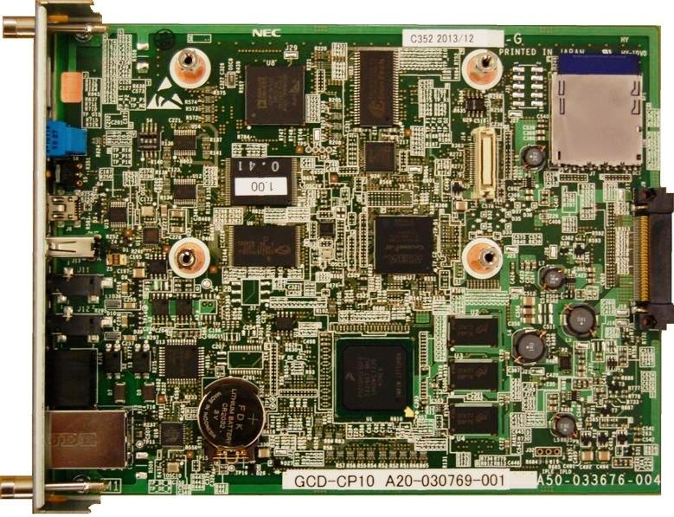
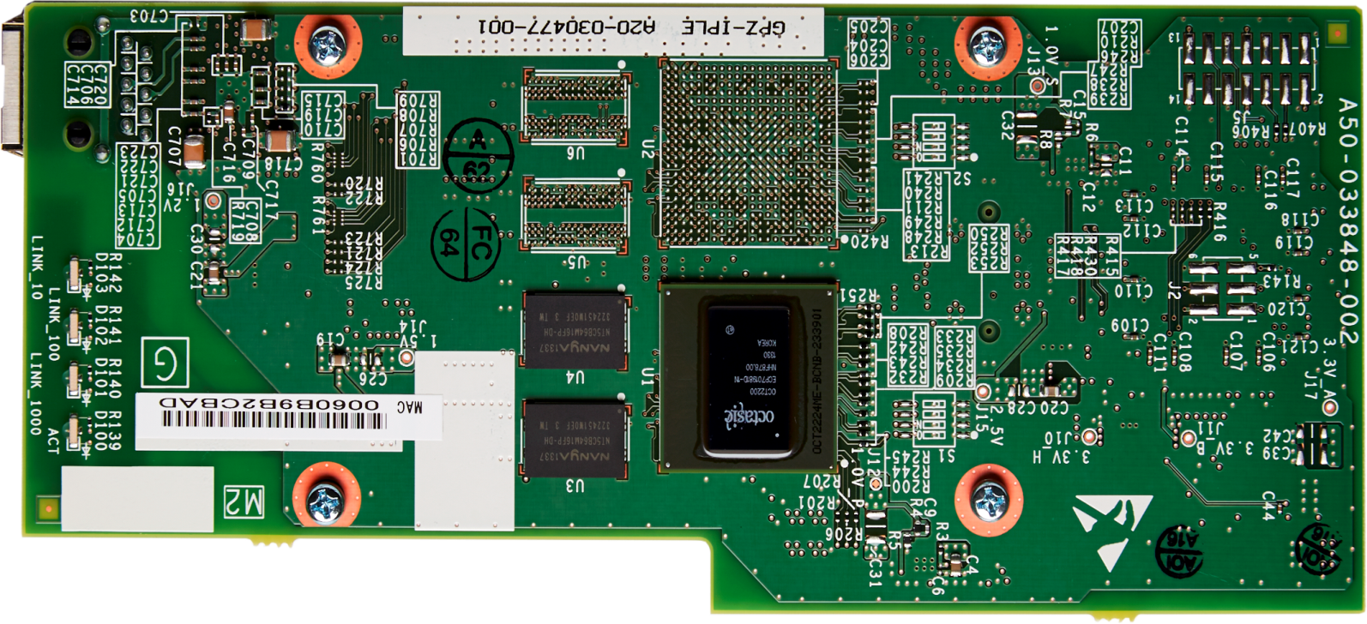
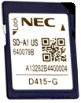
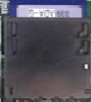
SV9100 CPU Components
SV9100 CPU (GCD-CP10)
InMail
Built In Memory
IPLE Up To 256 IP Pad Channels

Slide 45

SV9100 InMail
9100S 1 Gig SD Card 15 hr. InMail
SV9100 CPU
InMail is embedded
9100E 4 Gig SD Card 120 hr. InMail
SV9100 InMail Automatically Programmed!
16 Voice Channels
15/120 Hours
960 Total Mailboxes
  896 Station Mailboxes
    32 Routing Boxes
    32 Group Boxes

Slide 46


SV9100 CPU (GCD-CP10)
SV9100 CPU

Slide 47
SV9100 CPU Overview
SV9100 CPU Connections
AUX1 and AUX2 IN/OUT Jacks can be used for Background Music, Music on Hold or Paging Zone 9. 600 Ohm
Control Relays (2) normally open can be closed by dialing a service code or pressing a function key. The relay is timer controlled. Rated at 500mA @24 VDC, 50 Ohms
Ethernet Connection used for programming and applications when there is no VoIP needed. Default IP Address is 192.168.0.10
Serial Port (Used for engineering purposes only)
USB Port Memory Connection (Used for upgrading software or downloading system data)
VoIP Gigabit Port (IPLE) Used for Programming, VoIP Traffic and Applications Default IP Address 172.16.0.10
Load Switch which is used for initial system startup, resetting the system, or when upgrading system software
Sense Switch (Not Used)
When the VOIP connection is used for IP and Applications DO NOT USE the Ethernet Port

Slide 48
NEC SV9100
SV9100 CPU Start Up

Slide 49
SV9100 Battery and SD Flash
Install the battery (CR2032 3.0V coin-type lithium battery) onto the GCD-CP10.
The polarity + symbol must be on top.
The battery retains the date and time when powered off.
Install the SD Memory card
The Memory card will have an “A” for the SV9100S and a “B” for the SV9100E
The memory card stores the SV9100 Database and InMail
SDA or SDB
SV9100 Battery

Slide 50

SV9100 Defaulted System From The Factory
The SV9100 must be initialized on it’s first startup!
1.) Install the battery on the CPU
2.) Install the CPU in the first slot
3.) Press and hold the Load Button on the CPU
4.) Power the chassis on while holding the Load button
5.) Count to 10 and let go of the Load button
SLOT 1

Slide 51

NEC SV9100
SV9100 Loading CPU Software

Slide 52


SV9100 CPU Software Update
Always start out by initializing the CPU
Next install the latest system software
SV9100 system software can be downloaded from NTAC
Log into www.necntac.com
Set the site filter for SV9100 and Software
Search for the latest version of SV9100 software

Slide 53



SV9100 CPU Software
Two Software File Types
  Local and Remote
  Local gets loaded using a USB stick installed on the CPU
  Remote can be uploaded locally or remotely using WebPro

Slide 54


SV9100 Remote Software Update

Slide 55

SV9100 Loading System Software
How to load SV9100 System Software
With power off, use a USB stick to install the SV9100 software. Make sure the file is unzipped and in the root directory. You should see seven folders and six files on your USB stick. Now insert the USB stick.
While holding the Load Switch turn power on. Hold the Load Switch for 10 seconds then release. The software will load.

Slide 56
SV9100 Installing System Software
Loading SV9100 System Software
Wait until the Status LEDs on the GCD-CP10 have the following
indications (approximately two minutes):
LED 2: Flashing Red
LED 3: Flashing Red
LED 4: Flashing Red
LED 5: Steady Red
Turn the system power off and remove the USB Memory.

Slide 57
Checking Software Level (Phone)
1. Go to any working display telephone
2. Do not lift the handset
3. Press the Feature Key and press the digit 3 on the dial pad
4. This will display the SV9100 CPU Software Level

Slide 58



SV9100 WebPro Software Load
Log Into WebPro
Click on Firmware Update

Slide 59

NEC SV9100
SV9100 Phone Programming

Slide 60
Phone Programming
HOW TO ENTER PROGRAMMING MODE
To enter programming mode:
1. Go to any working display telephone.
2. Do not lift the handset.
3. Press Speaker.
4. Dial #*#*
5. Dial the system password 47544 + Transfer.

Slide 61
SV9100 Terminal Keys for Entering Data (Programming Manual)

Slide 62
NEC SV9100
SV9100 IP Connection and WebPro

Slide 63
SV9100 CPU IP Connection
SV9100 CPU Connections
VoIP Gigabit Port (IPLE) Used for Programming, VoIP Traffic and Applications Default IP Address 172.16.0.10
Ethernet Connection used for programming and applications when there is no VoIP needed. Default IP Address is 192.168.0.10

Slide 64


SV9100 CPU (Connection)
SV9100 CPU
Ethernet Connection
Default IP Address is 192.168.0.10
VoIP Gigabit Port (IPLE)
Default IP Address 172.16.0.10
Ethernet Connection
IP Address is 172.16.0.11
Ethernet Connection
IP Address is 192.168.0.11

Slide 65

SV9100 Passwords (90-02 Admin. Programming Passwords)
Manufacturer Level necii 47544
Installer Level tech 12345678
Sys. Admin Level (A) ADMIN1 0000
Sys. Admin Level (B) ADMIN2 9999
User Admin Level USER1 1111

Slide 66



SV9100 WebPro Log In
necii
47544

Slide 67
SV9100 WebPro Log In

Slide 68
NEC SV9100
SV9100 Installing a License File to the CPU

Slide 69


SV9100 WebPro License File Load
Log Into WebPro
Click on Feature Activation
Click Choose File
Click Upload
Locate and Upload
The license file…

Slide 70
NEC SV9100
SV9100 Basic Programming

Slide 71
SV9100 Programs to Start
10-01 Time and Date
IP Information 10-12-01-09
IP Pad channels 10-54 (Should match IP License 5103)
Passwords 90-02
11-02 Extension Numbering (101-199, 201-299 Virtuals)
15-01-16
15-07 Telephone Key Programing
15-20 Names For Keys
15-25 Desi Less Page Configuration
There are 3 different types in incoming call
  Ring groups
  Direct Inward Lines (DIL)
  DID trunks

Slide 72


