Slide 1
Enterprise Wireless Solutions: Controller-based vs. Controller-less
What should you be implementing in 2014?
Notes:
Introduction
Purpose
This Market Development Plan provides Avaya and Partner sales with essential information about the Avaya Enterprise Mobility Sales Play. Together with the Enterprise Mobility Playbook this plan will help sales move through the buyer’s journey and effectively plan, pre-qualify, qualify, propose and win deals with customers.
Content in the document is designed to enable readers to quickly grasp the customer problem and corresponding Avaya solution and value proposition. In conjunction with the market analysis and competitive landscape Avaya associates and channel partners will be positioned to identify specific opportunities within their territory and drive enterprise mobility sales through a value selling framework.

Slide 2
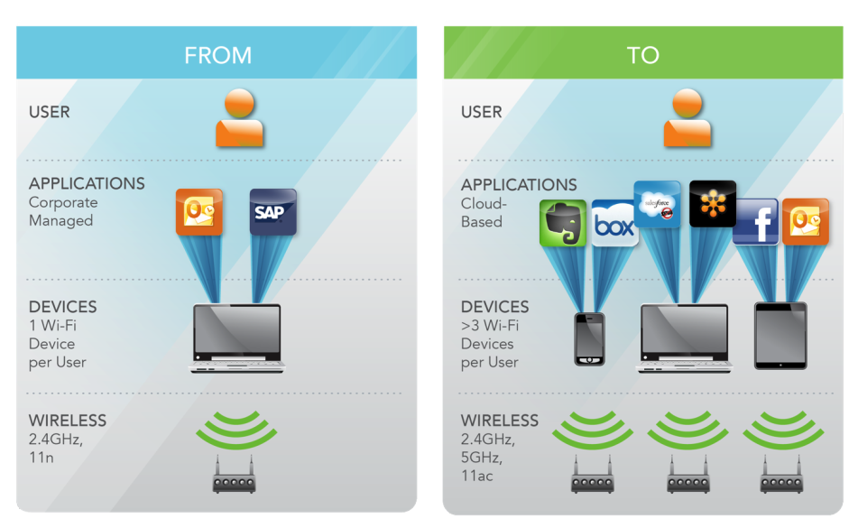
Wi-Fi is Evolving
FROM
TO

Slide 3
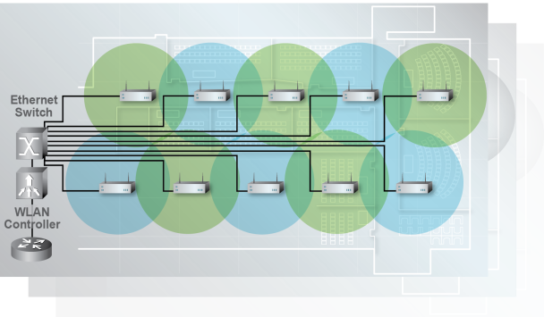
Traditional Wireless Approach is Failing Conventional APs + Central Controller
Reduced Performance
Poor Reliability
Limited Scalability
Restricted Intelligence
Data Bottleneck at 11n and 11ac traffic loads
Multiple single points of failure
Each new AP tasks existing controller capacity
Traffic chokepoint for Application control, tagging, QOS, Security authentication/encryption, etc.

Slide 4
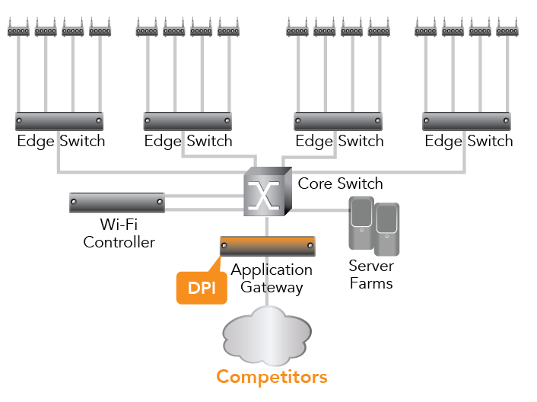
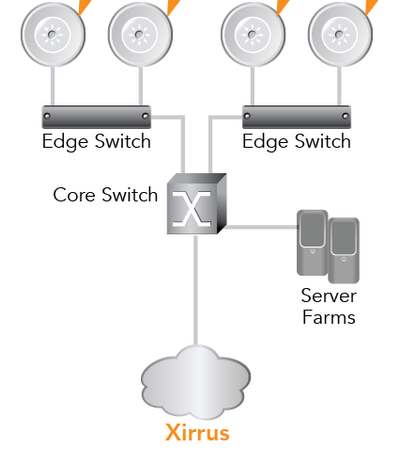
Wi-Fi Architectures and Traffic Flow
Edge Traffic Management
Centralized Traffic Management
Distributed Control
Control at edge for best performance
No Single Point of Failure
Seamless Scalability
Distributed Intelligence
Central Control
Central processing creates bottlenecks
Single Point of Failures
Stair step scalability
Intelligence Choke Point

Slide 5
Architecture Comparison: Performance
Distributed architecture has distributed traffic load processing at each Access Point (e.g. wired switches)
A Centralized architecture forces all traffic through a centralized controller (e.g. old Hub/Router designs)
Distributed Control & Intelligence provides higher network performance

Slide 6
Architecture Comparison: Scalability
With a distributed architecture each new access device added to the network increases the overall network processing capability
In a Centralized architecture adding additional APs degrade the fixed performance and license capabilities of a controller
Distributed Control & Intelligence Linear Scalability

Slide 7
Architecture Comparison: Scalability
With a distributed architecture each new access device added to the network increases the overall network processing capability
In a Centralized architecture adding additional APs degrade the fixed performance and license capabilities of a controller
Distributed Control & Intelligence Linear Scalability

Slide 8
Architecture Comparison: Scalability
With a distributed architecture each new access device added to the network increases the overall network processing capability
In a Centralized architecture adding additional APs degrade the fixed performance and license capabilities of a controller
Distributed Control & Intelligence Linear Scalability

Slide 9
Architecture Comparison: Scalability
With a distributed architecture each new access device added to the network increases the overall network processing capability
In a Centralized architecture adding additional APs degrade the fixed performance and license capabilities of a controller
Distributed Control & Intelligence Linear Scalability

Slide 10
Architecture Comparison: Resiliency
Devices operate independently, as a result eliminate any network wide single point of failure (e.g. wired switches)
SPoF
SPoF
SPoF
SPoF
SPoF
SPoF
Many APs are dependent on controllers meaning loss of controller or access to a controller can cause a network wide failure
Distributed Control & Intelligence eliminate single point of failure (SPoF)

Slide 11
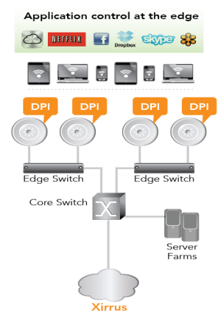
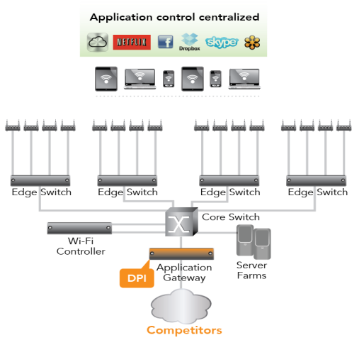
Architecture Comparison: Intelligence
Distributed Control & Intelligence allows forward/filter decisions at the edge

Slide 12
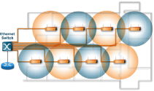
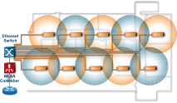
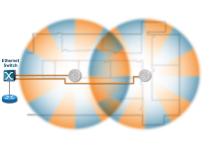
Summary: Intelligence belongs at the Edge!
1990
1995
2000
Independent Wired Segments
Central Wired Hub
Distributed Wired Intelligence
2000
2005
2006
Independent Wireless APs
Central Wireless Controller
Distributed Wireless Intelligence
1st Generation Practice
Minimal device Intelligence
No central management/control
Niche deployments
2nd Generation Practice
Centralized intelligence
Limited performance
Non-Critical Applications
Enterprise Best Practice
Distributed Intelligence
High Performance
Critical Applications
Best Practice:
Distributed Intelligence is a proven best practice of Enterprise Switching, wired or Wi-Fi. Positioning processing services closer to the user improves capacity performance, reliability, scalability and the overall user experience

