Slide 1
Avaya WLAN 9100
Wireless Orchestration System

Slide 2
Wireless LAN Orchestration System (WOS)
Powerful and Feature rich software solution that enables Network & IT Administrators to embrace Mobility in enterprises of all scales.
Design, deploy and manage wireless services
  Scalable from small deployments to complex multi site environments with thousands of APs and clients.
Gives control back to administrators to handle device and application proliferation via BYOD.
  Enterprise wide visibility into Device & Application performance
  Ability to drill down to an AP or a Device level.
  Comprehensive Reporting Capabilities
Ability to define a single policy for enterprise wide wireless services or customize policies specific to a site, a location, an AP or a Device.

Slide 3
Wireless LAN Orchestration System - Portfolio
WOS Enterprise Server –Deployment Recommendations
On Premise Enterprise Solution
  Virtual Appliance - VMware or Hyper-V
Deployment Size | Small | Medium | Large
Max Aps | 50 | 500 | 1500
Max Stations | 1500 | 10000 | 15000
Min Recommended Processor | Two Cores | Four Cores | Eight Cores
Min Recommended RAM | 4GB | 8GB | 16GB
Min Recommended Storage/Thin Provisioned | 150GB | 300GB | 500GB
Recommended Virtual OS | VMware – ESXi or VSphere 5.0+ Microsoft – Hyper-V Server 2012 R2 (Standalone) or Windows Server 2012 R2 with Hyper-V Role
Note: In all VM deployments, one must take care not to over-provision RAM when using a Virtual WOS Appliance – e.g. if there are 3 VM instances on the system that are provisioned for 8GB each, then the total system must have no less than 3*8GB = 24 GB provisioned for it.

Slide 4
Wireless Orchestration System – Key Features
Dashboard
Service
Policies
RF Visibility
WOS
Auto
Provisioning
Tools / API
Analytics
Notes:
Web Based Design
Automated deployment of Wireless Access Points.
RF Visibility
RF Coverage Heat Maps
Performance Maps
Location Tracking
Customizable Dashboard
Add, Move, Delete Widgets to match service needs.
Comprehensive & Customizable Reports
Define what to report, when to run and where to deliver.
Customizable Alerts / Alarms
Network & Application Triggers
Rouge Detection / Mitigation

Slide 5
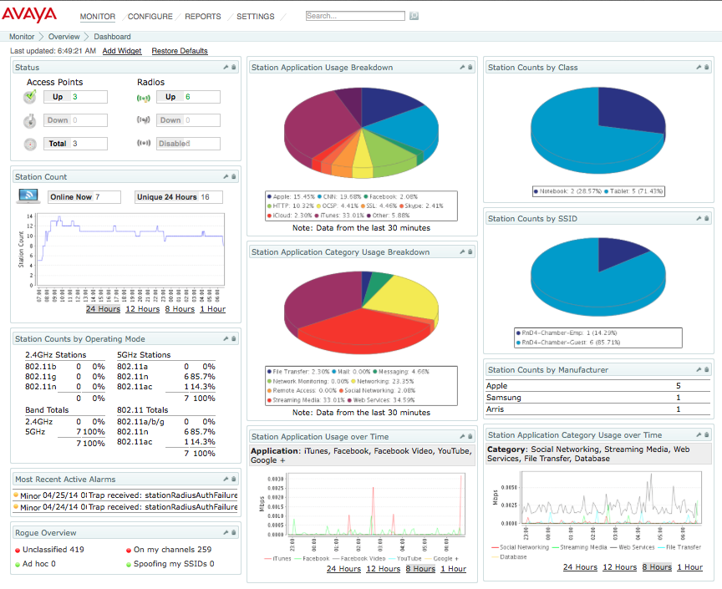
Wireless Orchestration System – Key Features
Customizable Dashboard

Slide 6
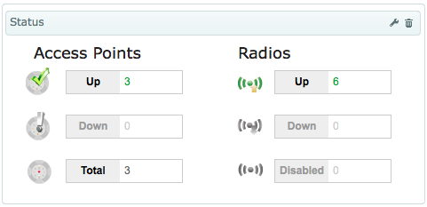
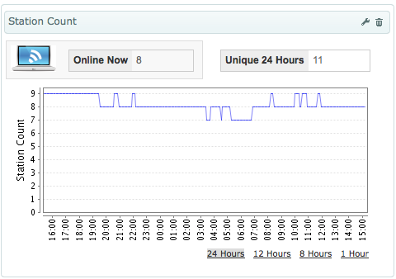
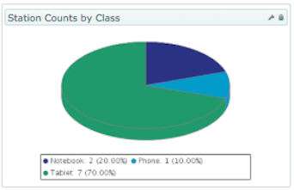
Wireless Orchestration System – Key Features
Customizable Dashboard
Fully Customizable Dashboard view based on widgets
  Add, Remove, Edit or Rearrange widgets to customize views on a per user basis.
  Customize widgets to provide visibility to data categories of interest.
AP / Radio Status
Rouge Overview
Alerts / Alarms View
Station Summary
Station Count Trends
Station Traffic Trends
Station Classification
  By Class (Notebooks / Tablets / Phones)
  By Manufacturer
  By SSID
  By 802.11 Capabilities
  By 802.11 Operating Mode

Slide 7
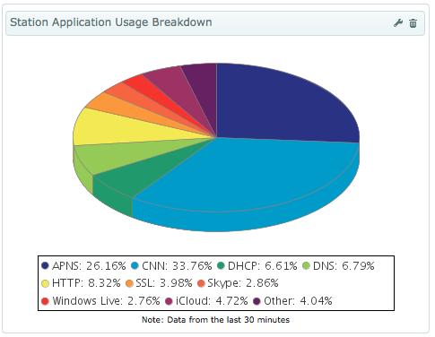
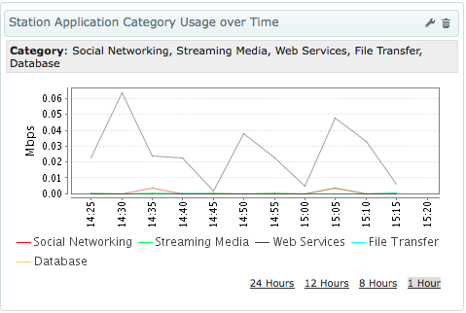
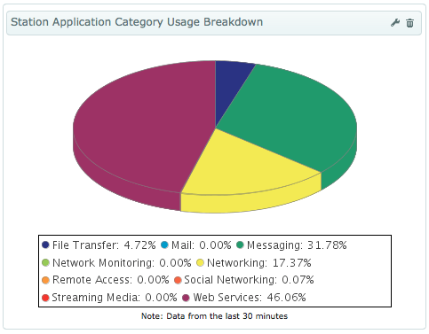
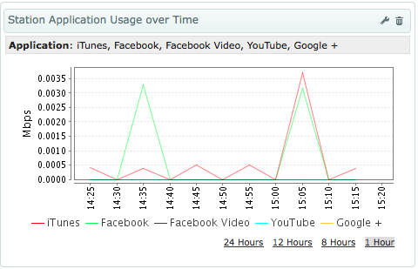
Wireless Orchestration System – Key Features
Customizable Dashboard
Application Widgets
  Visibility into Applications by Category & Individual Application
  Real Time Summary
  Usage Trends over time
  Track up to 5 individual Applications per Widget
  Create additional Widgets to track additional Applications.

Slide 8
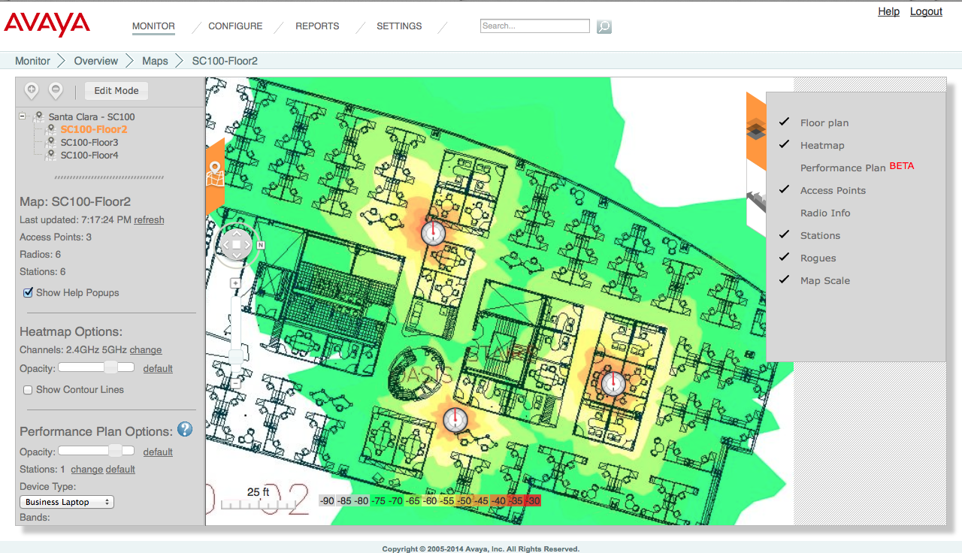
Wireless Orchestration System – Key Features
RF Visibility - Maps View
RF Heat Map - Hierarchical Maps View showing floor plans with layerd information for each location - AP Placement, Signal Coverage, Stations, etc.

Slide 9
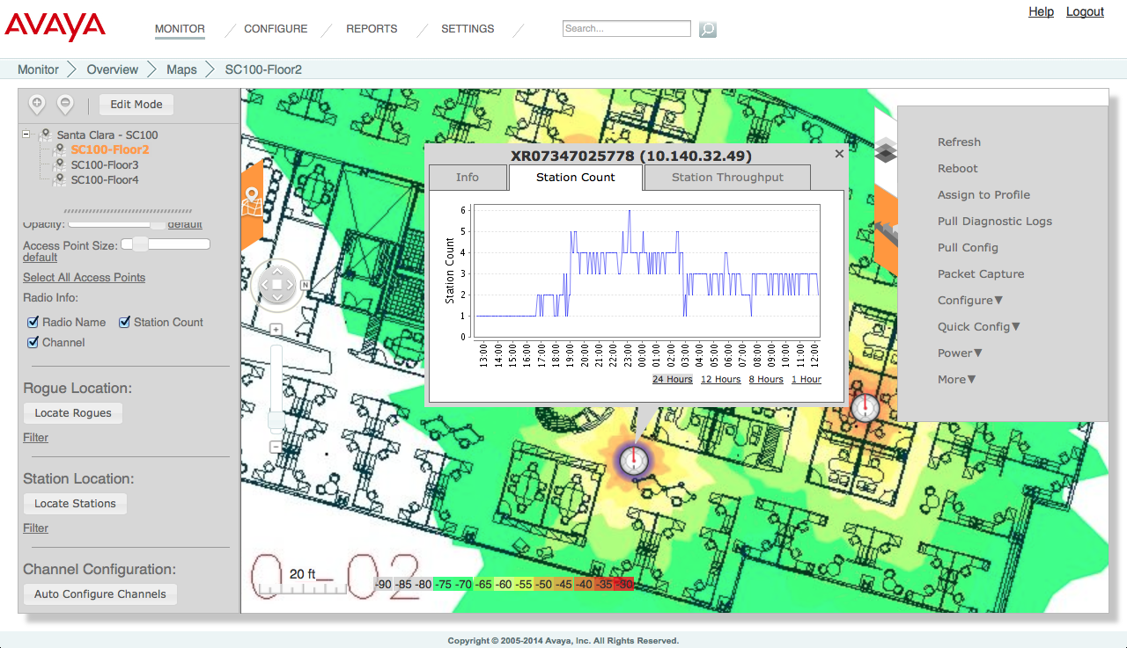
Wireless Orchestration System – Key Features
RF Visibility - Maps View
RF Heat Map - Select AP – For Visibility into AP details, Station Count and Station Performance. Tune AP / Radio Settings if required.

Slide 10

Wireless Orchestration System – Key Features
RF Visibility - Maps View
RF Heat Map - Select AP – For Visibility into AP details, Station Count and Station Performance. Tune AP / Radio Settings if required.

Slide 11
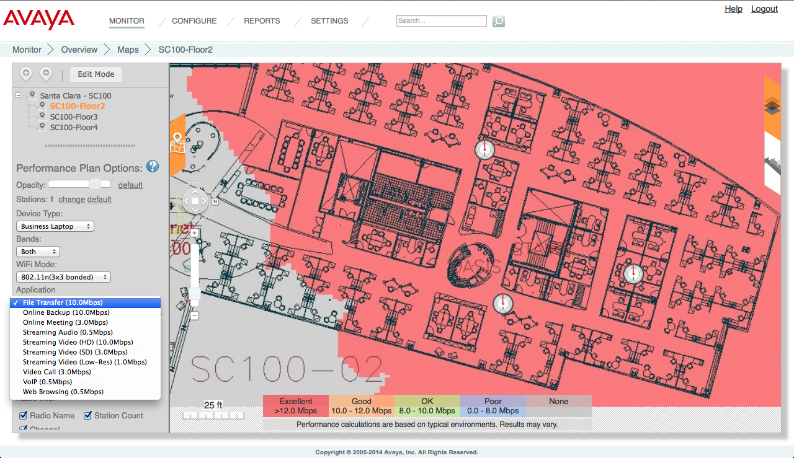
Wireless Orchestration System – Key Features
RF Visibility - Maps View
RF Performance Map - Projected Performance View tuned for device type, device capability and desired applications.

Slide 12
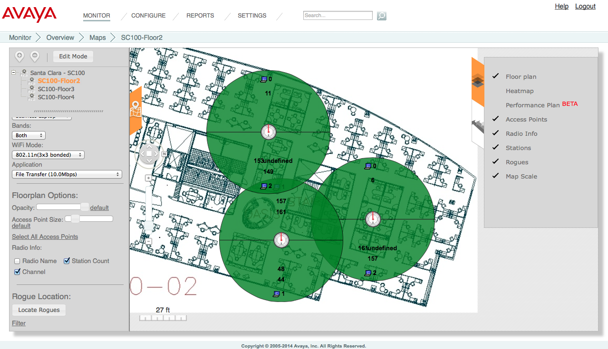
Wireless Orchestration System – Key Features
RF Visibility - Maps View
RF Channel Plan - Visibility into AP Radio Channel Plans along with Station and Rouges on the Floor Plan. Ability to tune channel / power settings.

Slide 13
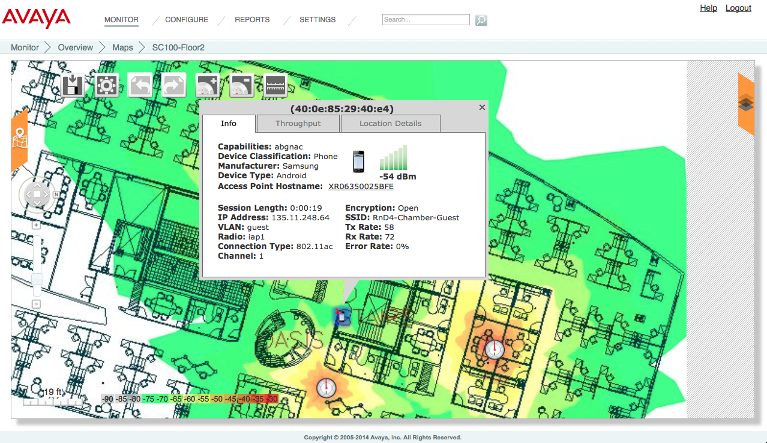
Wireless Orchestration System – Key Features
RF Visibility - Location
Locate Client on Floor Plans – Select Client to View Client Fingerprint Data

Slide 14
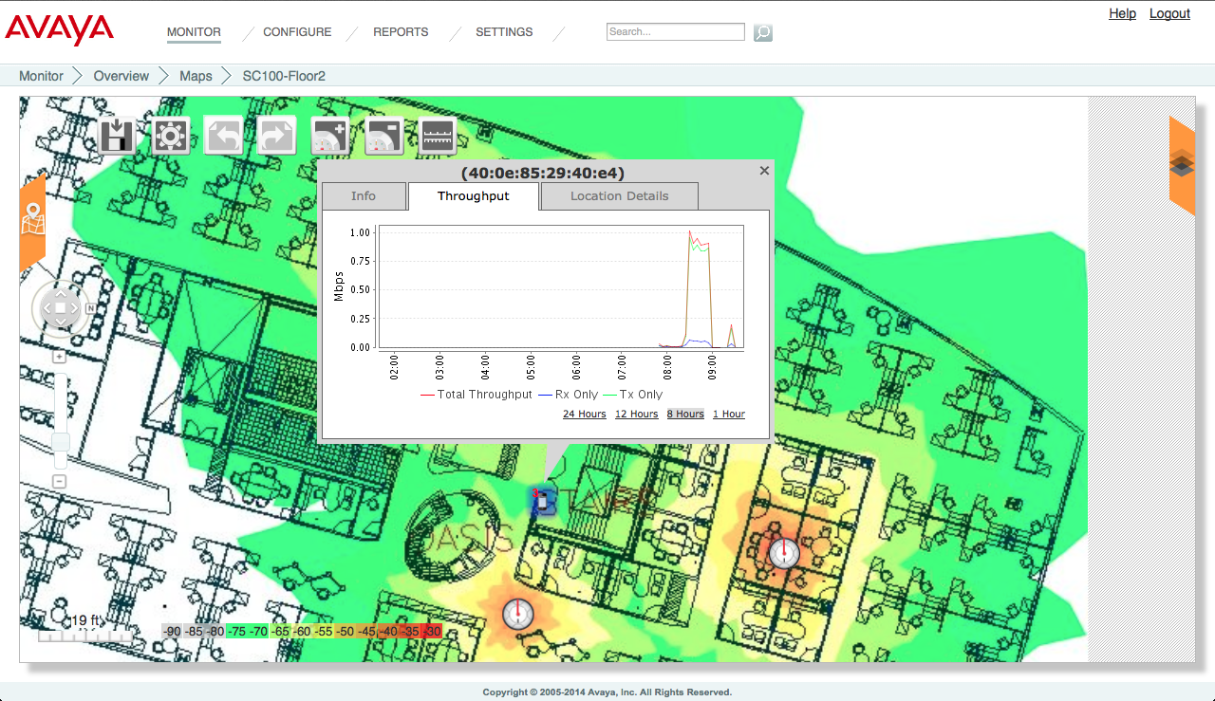
Wireless Orchestration System – Key Features
RF Visibility - Location
Locate Client on Floor Plans – Select Client to View Client Performance

Slide 15
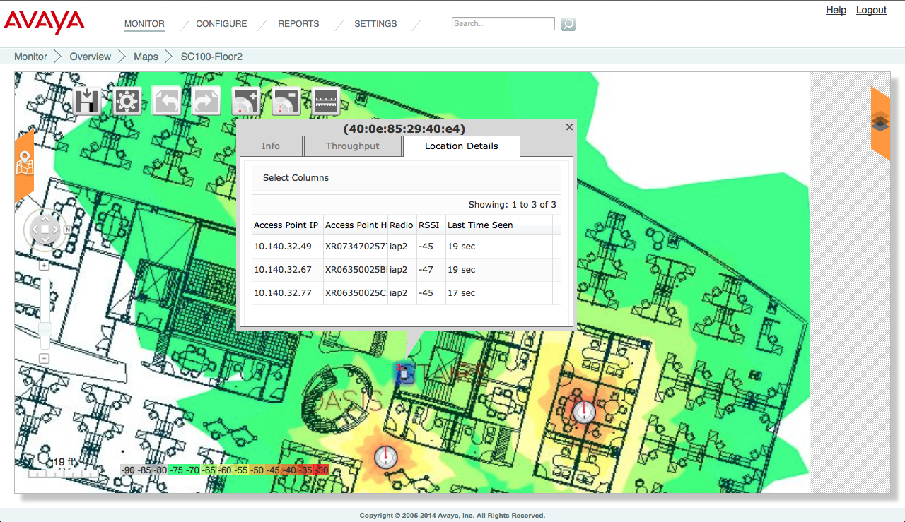
Wireless Orchestration System – Key Features
RF Visibility - Location
Locate Client on Floor Plans – Select Client to View Client Triangulation Data

Slide 16
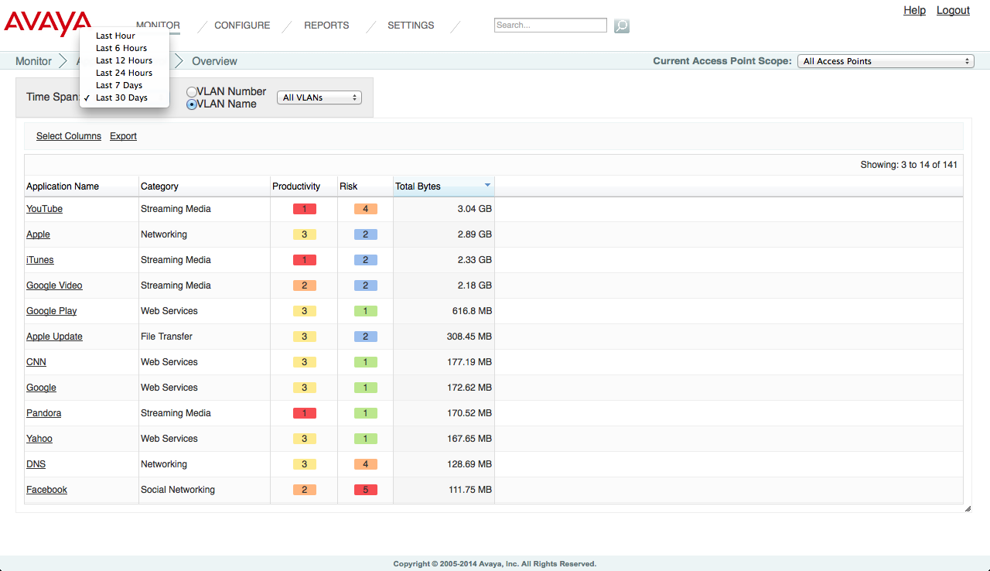
Wireless Orchestration System – Key Features
Analytics - Application Data
Application Usage Metrics, Network Productivity & Risk Assessment

Slide 17
Wireless Orchestration System – Key Features
Analytics - Reports
Comprehensive suite of Reports – 25+ Report Templates
  Application Control Reports – Wireless Traffic Reports
  Access Point Reports – Associated Stations Reports
  RF Reports – Security Reports
Fully Customizable to create hundreds of unique reports.
  Create and Save Reports to match unique business needs.
  Customizable based on APs associated to a Profile or a Group or APs located on a Map,
  Report Overall Application Usage or Individual Application Categories or an Individual Application etc.
  Customizable based on Station Classification, Capabilities, Manufacturers etc.
  Report current data or archived data for up to 30 days and up to 1 year in some cases.
Generate On-Demand Reports or Run Reports at Scheduled Intervals
  View and Archive Reports within WOS or Export to PDF, Excel or CVS file.
  Automatic Email delivery at scheduled intervals.

Slide 18
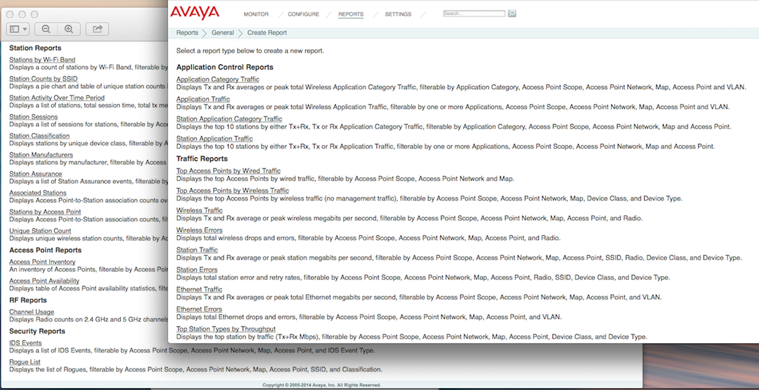
Wireless Orchestration System – Key Features
Analytics – Reports – 25+ Unique Templates

Slide 19
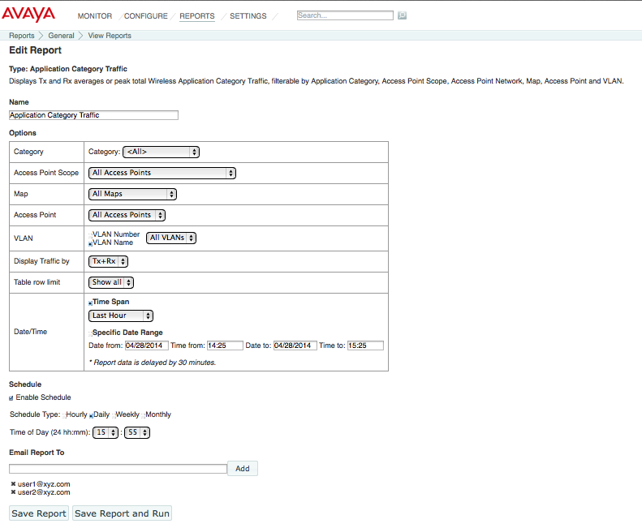
Wireless Orchestration System – Key Features
Analytics – Reports – Customizeable to business needs

Slide 20
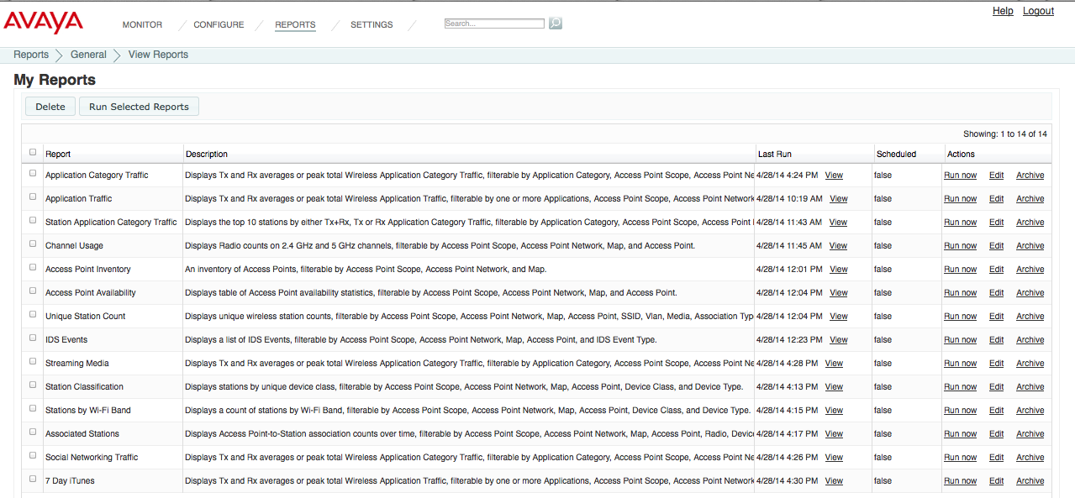
Wireless Orchestration System – Key Features
Analytics – Reports - Archive within WOS

Slide 21
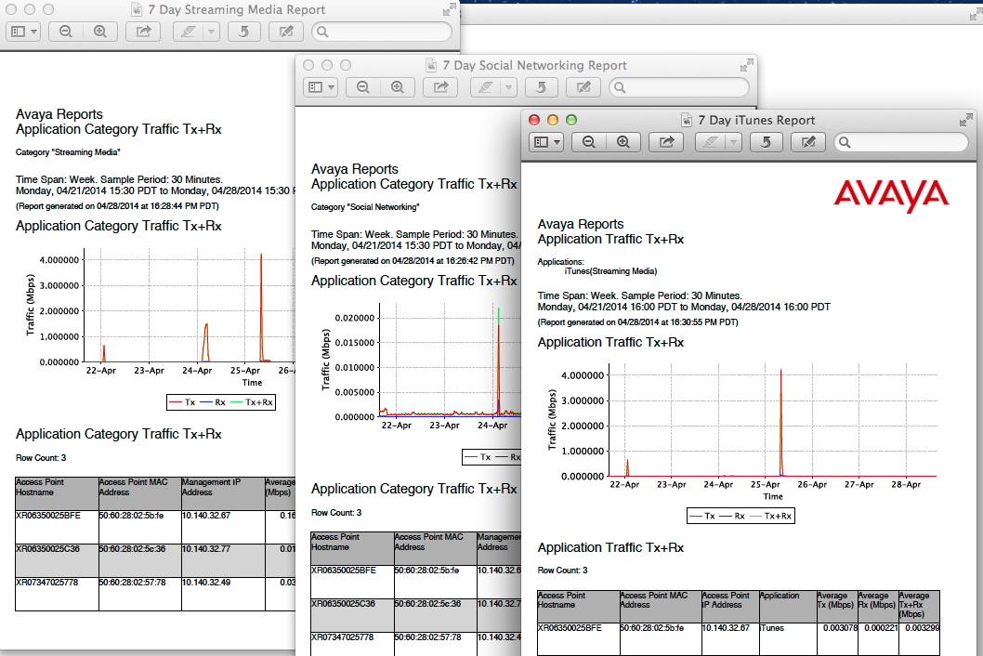
Wireless Orchestration System – Key Features
Analytics - Reports

Slide 22
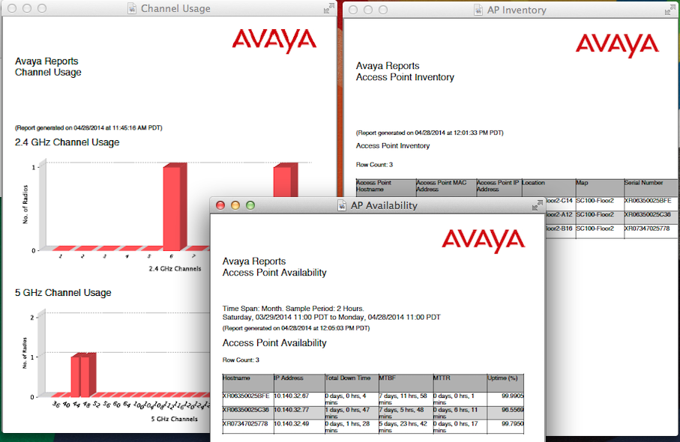
Wireless Orchestration System – Key Features
Analytics - Reports

Slide 23
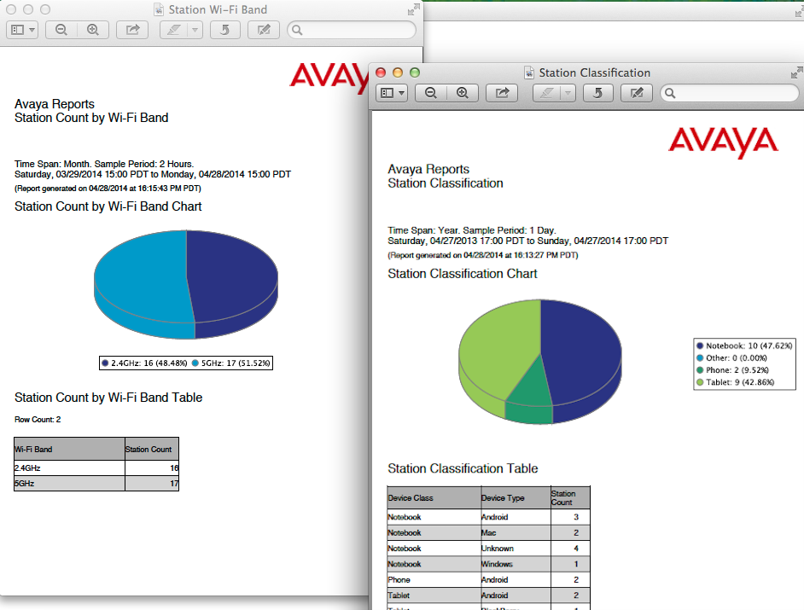
Wireless Orchestration System – Key Features
Analytics - Reports

Slide 24
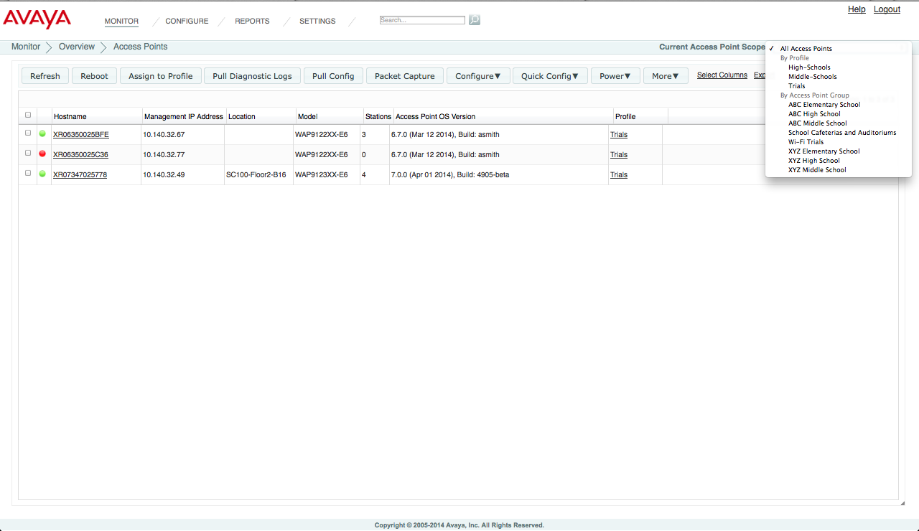
Wireless Orchestration System – Key Features
Device / Network Visibility – Customizable Monitoring Screens
Access Points Summary - Visibility into Enterprise Wide Access Point Summary customizable to allow views / operations on per group basis

Slide 25
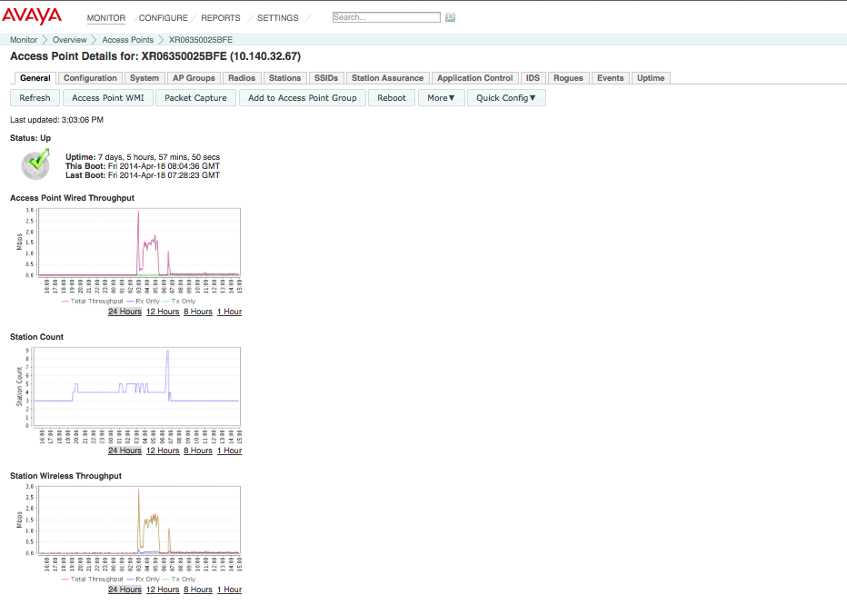
Wireless Orchestration System – Key Features
Device / Network Visibility – Customizable Monitoring Screens
Access Points Summary - Drill into individual Aps – Visibility into AP Performance Metrics & Ability to update individual AP settings.

Slide 26
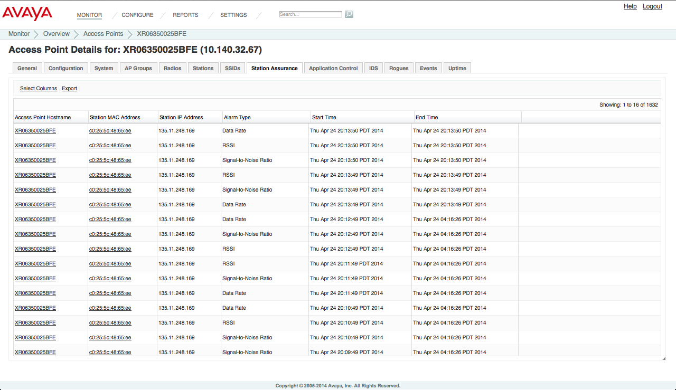
Wireless Orchestration System – Key Features
Device / Network Visibility – Customizable Monitoring Screens
Access Points Summary - Visibility into Station Assurance on the AP Radios.

Slide 27
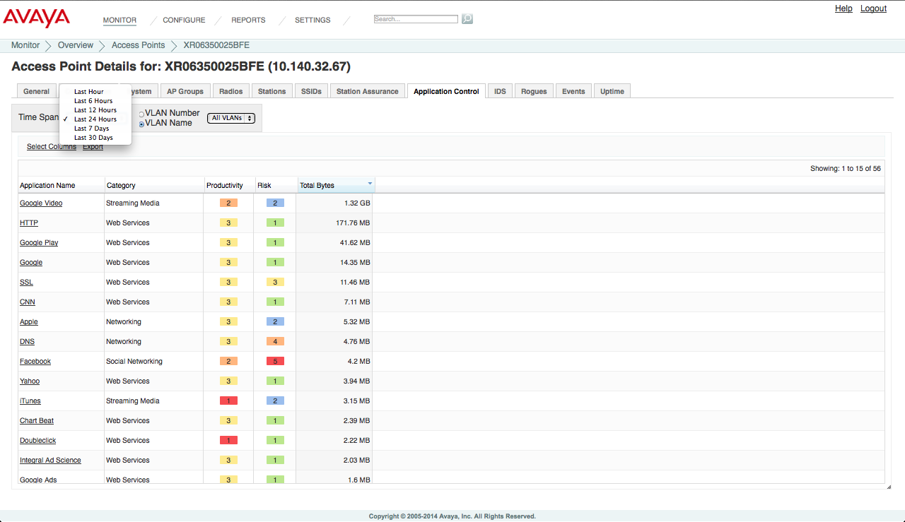
Wireless Orchestration System – Key Features
Device / Network Visibility – Customizable Monitoring Screens
Access Points Summary - Application Data Analytics – Application Usage Metrics & AP Productivity & Risk Assessment

Slide 28
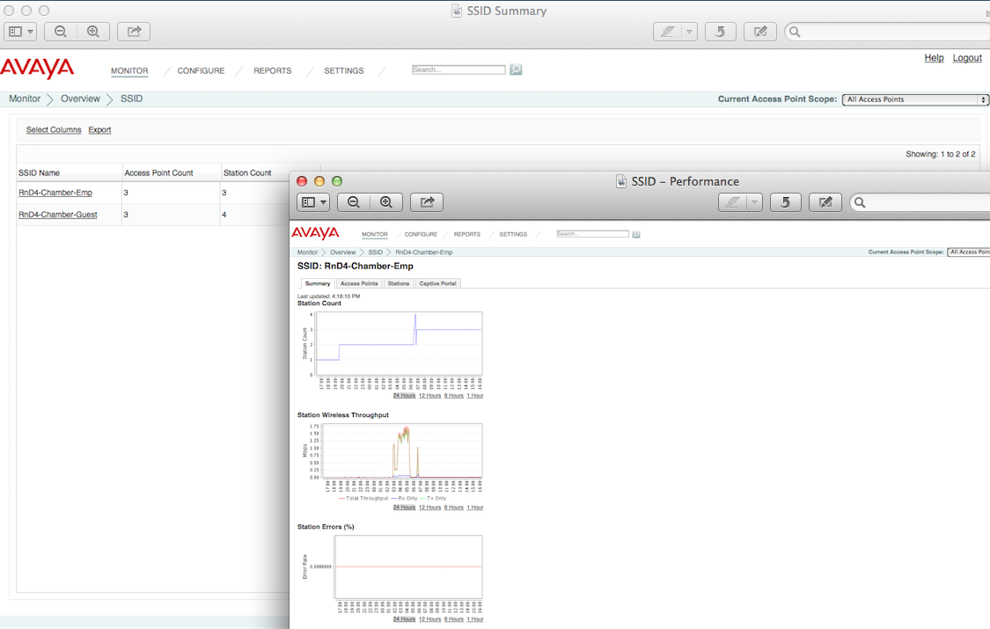
Wireless Orchestration System – Key Features
Device / Network Visibility – Customizable Monitoring Screens
SSID Summary - Visibility into advertised SSIDs and drill down into individual SSID’s for detailed view with performance statistics.

Slide 29
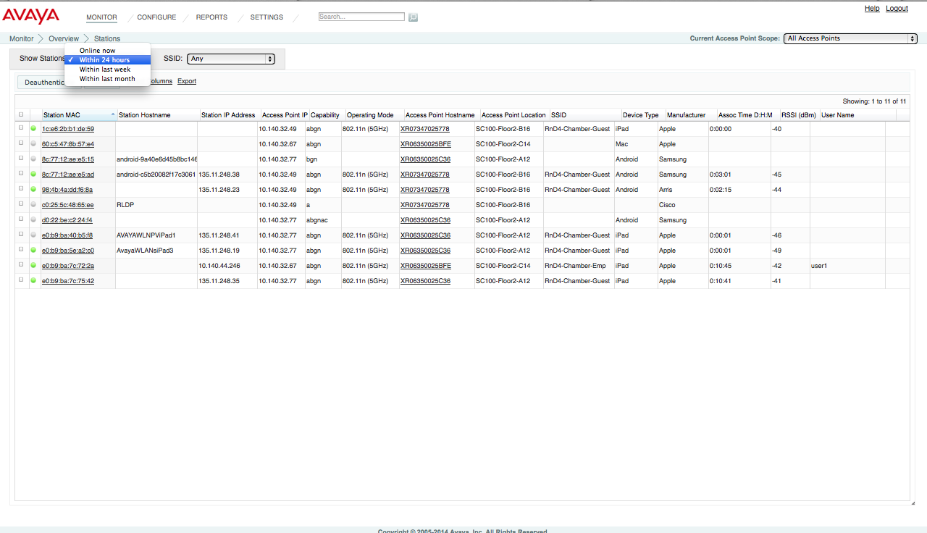
Wireless Orchestration System – Key Features
Device / Network Visibility – Customizable Monitoring Screens
Station Summary - Visibility into Station association, performance & finger printing details of online as well as historic associations.

Slide 30
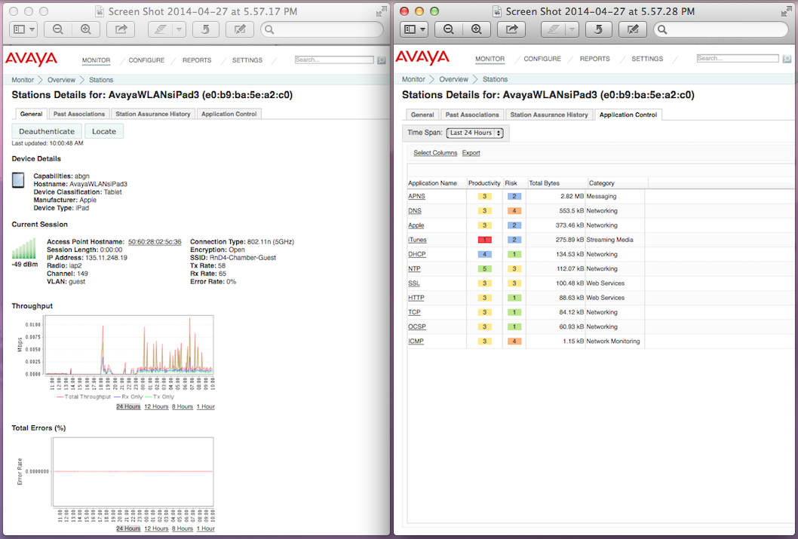
Wireless Orchestration System – Key Features
Device / Network Visibility – Customizable Monitoring Screens
Station Summary - Drill down to individual station for device details, performance, station assurance, association history & Application Control View.

Slide 31
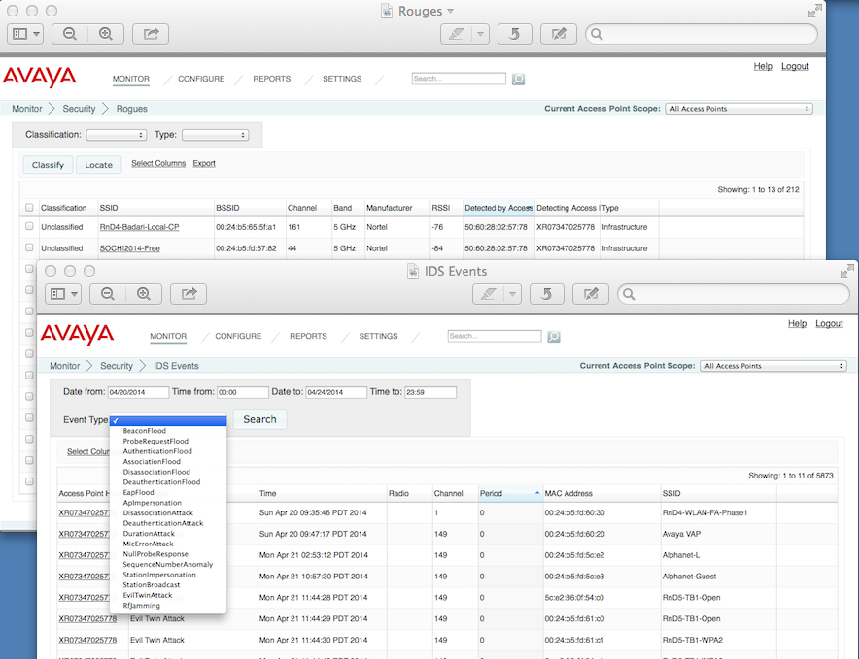
Wireless Orchestration System – Key Features
Device / Network Visibility – Customizable Monitoring Screens
Security - Comprehensive visibility into Rouges & IDS Events. Ability to Locate Rouges in Maps.

Slide 32
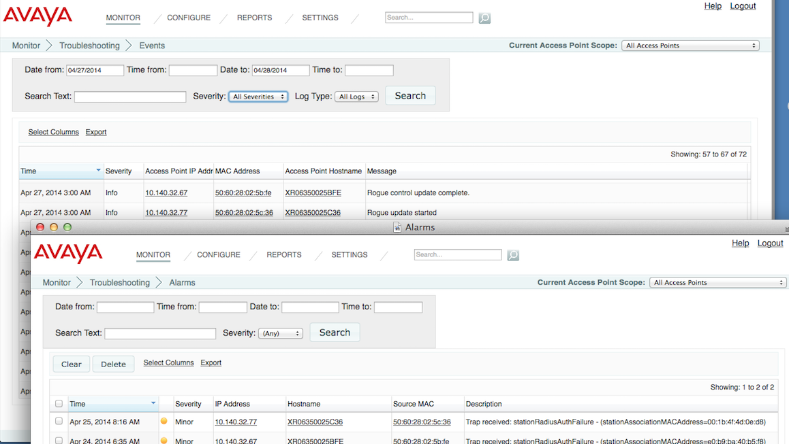
Wireless Orchestration System – Key Features
Diagnostics
Events & Alarms Visibility - Searchable & Customizable views for Network Events and Alarms

Slide 33
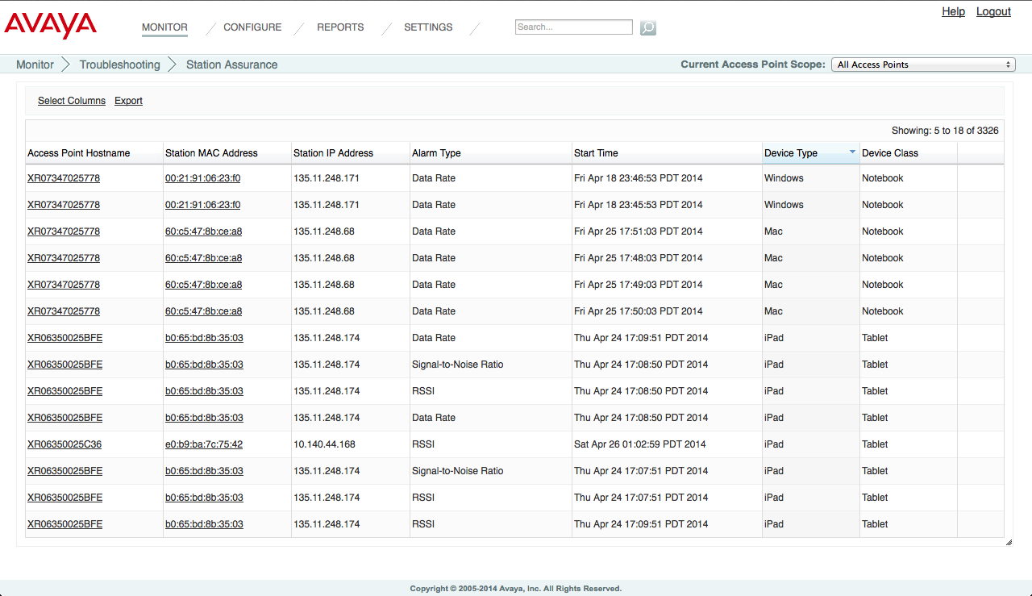
Wireless Orchestration System – Key Features
Diagnostics
Station Assurance - Real Time Monitoring of user experience – Generate Events or Alarms when performance degrades below desired service thresholds.

Slide 34
Wireless Orchestration System – Key Features
Auto-Provisioning
Pre-Define Service Policies
  Create a Profile that would be used for Auto-Provisioning
  Configure Profile to define Wireless, Network and Application Policies for the Enterprise
  Set AP Operating System for the Enterprise & Set Profile as Default
Auto – Discovery
  Add DNS entry for Avaya-WOS in the enterprise DNS Server
Attach Access Points to the Network
  Access Points discover Avaya-WOS deployed and establish communication with WOS.
  WOS applies the pre-defined Policies to the Access Point after license validation.
  WOS performs AP upgrade if required
  AP auto-provisioning is complete & AP goes into service.

Slide 35
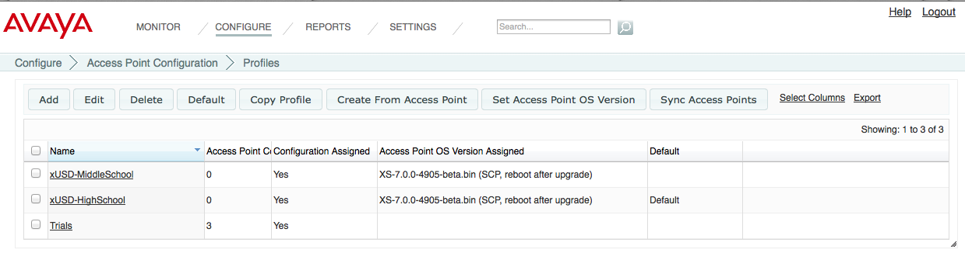
Wireless Orchestration System – Key Features
Service Policies – Access Point Profiles
Profiles define uniform Wireless Services, Access Policies, RF characteristics, Application Control to be applied to all of the Access Points or to Access Points delivering a specific set of services.
Eliminate the time-consuming and error-prone task of configuring and managing Multi-Site Environments, Wireless Networks or Access Points individually.
Automatic AP Image Management – Ensure all Aps are running desired OS.

Slide 36
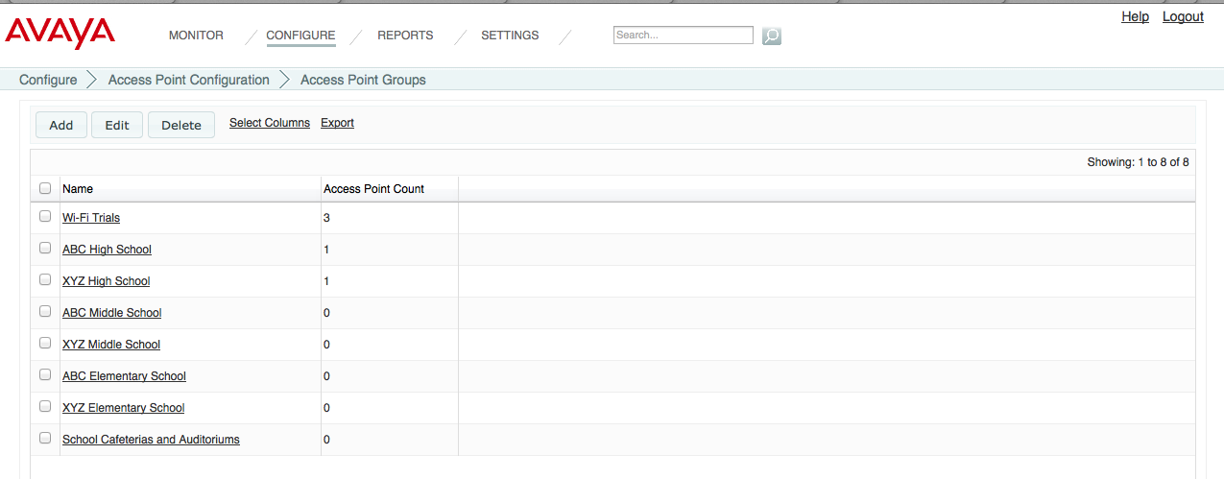
Wireless Orchestration System – Key Features
Service Policies - Access Point Groups
Create Logical Grouping of Access Points ex. auditorium, class room, cafeteria.
Customize Wireless Services on a per group basis. ex. Specific Applications are blocked throughout the campus but only allowed in the cafeteria.
Use Groups to filter the data displayed in Dashboard Widgets, Monitoring Screens, Reports etc. so that only information for selected AP Group members is presented.

Slide 37
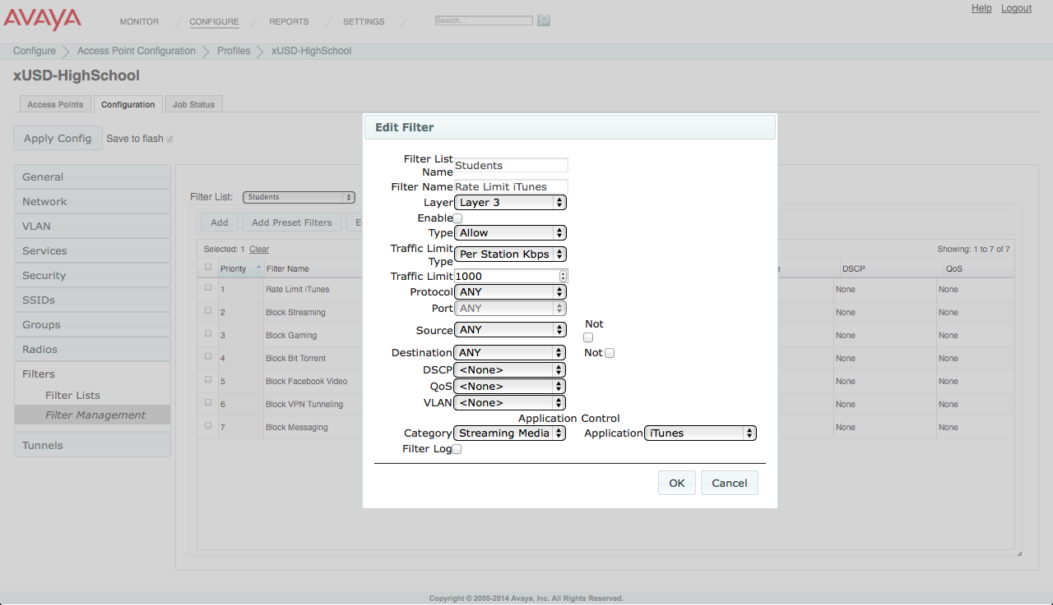
Wireless Orchestration System – Key Features
Service Policies – Application Control
Define Application Control Policies and enforce at SSID or User Group Level
Ability to enforce unique policies at specific Sites/Locations, on specific APs, to specific Device Types. Enforce all the time or specified days and time intervals.
Policies can allow, deny, prioritize or rate limit entire Application Category or Individual Applications.

Slide 39

Wireless LAN Orchestration System - Portfolio
Hosted & Private Cloud Solution – Available in Q4, 2014
Wi-Fi – As – A - Service
Cloud-based Orchestration for Wireless LAN Network & Services
Public and Private Cloud
Intuitive, simple web interface
Massively scalable platform
Zero-touch configuration
Multi-tenant architecture
Secure and firewall-friendly

Slide 40
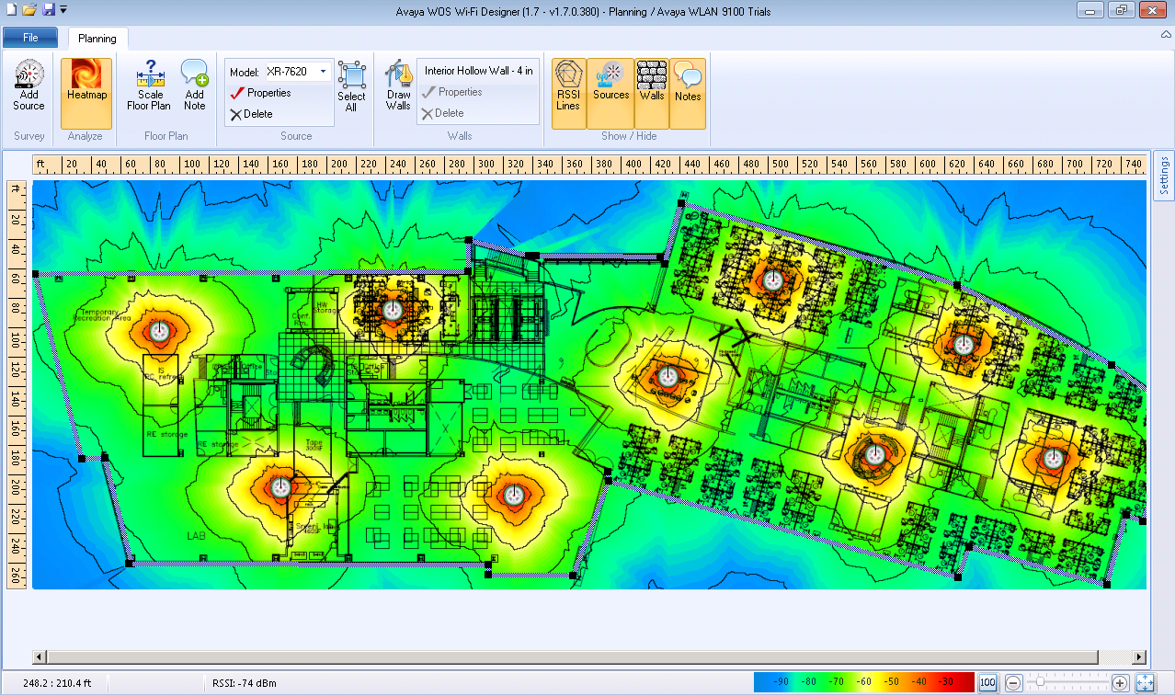
Wireless LAN Orchestration System - Portfolio
Wi-Fi Designer
Windows based application
Predictive Site Surveys – Plan Wi-Fi Network Strategy, optimal number of Aps required and AP Placement.
Site Modeling - Model different site conditions, AP configurations and positioning options to visualize impact to RF coverage and capacity
Active Site Surveys – Perform onsite surveys with Avaya Aps taking real-time measurements to qualify the network design & AP placements.
Post Deployment Surveys - Validate post-installation capacity and coverage against the initial plan to ensure a successful deployment

