Slide 1
WLAN 9100 Deep Dive
April 2014
Notes:
Good morning and welcome to this webcast. My name is Laurent Beucher. I’m a system engineer based in France.
Today’s topic is a deep dive into the new Avaya WLAN portfolio 9100.

Slide 2
Agenda
WLAN architecture review
WLAN 9100 portfolio overview
802.11ac new standard
WLAN 9100 features
WOS – Centralized Management Solution
Orderable parts and licensing
Q&A
** Cloud management phase2
© 2014 Avaya Inc. Avaya – Confidential & Proprietary
Do not duplicate, publish or distribute further without the express written permission of Avaya.

Slide 3
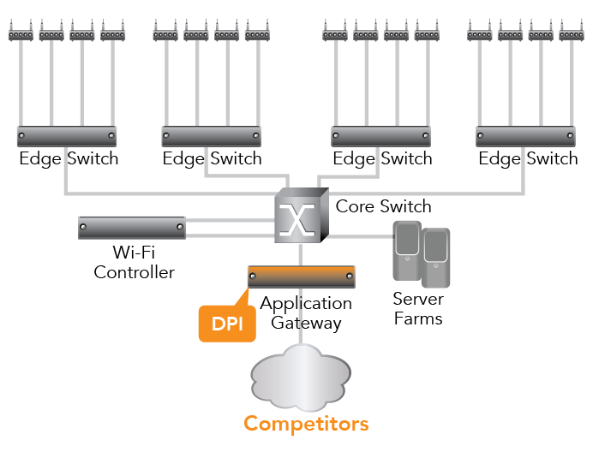
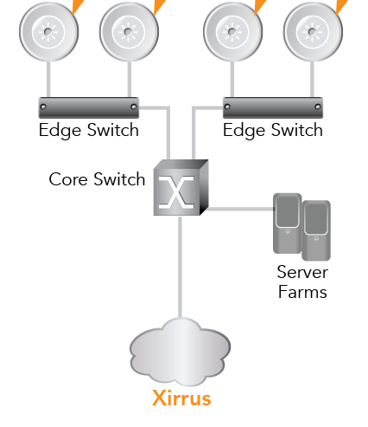
Wi-Fi Architectures and Traffic Flow
Centralized Traffic Management
Edge Traffic Management
SPoF
Central Control
Central processing creates bottlenecks
Single Point of Failures
Stair step scalability
Intelligence Choke Point
Distributed Control
Control at edge for best performance
No Single Point of Failure
Seamless Scalability
Distributed Intelligence
© 2014 Avaya Inc. Avaya – Confidential & Proprietary
Do not duplicate, publish or distribute further without the express written permission of Avaya.
Notes:
Let start with a brief review of WLAN architecture to understand where we stand and why Architecture has to change. On the left you have one of the most deployed architecture today. With the increase number of unwired devices plus the bandwidth over the air achievable with 802.11n up to 600Mbps and tomorrow with 11ac up to 1Gbps, a centralized architecture will start ot shows its limitations.
SPOF
Central processing of the traffic
….
Avaya WLAN 9100, provides a distributed architecture which will remove these limitation by:
Removing the SPOF.
Delivering intelligence at the edge, Qos, packet filtering…
Much more scalable for the next ssantdard 11ac. instead of increasing the number of AP and controller.

Slide 4
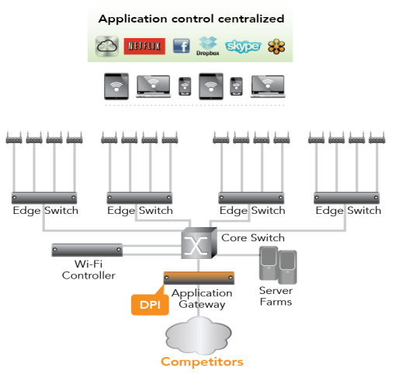
Architecture Comparison: Intelligence at the Edge
Avaya
© 2014 Avaya Inc. Avaya – Confidential & Proprietary
Do not duplicate, publish or distribute further without the express written permission of Avaya.
Notes:
Also as you can see on this slide by putting DPI at the edge on the AP we have a first level of protection at the edge in addition of what you can already have in the core like FW, UTM ….
Spreading DPI across AP vs having all done at the controller. DPI being a processor intensive mechanism.

Slide 5
WLAN 9100 Portfolio - What do we launch?
PHASE1 (May 2014)
PHASE2 (end 2014)
Next-gen wireless with predictable performance
802.11ac
Simplified RF planning
Application QoS control
Wlan architecture with distributed controller
Swap-less upgrades
Cloud-based management**
Single Software stream
Flexible deployment
Bonjour support
** phase2
WAP 9122 | WAP 9123 | WAP 9132 | WAP 9133 | WAO 9122 (Outdoor) | WAP 9162/9173
802.11n 2x2 AP | 802.11n 3x3 AP | 802.11ac 2x2 AP | 802.11ac 3x3 AP | 802.11n 2x2 AP | 802.11ac 2x2 / 3x3
2 Radios | 2 Radios | 2 Radios | 2 Radios | 2 Radios | 2 or 4 Radios
 | Common Advanced Feature Set
 | Integrated Controller
 | Application Control
 | Zero Touch Provisioning
 | On-Premise or Cloud Management
WLAN Distributed Architecture
© 2014 Avaya Inc. Avaya – Confidential & Proprietary
Do not duplicate, publish or distribute further without the express written permission of Avaya.
Notes:
So what are we launching in May?
Describe the slide.

Slide 6
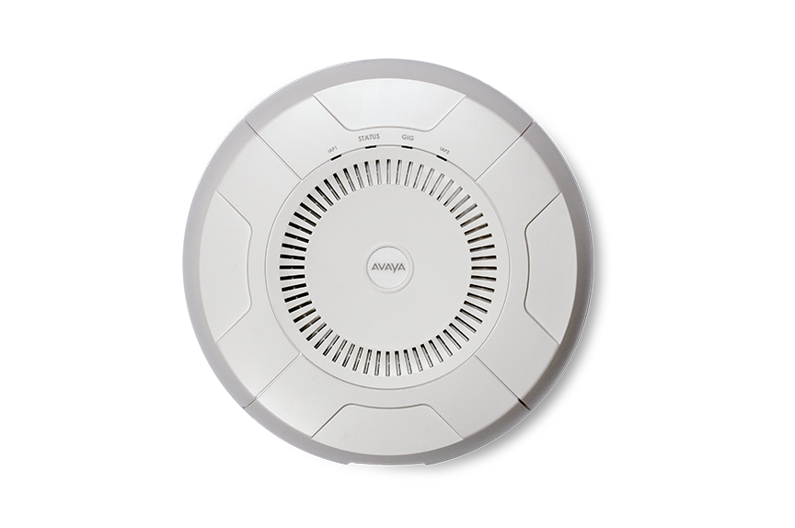
WAP 9122 & 9123 access points
Indoor dual-radio AP with omni-directional antennas
Models:
WAP 9123: 3x3 11n
WAP 9122: 2x2 11n
Software programmable per radio
Dual bands 2.4GHz and 5GHz
Multiple modes 802.11a/bg/n
11ac software upgradable
Integrated controller
Integrated services:
Application Control: Visibility and Policy Enforcement
Security: WIDS/WIPS, Firewall, Guest Access
Analytics: Spectrum Analysis, Packet Capture
Dual Gigabit Ethernet uplinks
802.3at POE+ powered (9122 can use POE)
Cloud** or on-premise provisioning and management
** Cloud management phase2
© 2014 Avaya Inc. Avaya – Confidential & Proprietary
Do not duplicate, publish or distribute further without the express written permission of Avaya.

Slide 7
WAP 9132 & 9133 access points
Dual-radio APs with omni-directional antennas
Models:
WAP 9133: 3x3 11ac
WAP 9132: 2x2 11ac
Software programmable radios
Dual bands 2.4GHz and 5GHz
Multiple modes 802.11a/bg/n/ac
Integrated controller
Integrated services:
Application Control: Visibility and Policy Enforcement
Security: WIDS/WIPS, Firewall, Guest Access
Analytics: Spectrum Analysis, Packet Capture
Dual Gigabit Ethernet uplinks
802.3at POE+ powered
Cloud** or on-premise provisioning and management
** Cloud management phase2
© 2014 Avaya Inc. Avaya – Confidential & Proprietary
Do not duplicate, publish or distribute further without the express written permission of Avaya.
Notes:
At A Glance this AP support
• Dual radio
2x2 802.11ac AP with 1.7Gbps total Wi-Fi bandwidth for 9132 and up to 3x3 802.11ac AP with 2.6Gbps total Wi-Fi bandwidth for 9133
• Two software programmable radios for mixed 2.4/5GHz or dual concurrent 5GHz operation
• 802.11ac speed optimization ™
• Integrated omni-directional, internal antennas
• Supports up to 240 users with 2 – 1Gbps uplinks
• Integrated Controller
• On-premise management

Slide 8
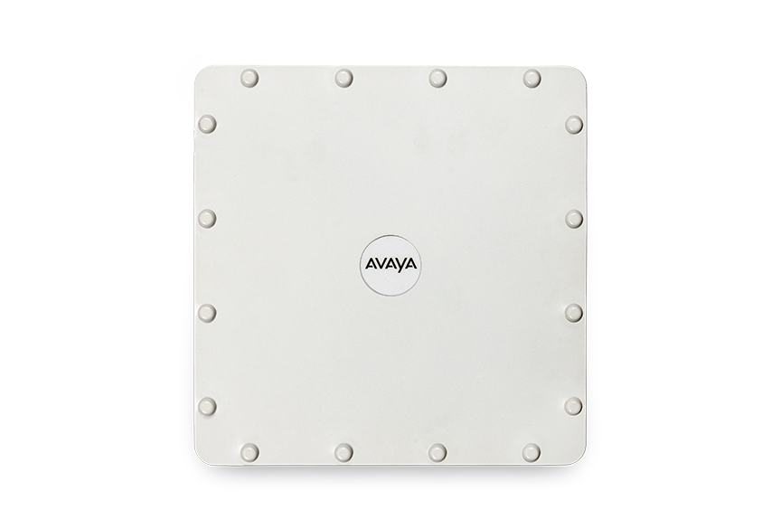
WAO 9122 access point
Outdoor dual-radio AP with external antennas
External RP-TNC antenna connectors - two per radio
Directional
Omni
Models:
WAO 9122: 2x2 11n
Software programmable per radio
Dual bands 2.4GHz and 5GHz
Multiple modes 802.11a/bg/n
Integrated controller
Integrated services:
Application Control: Visibility and Policy Enforcement
Security: WIDS/WIPS, Firewall, Guest Access
Analytics: Spectrum Analysis, Packet Capture
Single Gigabit Ethernet uplinks
802.3af POE powered
Cloud** or on-premise provisioning and management
** Cloud management phase2
© 2014 Avaya Inc. Avaya – Confidential & Proprietary
Do not duplicate, publish or distribute further without the express written permission of Avaya.
Notes:
9122 Outdoor Access Point provides WLAN technology in a hardened case for harsh environments. The unique case design protects the AP electronics from rain, heat, cold, direct sun, and wind. The hardened Access Point includes two software programmable (2.4GHz and 5GHz) radios with two lightning protected RP-TNC style connectors each, integrated wireless controller, application-level intelligence, automated provisioning, and cloud management (optional) contained in a hardened case. The outdoor 9122 AP is designed to meet requirements for extending wireless coverage outdoors or in other harsh environments such as playgrounds, campus quads, stadium stands and warehouse freezers. In addition the 9122 is an ideal candidate for high speed point-to-point wireless data links directly connecting networks across streets, building….
At A Glance
• Dual radio 300Mbps (2x2 MIMO) 802.11n AP
It is completely dust sealed and meets the requirements for IP65. The product has been tested to operate in temperatures as low as -40˚C and as high as +55˚C.

Slide 9
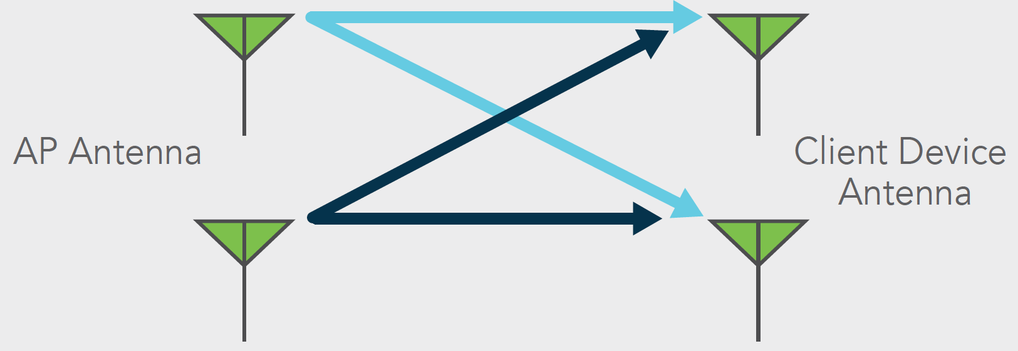
2x2 and 3x3 11ac?
What is 2x2 and 3x3 11ac?
2x2 = 2 antennas, 2 spatial data streams
3x3 = 3 antennas, 3 spatial data streams
Additional streams provides additional throughput
How fast is 2x2 and 3x3 11ac?
2x2 = up to 867Mbps data rates per radio
3x3 = up to 1.3Gbps data rates per radio
11ac is about 3X faster than 11n
© 2014 Avaya Inc. Avaya – Confidential & Proprietary
Do not duplicate, publish or distribute further without the express written permission of Avaya.
Notes:
I’ve been talking about the new satndard 802.11ac. Here’s a high level detai lof what’s coming.
First of all like 11n , 11ac will be the second wlan standard to use MIMO technology. Mimo technology allows the sender to use multiple antennas and receive on multiple antennas. Therefore sending data across multiple spatial streams. By doing this it is easy to understand how we can achieve u pto 1gbps over the air. 11ac in phase 1 will allow up to 8 spatial stream vs 11n up to 4 (600Mbps). A huge number assuming that in order to achieve tis we need to have the same amount of antennas on the client side with all the implication it can have.

Slide 10
Remember: Wi-fi performance is limited by the device
Most BYOD clients are 1x1 or 2x2 and cannot take advantage of 3 streams in a 3x3 Wi-Fi infrastructure
Device | 2.4GHz | 5GHz | Antennas | Max Rate
Media Players (iPod Touch) | X | Some | 1x1 | 65-150Mbps
Smartphones – low end | X |  | 1x1 | 65Mbps
Smartphones – high end | X | X | 1x1 | 150Mbps
Tablets – low end | X |  | 1x1 | 65Mbps
Tablets – high end (iPad) | X | X | 2x2 | 300Mbps
Laptops – low end | X | Most | 2x2 | 300Mbps
Laptops – mid/high end | X | X | 3x3 | 450Mbps
Notes:
A very important thing to keep in mind on this slide is that not every product are born the same performance. Therefore putting all this devices on a wireless network can have a significant impact.

Slide 11
Deploying different 11ac technologies with AVAYA WLAN 9100
Where would you use 2x2 11ac vs. 3x3 11ac?
Use 2x2 in more cost sensitive areas with low to medium user density
Use 3x3 in higher performance areas or where there is more laptop usage
What are the key benefits of 2x2 11ac?
Reduced 11ac upgrade infrastructure costs
Optimal for connecting 1x1 & 2x2 smartphones and tablets
24Mbps
x
= # streams
1
1.3Gbps
3
150Mbps
2
1
1
24Mbps
13Mbps
1
3
65Mbps
1
300Mbps
6Mbps
Notes:
Read the slide

Slide 12
SOFTWARE PROGRAMMABLE RADIOS
Program 2 bands per radio – 5GHz or 2.4GHz
Program 6 Wi-Fi modes per radio – 802.11a/b/g/n2.4/n5/ac
Competitor APs:
One Configuration
11ac
11n 2.4GHz
11ac
11n 2.4GHz
11n 5GHz
11n 2.4GHz
Avaya APs Flexible Configurations
11ac
11n 5GHz
11ac
11ac
© 2014 Avaya Inc. Avaya – Confidential & Proprietary
Do not duplicate, publish or distribute further without the express written permission of Avaya.
Notes:
A very nice feature here. Normally AP comes with fix radio 2.4 and 5. On 9100 AP you can change the radio by a software and therefore be able to run 2 radio on 5Ghz and apply different combinations on each radio 11n ,, 11ac.

Slide 13
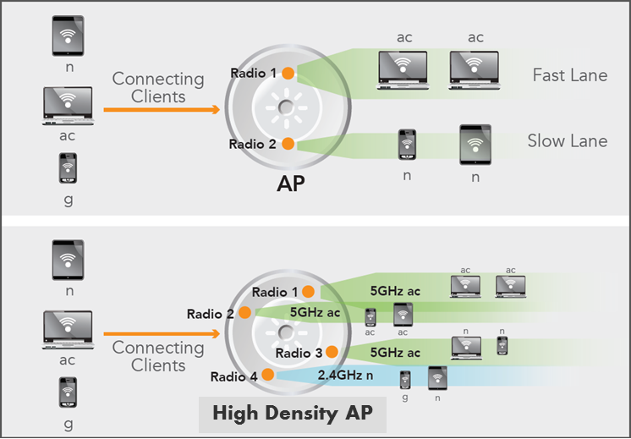
802.11ac PERFORMANCE OPTIMIZATION
The Problem
Wi-Fi is shared medium - slow clients reduce speed of fast clients
The Solution
Separate high speed and low speed clients on different radios
Maximize system performance for ALL clients
© 2014 Avaya Inc. Avaya – Confidential & Proprietary
Do not duplicate, publish or distribute further without the express written permission of Avaya.
Notes:
This station load balancing or kind of band steering+ provides several key benefits:
• Improved network performance available to Wi-Fi stations. Since each radio has a defined
maximum amount of bandwidth, reducing the number of users on more heavily loaded radios
will ensure more average bandwidth available per station.
• Better use of radio resources by ensuring more radios are servicing stations and not idle.
• More efficient use of Wi-Fi spectrum by reduction in packet retries and packet errors on heavily
loaded radios.
• Enables the AP to influence station connection decisions. Making these decisions centrally as
opposed to distributed per station provides greater control over the allocation of resources.

Slide 14
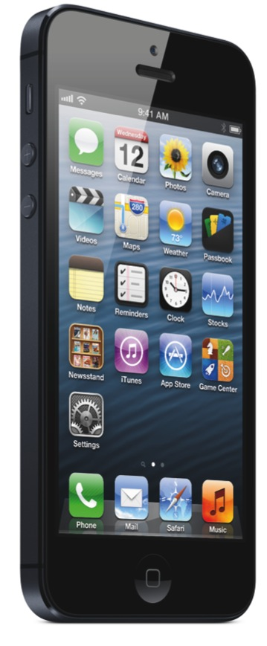
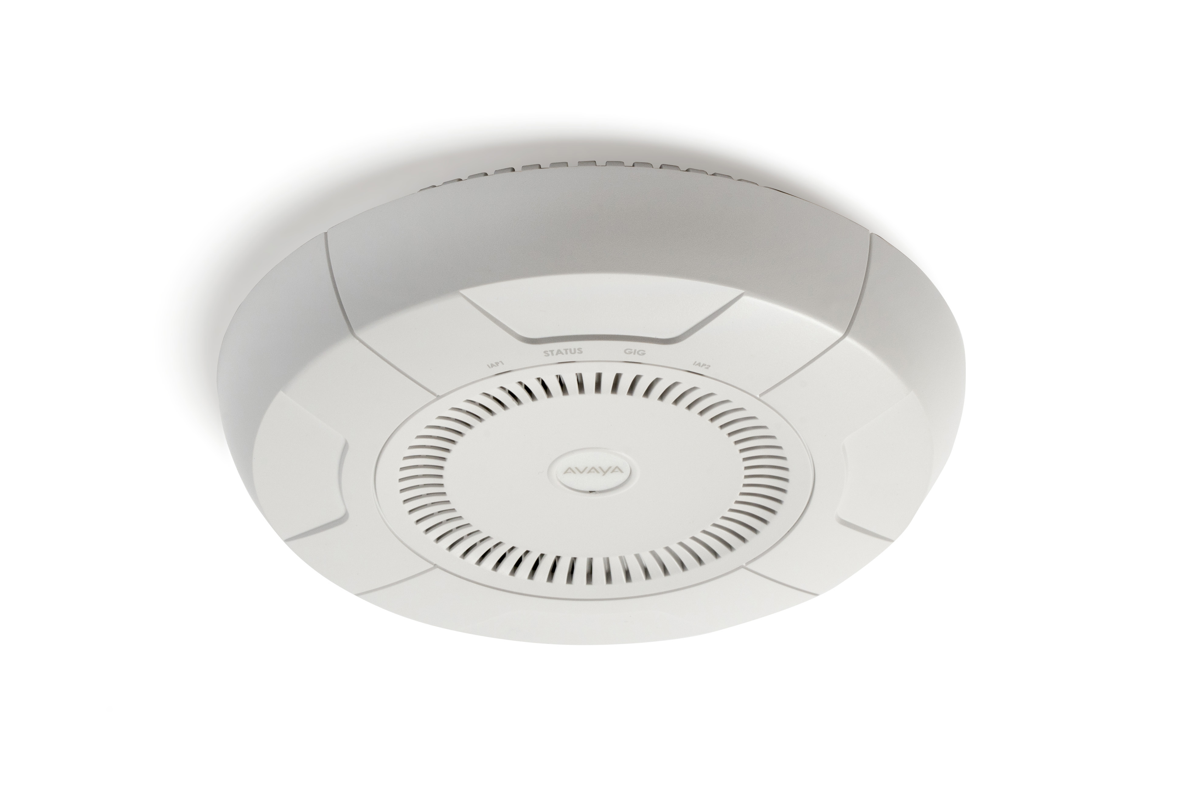
HONEYPOT – CLEANING THE AIR
Clean the air to improve performance by removing spurious probe requests from unassociated clients
SSID = honeypot
OtherSSID
honeypot
Dead VLAN
No Traffic
honeypot
honeypot
OtherSSID
OtherSSID
OtherSSID
Notes:
Some situations pose problems for all wireless APs. For example, iPhones will remember every SSID and flood the airwaves with probes, even when the user doesn’t request or desire this behavior. In very high density deployments, these probes can consume a significant amount of the available wireless bandwidth, especially on the 2.4Ghz radio. The 9100 AP offers a feature targeting this problem—a “honeypot” SSID. Simply create an SSID named honeypot (lower-case) on the AP, with no encryption or authentication (select None/Open). Once this SSID is created and enabled, it will respond to any station probe looking for a named open SSID (unencrypted and unauthenticated) that is not configured on the AP. It will make the station go through its natural authentication and association process.

Slide 15
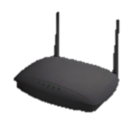
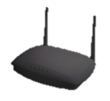
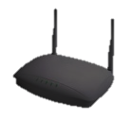
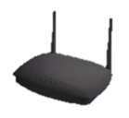
RF Transmission (TX) Power AP
Today’s high density networks are no longer focused on the maximum area that a single radio can cover. Coverage vs Capacity
Increasing numbers of devices per person and per square foot are demanding smaller, high capacity, Wi-Fi cells
Avaya provides Ultra-Low Transmit power (down to -15dBm) to create very small Wi-Fi coverage Cells
As density and usage increases…
…wireless performance deteriorates

Slide 16
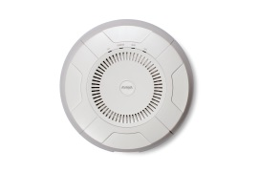
RF Receiver (RX) Sensitivity AP
High performance networks require that wireless clients achieve the best possible data rates and throughput the network can offer.
Adjusting RX Threshold values can ensure that clients with weak signals and therefore low data rates do not negatively impact clients with good RF signal.
Avaya APs allow for adjustable receive sensitivity on a per radio basis
With proper wireless design, you can ensure that all your clients have the best possible signal.
6.5Mbps
300Mbps
300Mbps
6.5Mbps

Slide 17
How this benefits you
Enhanced RF technology provides further differentiation from the competition
Ultra low TX power provides:
Greater use and reuse of 2.4GHz channels with very small (pico) cells.
Reduce the amount of AP co-channel interference (interference between radios on the same channel).
Adjustable RX/Receive Sensitivity provides:
Ability to guarantee that associated devices have the best possible connections and throughput
Eliminate negative effects of clients with low signals
Provide RF “no go” zones. Areas in which Wi-Fi coverage is prohibited due to IT defined access rules.

Slide 18
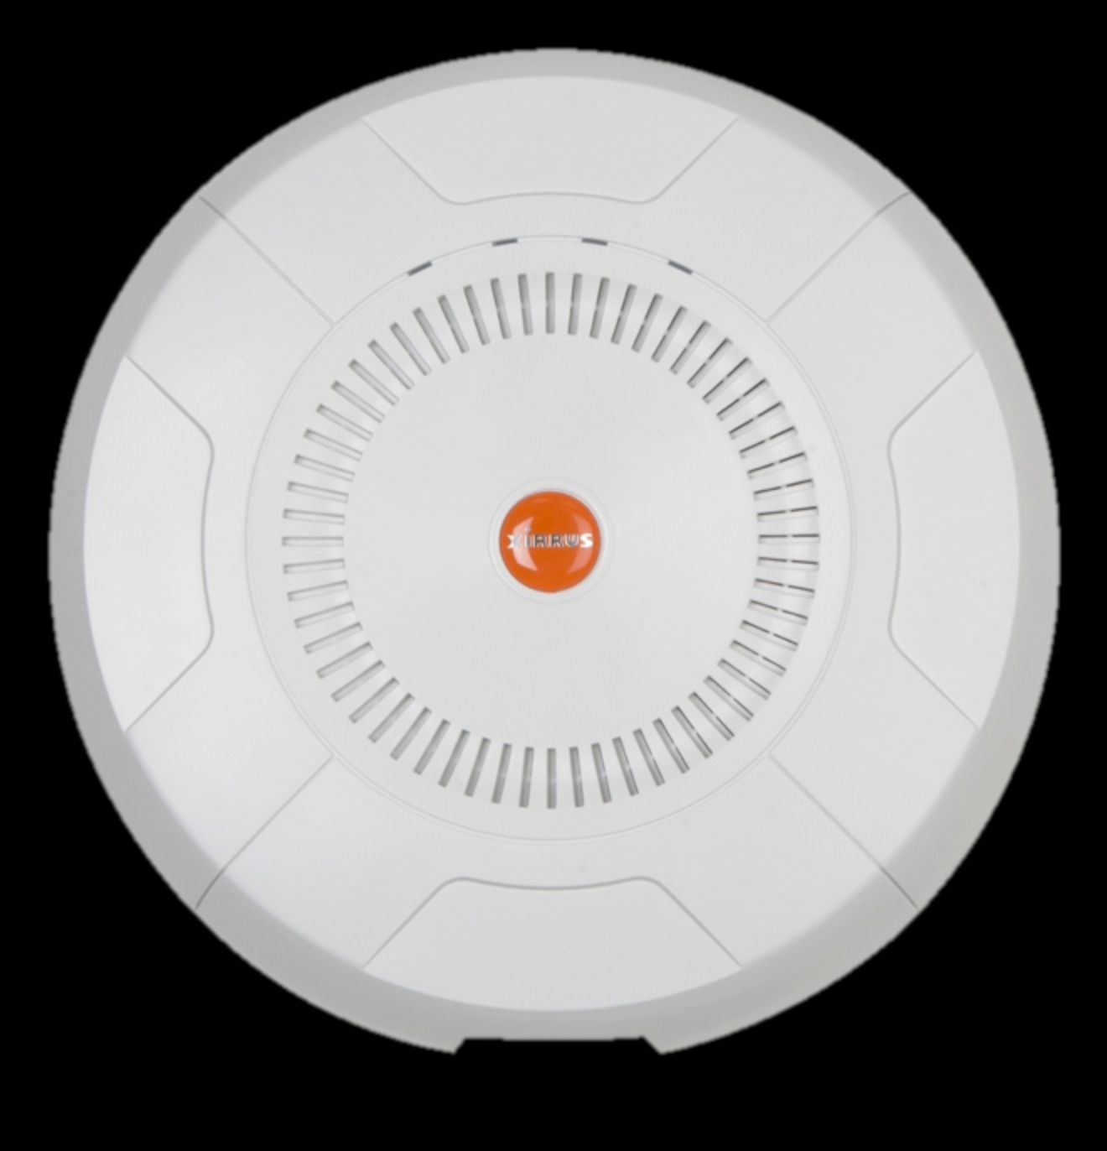
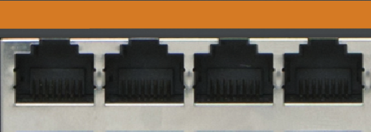
Flexible GigE Uplink Modes
Link Aggregation
Daisy Chain
Greater Backhaul
Fewer Cables
Link Backup
Local Devices
Greater Resiliency
Fewer Cables
Notes:
All AP models except the outdoor AP have more than one Gigabit port.
These ports may be bonded, i.e. configured to work together in sets.
For example, one port may provide active backup or load balancing for another, or other options as described in this section.
You may use the mirror option to have all the traffic that is ingressing and egressing one bond be transmitted by the bond you are configuring. For example, if you configure Bond2 to mirror Bond1, then all traffic going in and out of Bond1’s Gigabit ports will be transmitted out of Bond2’s Gigabit ports. This way of duplicating one bond’s traffic to another bond is very useful for troubleshooting with a network analyzer.
802.3ad and Load Balancing modes increase the resiliency of the wired connection by providing
dual active connections. If one link fails, the other will continue to service traffic.
• 802.3ad and Load Balancing modes achieve greater uplink performance by providing a total 2
Gbps throughput connection from the AP.
• Bridge mode (or daisy chain)extends the reach of a wireless network by allowing AP to be wired directly to
each other in a daisy chain fashion, eliminating cable runs and wired switch ports in the wiring
closet.
• Link Backup provides for fail-over resiliency of the wired connection if a GigE port fails.
• Broadcast mode provides fault tolerance by transmitting all traffic on both GigE ports.
• Mirror mode simplifies network troubleshooting of your network. If Gig1 is connected to your
corporate network, Mirror mode can be configured on that Wi-Fi Array with a wired packet
capture connected to Gig2 to monitor inbound and outbound Gig1 traffic.

Slide 19
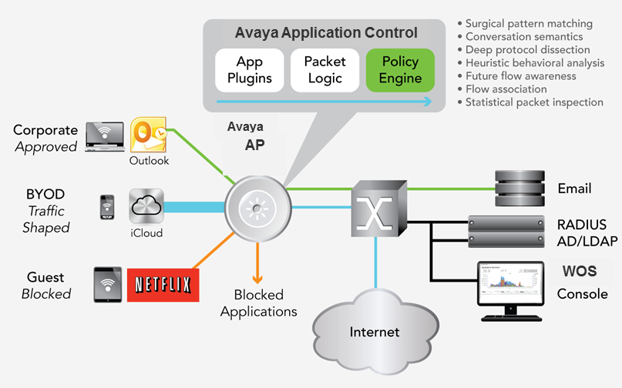
Key Features – application control
KEY BENEFITS
Improved user experience by prioritizing critical applications over recreational applications and reducing network load
Granular policy control by blocking, throttling, or applying QoS to applications directly at the network edge
Notes:
Wireless is quickly becoming the primary access to the network. Unlike wired users, mobile users expect to connect anytime, anywhere – at home, in the office, in classrooms, and at conferences with dependency on mobile applications and cloud-access now business-critical. Application downloads, online backups, and cloud application usage will continue to grow, increasing the traffic demands on networks for years to come.
Millions of Wi-Fi enabled smartphones, tablets, and laptops are activated daily, many of which make their way onto corporate networks. This led to a significant growth in user-driven, non-managed applications on these networks. Smartphone users on average have over 40 apps on their phones ranging from Facebook to Email.¹
Primary Benefits
With an average wireless equipment refresh cycle of 4-5 years, it is vital for customers looking to purchase a new system today to consider this down the road towards accommodating the expected continued explosion of devices and applications on their networks. Avaya Application Control, offers a number of key unique benefits.
Improved user experience, Prioritize critical over best effort applications at the network edge for optimal performance throughout the network
Improved visibility Identify bandwidth-hogging apps and analyze usage trends over time
Superior scalability Distributed intelligence for limitless growth – DPI compute power added by AP, not in a stair step fashion with centralized appliance
Reduced network costs Control Internet WAN uplink network traffic by dropping or throttling at the network edge
Reduced application risk Block risky or out-of-policy applications from accessing the network
Superior resiliency Distributed functionality in each AP means no single point of failure for applying application control policies

Slide 20
Avaya Application Control – what is different?
Full function DPI engine in every AP – Layer 7 DPI implementation
Greater depth and accuracy of application detection:1200+
Uses advanced pattern matching, heuristics, flow awareness, etc.
Superior performance with 2-6 core processors per AP
Traditional APs run with limited performance 1 core processors
Operates at the network edge where BYOD control is needed the most
Competitors rely on central appliances/controllers implementations
Notes:
Firewall, apply QoS,
manage 1,200 individual or groups of applications under 15 categories using Layer 7 Deep Packet Inspection (DPI) and other contextual application detection techniques.

Slide 21
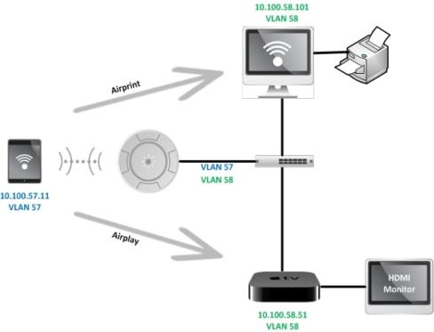
Key Features – Bonjour Director
Bonjour Director provides control of Apple mDNS traffic to enable the use of iOS devices across enterprise networks
Key Benefits
Enables broad use of Apple services (e.g. AirPrint, AirPlay) and devices (e.g. tablets, AppleTV, printers) across enterprise networks
Increases performance in Apple-heavy environments by controlling mDNS traffic which can slow wireless networks
Notes:
For hostnames as well as service advertisement and discovery, Apple implemented a multicast version of DNS, where devices self-assign hostnames and also advertise and request services using a specific IPv4 and IPv6 multicast address. This is referred to as mDNS and is detailed in the Internet Engineering Task Force (IETF) mDNS draft document. Apple’s mDNS protocol uses specific IPv4 and IPv6 multicast addresses, that are in the Local Network Control Block Multicast address space as defined in IETF RFC 5771 and IETF RFC 4291. mDNS uses the following IPv4 and IPv6 multicast addresses and port number
MAC address 01:00:5E:00:00:FB
IPv4 address 224.0.0.251
IPv6 address FF02::FB
UDP port 5353
By using the Local Network Control Block addresses, mDNS was intended to be restricted to a single Local Area Network, as the Local Network Control Block addresses are not routed and do not need to use Internet Group Management Protocol (IGMP), as IGMP is used by IP routers and gateways to manage Multicast groups and multicast traffic in multi-subnet routed networks.
This is now creating issues in larger organizations, as Apple iOS applications that use mDNS such as Airplay and Airprint, and Apple devices such as AppleTV, find their way into classrooms and meeting rooms, and their users expect them to work the same as they do in their home network environment.

Slide 22
Key Features – RF spectrum optimization
5GHz
2.4GHz
Future Proof
Software Programmable Radio
Choose 5GHz or 2.4GHz to adapt to changing Wi-Fi clients, compared to traditional APs that are fixed configuration.
Investment Protection
Ultra-low power
Extended power control range to reduce cell size and increase density of users serviced
Honeypot
Automatically associate unused Wi-Fi devices in public areas to reduce overhead and increase RF capacity

Slide 23
Key Features – Flexible Radio Control
Individually control each radio by:
Band – set to 2.4GHz or 5GHz operation
Channel – manual or automatic configuration
Cell size – manual or automatic configuration from 1 to 20dBm
Wi-Fi Mode – set to 11n only, 11b only, 11bgn, etc.
Individually assign radios to separate SSIDs

Slide 24
Key Features – Wireless IDS/IPS
Intrusion Detection and Prevention integrated into each AP with dedicated radio resource
Classify rogues (Approved/Known/Unknown) and optionally block
DoS and impersonation attack recognition and alerting
Configurable threat thresholds

Slide 25
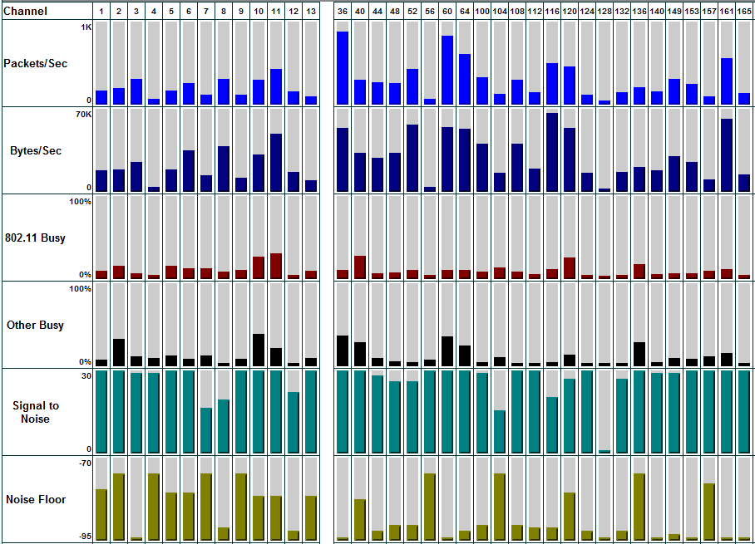
Key Features – Spectrum Analysis
Leverage dedicated monitor radio in each AP
24/7 monitoring of RF spectrum across all Wi-Fi channels
Activity, Noise/Interference, SNR, Errors, Average signal, etc.

Slide 26
WOS – Wireless Orchestration System
WOS is delivered as a .ova file
The Virtual Appliance package must be installed on a server running VMware™ or MS Hyper-V.
To access the web client, set your browser’s URL to this IP address of the WOS server , followed by port :9090.
Login=admin/admin

Slide 27
WOS Enterprise Server –Deployment Recommendations
On Premise Enterprise Solution
– Virtual Appliance - VMware or Hyper-V
WOS - VM | SMALL SCALE INSTALL | MEDIUM SCALE INSTALL | LARGE SCALE INSTALL
Maximum APs | 50 | 500 | 2000
Max Station (clients) managed | 1500 | 10000 | 25000
Minimum Recommended Processor | Two cores | Four cores | Eight cores
Minimum Recommended RAM | 4GB | 8GB | 16GB
Minmum Recommended Storage | 150GB/Thin provision | 300GB/Thin provision | 500GB/Thin provision
Recommended VMWare OS | VMware – ESXi or VSphere 5.0+ Microsoft – Hyper-V Server 2012 R2 (Standalone) or Windows Server 2012 R2 with Hyper-V Role
Note: In all VM deployments, one must take care not to over-provision RAM when using a Virtual WOS Appliance – e.g. if there are 3 VM
instances on the system that are provisioned for 8GB each, then the total system must have no less than 3*8GB = 24 GB provisioned for it.

Slide 28
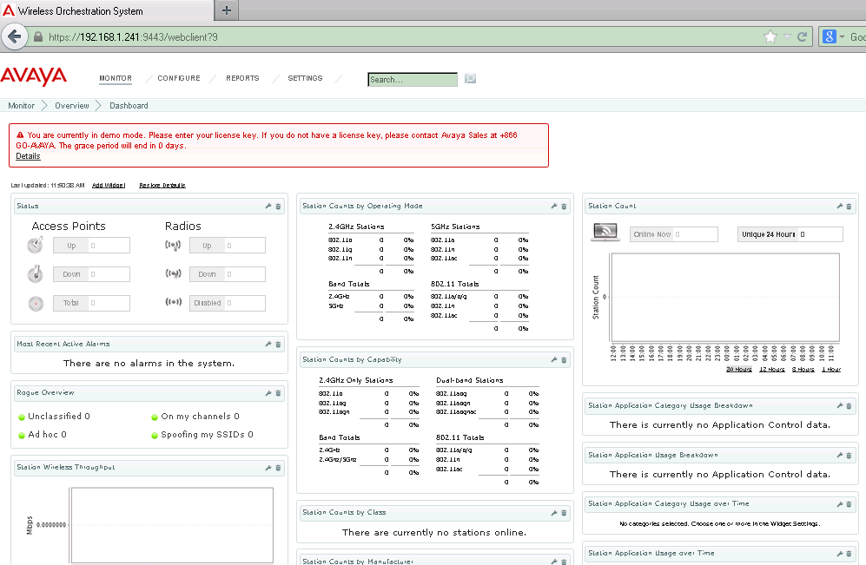
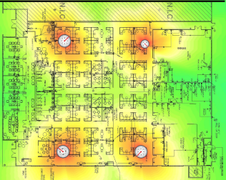
WOS features
Web-Based Interface
Wireless Heat Maps
Device Location
Centralized Upgrade Management
Security Monitoring
Reporting

Slide 29
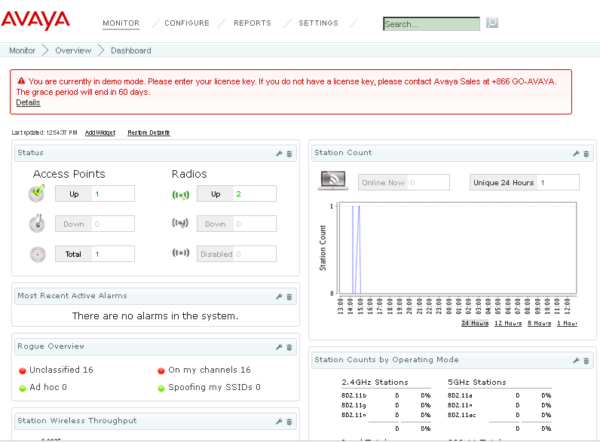
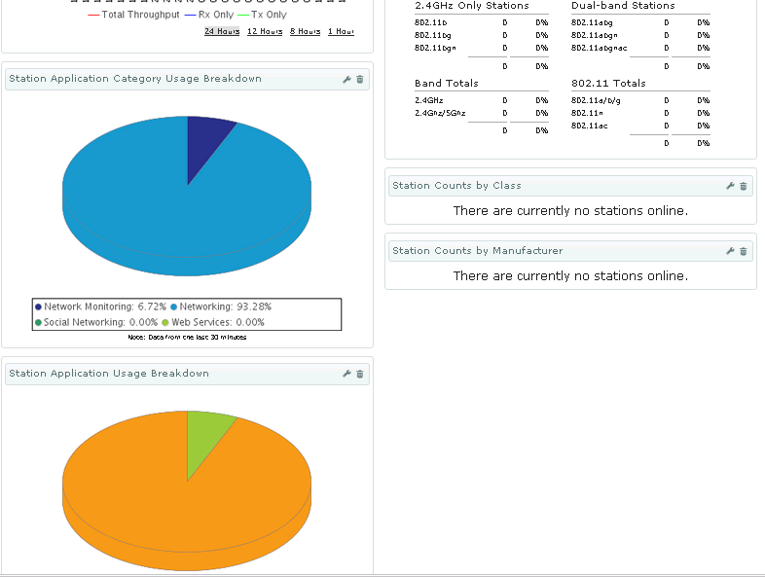
WOS Features – Web-based interface
Web based interface provides browser-based access to all network information and management capabilities
Dashboard view provides real-time summary of system status and activity
AP and Radio Status
AP/Radio Throughput
Rogue & Threat Overview
Most Recent Alarms
Station Information

Slide 30
WOS Features – Wireless heat map
Organize APs by physical location on pre-loaded maps
Predictive wireless coverage of entire AP network

Slide 31
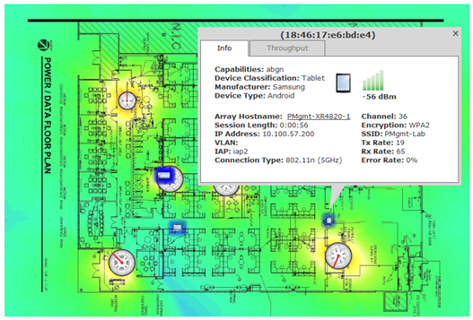
WOS Features – Device Location
Locate Rogues, Devices and Equipment
Locate function jumps to map showing device location
Icons distinguish between device types
Click for drill down details and troubleshooting

Slide 32
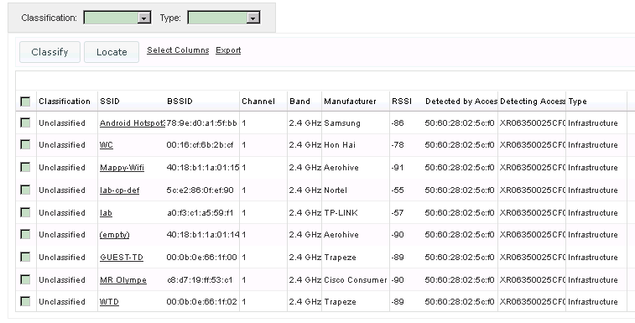
WOS Features – Security monitoring
Continuous monitoring for Rogues and unauthorized devices
Automated alerts notify administrators upon device discovery
Aggregated view of IDS system alerts

Slide 33
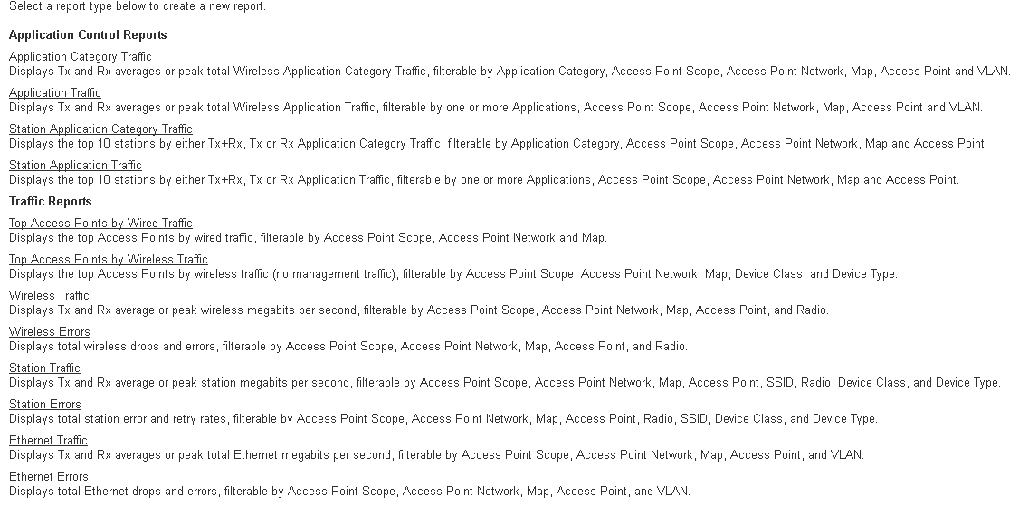
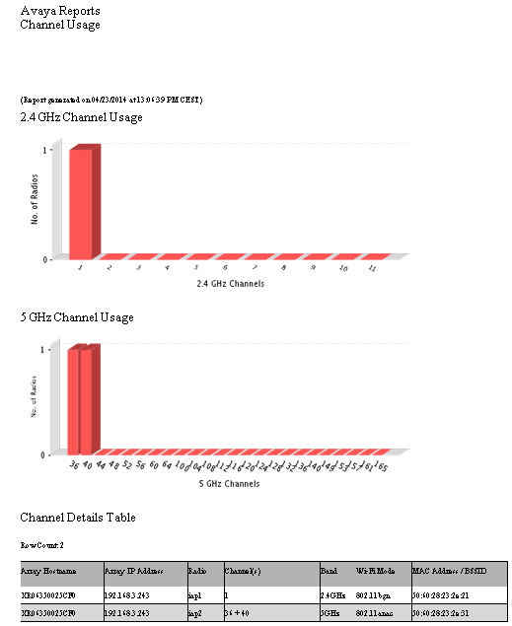
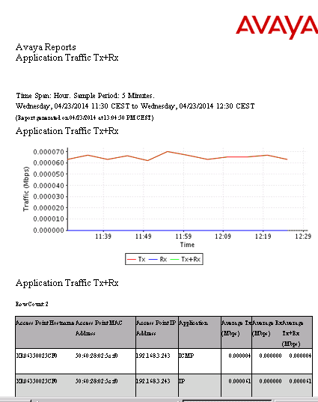
WOS Features – Reporting
Dozens of predefined reports for performance, security, usage
Track wireless network operation over last day, week, month, year

Slide 34
Avaya WLAN difference
11ac capable on every radio = 100% AC
Application Control = L7 DPI engine with 1200+ applications signature
Software Programmable = 11n or 11ac / 2.4GHz or 5GHz
Band Steering+ = maximize 11ac client performance
Integrated controller = maximize performance, reduce TCO

