Slide 1
Avaya Ethernet Switching
Level 3 –
Technical Decision Influencer Presentation
Notes:
Updated for 1Q11

Slide 2

Agenda
1
Avaya Networking Vision
2
Avaya VENA: Delivering Valuable Differentiation
3
Ethernet Switching Portfolio
4
Summary & Value Statements

Slide 3













The Avaya Data Solutions Vision
Network Imperatives for Plug & Play Communications
Always-On
PLUG & PLAY COMMUNICATIONS
Efficient
Scalable
Notes:
Avaya’s vision for the Enterprise – “Plug & Play Communications” – calls for a new level of synergy between People, the collaborative real-time Applications that they use, and the underlying, enabling Network. The goal is to deliver a consistent Enterprise-class experience, one that supports context-aware collaboration that is always-on, simplified and virtualised.
A key building block for this vision is the foundational network. As real-time communications continue the evolution to IP the data network becomes totally integrated into the delivery of Communications-enabled Business Services, in addition to transporting non-real-time critical business applications. To be completely successful, the network must operate with three imperative characteristics. Let’s look how Avaya uniquely addresses these…

Slide 4


From Best-Effort to Cloud-Grade
Making the network the enabler of business objectives
Simplify the Network
Mobilize the Workforce
Reduce Time-to-Service
Drive Costs Down
Carrier-class reliability without complexity & high cost
Across the Campus, in the Branch, for Remote Workers
Network flexibility to quickly enable new applications and services
Capital expense, Operating
Expense,
Energy
Notes:
Devices, applications and communications have rapidly changed in the last decade and yet the network is the one area that has seemed to lag behind. And the challenge is that these new apps, these new devices, and this new way of communicating is just not going to work on a 10 year old network.
How long does it take you today to roll out a new application today? Many companies we are talking to say that it takes about 6 months on average. This is too long for the emerging workforce, that is used to, and demanding, speed and agility. Let’s also look at the past and the transition from TDM to voice over IP. This transition has taken 10 years. Most of the challenges in rolling out VoIP are related to the network. Making sure that QoS is provisioned correctly, that the appropriate amount of bandwidth is available, and that resiliency and redundancy is built into the network are all network-dependent.
The transition from voice to UC and full mobile and video collaboration cannot take 10 years. The network needs to change to facilitate this massive change in communications rather than hinder it. The network has to change to be the enabler of business objectives rather than just a necessary evil.
What is needed is a much simpler network. One that can provide all the reliability that you need for real-time, mobile communications without adding cost and complexity. A network that enables the mobile workforce and allows users to connect to applications on whatever mobile device they want - simply and securely. A network that enables IT to roll out applications faster. Reducing time to service from months or weeks to just minutes provides users with a more “consumer-like” network experience. A finally, in today’s do more with less environment we need to deliver a network that will reduce costs both from a CAPEX and OPEX perspective.

Slide 5
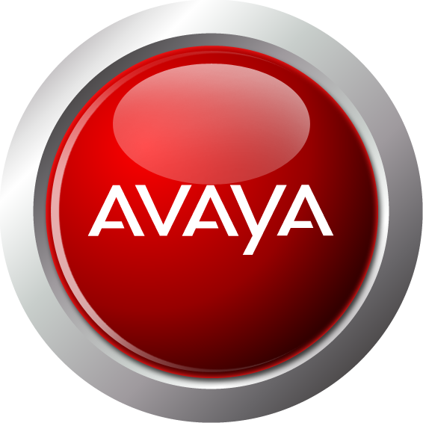



The Markets We Serve
Continuing aggressive investment in the Portfolio
Ethernet
Switching
Wireless
Networking
Unified
Branch
Access
Control
Unified
Management
Enterprise Campus
Branch
& Remote
Data Centers
Notes:
Avaya’s unique product and value offering allows Avaya the ability to serve the entire Enterprise market from campus to data centre to branch. Avaya’s data networking portfolio is grouped into five broad areas:
Ethernet Switching – a range of Modular & Stackable Chassis LAN Switches for Data centre, Core, Edge, and Branch applications
Wireless Networking – a complete solution enabling Enterprises to deploy Wireless coverage with a secure, cost-effective and highly scalable infrastructure
Unified Branch – a range of Routers and VPN Appliances that provide secure remote connectivity and application support for Branches and individuals
Access Control – solutions that integrate with current network infrastructures to provide the central policy decision to enforce role-based Access Control to the network
Unified Management – providing support for data and voice networks as well as heterogeneous network infrastructures, simplifying the requirements associated with managing faults, configuration, accounting, performance and security
A key element of our portfolio is the ability of our products and solutions to scale across the Enterprise – delivering a consistent set of services to the business regardless of “size” or “geography”.
We’ll now look at the high level product roadmap for each of the portfolio areas…

Slide 6
Avaya
Virtual Enterprise Network Architecture
Delivering Valuable Differentiation

Slide 7
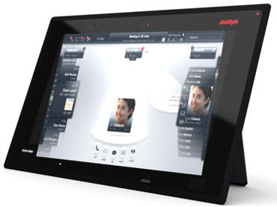





Avaya’s Vision for the Enterprise
Deliver breakthrough experience
Offer compelling applications in growth areas
Upgrade to session based environment
Virtualized
Services
Next-generation Cloud network infrastructure
Avaya
VENA

Slide 8



Enterprise-wide Virtualized Services
Simplify Configuration & Management
Efficient service activation – free of error & delay
Optimized Traffic Separation
Ensure regulatory compliance & multi-tenant partitioning
Delivering Network-as-a-Service
Creating the only optimized end-to-end Cloud architecture
Notes:
Extending Virtualized Services
Simplified Configuration & Management including efficient service activation – free of error & delay.
As virtualization becomes more widely deployed, networks will inherently become much more dynamic than they are today. Having an end-to-end solution that simplifies the perpetual adds, moves and changes within a network is critical - especially given the fact that human error in provisioning services accounts for almost 40% of all network downtime. This is just as important in the campus network as it is in the Data Center; Avaya, like our customers, understand that availability is an end-to-end equation.
With VENA, virtual networks can be created in seconds with single touch provisioning. The core is built out one time and when new virtual networks are required - supporting new applications or new communities of interest - they are provisioned solely at the edge of the network without requiring any manual change of the core. This dramatically reduces service activation from the days and months necessitated by today’s legacy networks. Also, it essentially eliminates the human error factor and thereby increases availability.
Optimized Traffic Separation - Ensures multi-tenant partitioning & regulatory compliance
In many organizations, there is a business requirement for separation of traffic. This could be for regulatory or security reasons, or it could be because a central IT organization supports departments or subsidiary companies – each with their own unique needs – but there is a common need to access a common set of business services. With the extension of VENA into the campus network, setting up these distinct communities is both simplified and optimized. Now, traffic separation can be truly end-to-end, without traffic being re-combined into shared networks within the core; a very common requirement within legacy networks.
Creation of the only optimized end-to-end cloud architecture
We are the only vendor creating an enterprise-wide model for delivering highly resilient access to applications and services with light-touch provisioning. This ultimately reduces operational expenses and simplifies the overall management of the infrastructure. Avaya has defined a single, consistent model that spans from user to content, one that retains the most efficient elements of our proven always-on heritage, together with the advantages of a sophisticated, standards-based and carrier-proven capability. Crucially the Avaya VENA solution does not suffer from the limitations of single points-of-failure and the need to interconnect differing forms of technology as per our rivals, one for the Data Center and others for the Campus and MAN/WAN.

Slide 9








Empowering the Cloud
Enhanced Shortest Path Bridging
Simplified network design and operations, regardless of topology
Simple, error-free provisioning at the Edge
(no re-configuration of the Core)
Empowers Cloud Computing
  Applications can be turned on anywhere on demand
  Application delivery location is transparent to end users
  Inter-Cloud Connectivity – Private/Private, Private/Public
Realizing the Full Potential of Virtualization
  Creating a closer tie between application virtualization and network virtualization
  Moving to full north/south, east/west virtualization
Shifting the Focus to Visibility & Manageability
Automatic, any-to-any, multiple-path connectivity with instantaneous re-route
Reliable, optimized end-to-end, any-to-any connectivity
Notes:
Empowering the Cloud
Most enterprises are looking at ways to reduce cost and improve time to service. Most also are looking for ways to improve the operational efficiency of the data center. Wouldn’t it be nice if you could deploy a new application across multiple data centers in an instant? Wouldn’t it be nice if we could allow IT the ability to simply say “yes’ when there is a new application or service needing to be deployed on the network..?
With the Virtual Enterprise Network Architecture, Avaya is going to improve network uptime by delivering the infrastructure that creates the private cloud and nearly eliminate user-error network outages. We are reducing the time to service with simple one touch provisioning and we are improving the data center efficiency with a tighter integration between applications and network virtualization. We are reliably connecting users and content, with the lowest Total Cost of ownership in the industry. With an Avaya data network, you will get more IT work for every dollar spent.

Slide 10




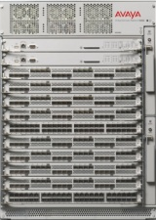

Virtualizing the Campus Core
Switch Clustering
User Access
Delivers end-to-end application availability
  Extends to Servers, etc
Solutions that scale Enterprise-wide
  Cost-effective every network size
Greatly simplified hardware, software, configuration, & maintenance solution
  Simple to deploy, less complexity & expense
Industry-leading sub-second failover & recovery
  Delivers availability & in-service maintenance
Open & interoperable
Leverages simple & ubiquitous functionality
All Links & Resources
are fully active
Fault tolerance
& instant recovery
Optimises end-to-end availability
Applications
& Services
Switch Clustering
Notes:
Virtualizing the Campus Core
Avaya’s ‘Switch Clustering’ capability is built using technology that is unique to our products (Split Multi-Link Trunking), yet it is fully interoperable with 3rd Party Switches, Servers, Appliances, and Routers. What this delivers is a series of benefits that are genuinely differentiated; whilst it may be possible to simulate certain individual elements, there is no competitive offering that can rival the combined capabilities, particularly in terms of simplicity and efficiency.
Delivers end-to-end application availability – Non-proprietary solution that extends beyond Switches to Servers, etc.
This means that the high-availability is not limited to only the Switching network (the Switches themselves and their direct links), but to the total network; importantly also extended to attached Servers, Appliances, and WAN Routers, etc. All competing offers are based on interaction within the Switch domain, and crucially do not extend to the application hosts themselves.
Technically-speaking: almost every other rival offering is based around variations of the Spanning Tree Protocol; however this is limited to the actual Switches and is not supported by other devices (Servers, etc). By excluding Servers from the active resiliency technology, these solutions cannot extend availability to the applications themselves. Avaya’s Switch Clustering is independent of STP and extends to support any device that utilises Link Aggregation, a technology that is both basic and ubiquitous. Devices that attach to the Switch Cluster create a virtual connection using multiple physical links, this provides resiliency together with additional capacity.
Solutions that scale Enterprise-wide – Cost-effective solutions for every network size; Not limited to top-of-the-range product
Business processes that demand high-availability are typically also deployed company-wide; therefore it is imperative to deliver consistent levels of resiliency across the entire network. Avaya is uniquely positioned in being able to offer the same capability, built using the same technology, in a broad range of platforms that scale in both price and performance matching various requirements across the network. This enables the consistent delivery of a network that is itself consistently delivering end-to-end application availability, regardless of location or size.
Technically-speaking: Avaya’s Switch Clustering to built on the basis of the Split Multi-Link Trunking protocol, and with only minor implementation variations it is a available on four different product families: ERS 5000 Series fixed-format Stackable Switches, ERS 8300 mid-tier Modular Switch, and ERS 8800 Campus Core Modular Switch, and now the VSP 9000. The only technology to rival Switch Clustering (Cisco’s Virtual Switching System, which is a direct copy of the underlying philosophy) is only available on the top-of-the-range version of the top-of-the-range Modular Switch, making it economically unfeasible to deploy network-wide.
Simplified solution; hardware, software, configuration, & maintenance – a capability that is not easily replicated, that is simple to deploy, & does not require complex and/or expensive products
The various capabilities and benefits that Switch Clustering provides are delivered without complexity, without the need for expensive hardware or software, and without the need for complex configuration or on-going maintenance. This ensures that the business benefits are not ‘purchased at any price’; indeed Switch Clustering uniquely combines both simplicity with cost-effectiveness. While some of the individual capabilities can be simulated using other techniques and/or a myriad of additional products, this approach only adds cost and complexity.
Technically-speaking: just one example, Switch Clustering delivers User pre-session load-sharing access all Uplinks from the Access Switch to the Core; this capability is automatically enabled without the need for any additional hardware, software, or configuration. To attempt to replicate this level of capability in a STP-based network, it would need to have multiple VLANs with MSTP/RSTP configured, a Layer 3-enabled Switch with Routing and ECMP configured, any even then this solution would be limited to pre-VLAN load-sharing only (not pre-session).
Sub-second failover & recovery – Delivers the necessary availability plus facilitates in-service maintenance and optimised performance
Switch Clustering is probably best known for delivering sub-second failover and recovery, and whilst this remains an extremely important and valid feature it’s not necessarily a feature that is unique to us. What Avaya continues to deliver in this area is a degree of network recovery which also facilitates in-service maintenance. The deterministic nature of Switch Clustering empowers network operators to compartmentalise the network, making essential services even more resilient, and allowing for individual failures to be repaired in real time, without service restoration work impacting on collateral components or applications.
Technically-speaking: enhancements to STP – namely Rapid Reconfiguration – can be aggressively configured to deliver similar levels of failover performance. However all flavours of STP remain tied to the concept of detecting and acting upon changes to the network topology. This makes a network extremely sensitive to the reliability and availability of particular devices (Root Bridges, etc). Avaya’s Switch Clustering is built around the concept of mirrored devices and virtualised capabilities, such that an entire Switch can be removed (through failure, or for emergence or routine maintenance) without any loss of overall application availability.
Proof-Points:
Resiliency – Always-on networking; the creation of a highly availability, virtualised Core Switch that provides fault-tolerant, sub-second recovery.
Efficiency – Simplified, minimised architecture utilising less and less complex equipment
Performance – Active-active utilisation of all resources – Links and Layer 3 Routing engines.
Multivendor – Leverages Standards-based, and ubiquitous, connectivity technology to interwork with 3rd Party LAN Switches, Servers, Appliances, Router, etc.

Slide 11








Future-proofing Performance
Route Switch Processor
Re-Programmable Packet Processor
Standards & features are constantly evolving
Avaya’s RSP supports in-life upgrades
  Empowers continual evolution
Maintains full-life optimization
Traditional ASIC-based designs cannot flexibly adapt
  Capabilities are locked-in during the product design
  Newer applications diverted to the CPU for processing
  Reducing performance & increasing latency
RSP
CPU
All traffic supported by the fast-path RSP
User
Access
Business
Content
Traditional ASIC
ASIC
CPU
Complex traffic routed from the ASIC to the CPU
Notes:
Future-proofing Performance
The networking industry is a perpetual work-in-progress, an ‘unfinished masterpiece’, and the number of Standards and recommendations now runs into the thousands. Equipment that is based on a traditional ASIC architecture are limited in that these are set at a certain point in this history and cannot easily adapt to future change; typically this means that newer features and functionality are no longer supported only in hardware and require additional software processing. The switching architecture of the VSP 9000 is uniquely based on Network Processing Units (NPU) rather than the ASIC technology typically found in rival products
NPUs are large-scale CPU arrays specifically designed for network-related functions such as efficient examination and manipulation of packet headers. Avaya’s specialized high-performance NPU is known as the Route Switch Processor (RSP) and is an in-house development. It delivers fast-path protection through its ability to support in-life firmware upgrades and provides 10Gbps line rate switching and routing capabilities regardless of Standards evolution. Avaya has been able to leverage this re-programmable capability to deliver new innovative features, such as IPv6 and our flexible IP VPN suite, and is unique in being able to ensure emerging functionality is continuously delivered with hardware-based performance levels.
The VSP 9000 reduces complexity and risk in network design by simplifying the network architecture and increasing value with advanced features on high-density modules. High port density, combined with rich capabilities and leading reliability technologies, deliver exceptionally high value to the Enterprise. Avaya’s RSP technology, based on this flexible NPU architecture, offers investment protection with the in-field firmware upgrade capability, and ensures that the VSP 9000 remains ever-green, always delivering hardware-based performance.
Technically-speaking: A well-known rival product – one of the many that utilize ASIC technology – is only able to deliver IPv6 forwarding performance at just 50% of the levels claimed for IPv4. This is prime example of how newer features cannot be guaranteed at the same hardware-based performance levels unless there is an ability to upgrade the architecture; this is the advantage that Avaya’s unique NPU design provides, and we continue to leverage this for evolving and emerging functionality such as virtualization and Shortest Path Bridging.

Slide 12

No-compromise Edge Networking
Stackable Chassis
User Access
Virtual hot-swap capability
  Enables in-service maintenance & restoration
No single point-of-failure
  Distributed power and forwarding
High-capacity virtual backplane
  Industry-leading, pay-as-you-grow scalable capacity
Simplified implementation & management
  Centralised management, automatic software & configuration control
Stackable Chassis
Standards-based
Access features
Automatic Unit Replacement
Distributed
architecture
Linear
scalability
Bi-directional
multi-path forwarding
Virtualized Core
Flexible Advanced Stacking Technology
Notes:
No-compromise Edge Networking
Stackable Ethernet Switches have become increasingly popular in the Wiring Closet, and are often selected in preference to Chassis-based alternatives. Price will often have a significant influence on decisions, especially when the multiplying factor of numerous Closets translates into the potential for a very large delta. However not all ‘Stackable Switches’ are created equal. Not all provide a genuine alternative option to the Chassis, and not all deliver the performance, resiliency, and ease of operations crucial in an Enterprise environment; some are not even truly Stackable.
Avaya’s portfolio of Stackable Switches is the result of the progressive evolution of a number of historically innovative products. A common thread that links the portfolio is a truly resilient, high-performance Stacking architecture – Flexible Advanced Stacking Technology (FAST) – this is what makes Avaya genuinely unique, and genuinely different to competitive offerings.
Virtual hot-swap capability – Enables in-service maintenance & restoration
This crucial serviceability and operability feature ensures that any unit failure can be quickly and easily rectified. It is a hot-swap capability pioneered in Modular Switches, and now also available on Avaya's Stackable Switches, made possible by virtue of intelligent virtualisation of the Stacking connections. Enabling immediate like-for-like unit replacement without impacting the remaining Stack functionality and traffic, and without complex engineering intervention empowers Operators to deploy our Stackable solutions just as they would a Chassis.
Technically-speaking: When a failure occurs the neighbouring Switches will automatically wrap their Stack connections ensuring that collateral Users are not impacted. The failed unit is simply disconnected from the Stack and a like unit – without any pre-staging of software or configuration – can be inserted, cabled, and powered-up. The Automatic Unit Replacement (AUR) process then self-manages any necessary downloads to the new Switch and then brings it online; all of this without the need for an Engineer to configure or manage a thing.
No single point-of-failure – Distributed power and forwarding
With a Chassis solution this has meant N+1 Power Supplies and even redundant Switching Fabrics. With our Stackables it is much the same but without the cost penalty: each unit has an independent Switching Fabric, and as each ‘Switching Module’ has an independent power supply it means that there is no one single point-of-failure. Adding a Redundant Power option further enhances the overall resiliency of the solution. Any individual element failure is equivalent to the failure of a single Module within a Chassis.
Technically-speaking: Frame Forwarding decisions are distributed across each independent Switching Fabric. When a frame forwarding decision results in the need to forward the frame to another Switch in the Stack, the Stack forwarding algorithm determines whether the frame will traverse the up or down Stack link, or possibly both.
More general Stack management functions are performed by a ‘Base Unit’ (BU), which selected as part of initialising the Stack. Once normal operations have been established, if the BU (Unit 1) fails or is rebooted, the next Switch (Unit 2) will take over as Temporary BU (TBU) and remain as such until either it is reset or the entire Stack is reset. If only Unit 2, as TBU, fails or is reset (but entire Stack is not reset), then the TBU status will transfer to the Unit 3, the next downstream unit in the cascade.
High-capacity virtual backplane – Industry-leading, pay-as-you-grow scalable capacity
With a Chassis solution it’s been a given that performance comes as a natural function of design and price. With our Stackables we’ve been able to combine non-blocking internal switching fabrics with high-speed stacking architectures to deliver a truly high performance solution. The Avaya FAST architecture is not bound by the limitations and constraints facing other Vendors (such as Token Sharing/Passing systems, or basic Cascading), and has been specifically designed to scale proportionally as new member Switches are added to the Stack; as more ports are added and the requirement for more bandwidth grows.
Technically-speaking: A Di-Directional Shortest-Path Traffic Forwarding capability is at the heart of our resilient Stacking architecture, ensuring that the shortest, most optimal forwarding path is selectively chosen for each unique data flow. There is none of the unwieldy logical Ring or Token technology that Competitors use, but a star-based distributed forwarding topology that allows traffic to flow either ‘upstream’ or ‘downstream’ simultaneously from every Switch in the Stack, optimising both performance and resiliency.
The various implementations of FAST scale capacity according to the market positioning of the different product lines. Ranging from 4Gbps per Switch and up to 32Gbps per Stack for the entry-level ERS 2500 Series, and on up to 144Gbps / 1.152Tbps for the premium ERS 5600 Series. Avaya delivers Industry-leading Stacking capacity in all market segments.
Simplified implementation & management – Automatic software & configuration control, and centralised management
With a Chassis solution it is simply a case of adding a new Module, adding configuration, and connecting devices. With our Stackables it is much the same: simply cable-in a new Stack member, extend the appropriate configuration – the Stack is managed as a single network entity.
Technically-speaking: The Automatic Unit Replacement (AUR) feature is the process that delivers the Agent Image software, the Configuration file, and the Diagnostic Image software to any additional or replacement Switch; it self-manages any necessary downloads to the new Switches and then brings it online.
The entire Stack operates, appears, and is managed as a single network entity, with specific Stack IP and MAC Addresses.
Proof-Points:
Resiliency – Always-on networking for the Edge; a fault-tolerant, actively resilient ‘Stackable Chassis’ that empowers a virtual hot-swap capability.
Efficiency – Highly energy-efficient Switches provide real and immediate cost-savings in every Wiring Closet.
Performance – High-capacity Stacking connections create a high-speed virtual backplane.
Security – Implements sophisticated, open, granular network access control.
Multivendor – Once the ‘Stackable Chassis’ is created it can interwork in an open-vendor environment, utilising all common L2 and L3 protocols.

Slide 13
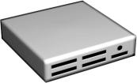
Future-Proofing the Data Center
Horizontal Chassis
High bandwidth & low latency
  Optimises Server-to-Server communication
Reduces the number of ports required on the Core
  Reduces costs & complexity
Simplifies cabling between Server & Switch
  Reduces complexity & maintains rack cooling integrity
Easily scale capacity (Switches & Uplinks)
  Zero network downtime for maintenance or failure
Virtualized Core
Horizontal
Chassis
Space
efficient
High-capacity
Stacking & Uplinks
Fault-tolerant
connectivity
Flexible
designs
Racked Servers
Notes:
Future-Proofing the Data Center
The consolidation of critical resources places a greater burden on network availability and performance. 24 x 7 access to applications and data stores is a common requirement in most enterprises. Any disruption in network service within the Data Centre has repercussions throughout the business. These effects are different in nature, scope and severity depending on the type of enterprise, but the effects are all negative and likely impact the enterprise’s revenue. The availability of applications begins with the availability of the network.
By leveraging Avaya's resilient architecture Horizontal Stacking provides a unique solution to solve today’s challenges in the Data Centre. The concept is simply a variation of ‘normal’ vertical stacking and sees the Switches cabled in a horizontal orientation. This now allows Switches to be deployed directly into multiple racks yet to function as part of a high-performance Stack. No special software or configurations are required to take advantage of this unique physical solution.
High bandwidth & low latency – Optimises Server-to-Server communication
Avaya's premium Stackables supports up to 144Gbps of Stacking capacity per Switch – up to 1.152Tbps for a Stack of eight units – and these capabilities allow a high-bandwidth pipe between all of the Servers that are interconnected on the same Stack.
The latency for server-to-server communication can be reduced from milliseconds to microseconds by utilizing Avaya's Stacking technology. The hardware-based forwarding and unique Stacking algorithm support an Industry-leading 9μs average port-to-port latency within a Stack. This order of magnitude improvement can be critical to time-sensitive applications and is near mandatory when working in high-speed computing and grid computing environments.
Reduces the number of ports required on the Core – Reduces costs & complexity
By being able to effectively Stacking the Switches, there is a reduction in the number of uplinks required to the Distribution/Core Layer. The number of uplinks and the speed of those uplinks (Gigabit or 10 Gigabit) are dependent on the amount of traffic expected to traverse the uplinks; this is dependent on types of applications and amount of data flow expected. However simplifying the network design – focussing on fewer, higher-capacity links to the Core – reduces the costs, both in capital procurement and operational management terms.
Simplifies cabling between Server & Switch – Reduces complexity & maintains rack cooling integrity
The Data Centre continues to evolve; with a transition from few, large systems to many multiple low-cost ‘CPU Cores’ – essentially Intel-class commodity Servers configured for massively-paralleled processing. This trend has had a corresponding impact on the requirements for network connections, sometimes exacerbated by the fact that often these Servers come equipped with multiple Interface Cards.
Administrators also are taking advantage of multiple network connections, separating the production traffic from the data backup traffic across different networks. This increased number of connections requires many more cable runs from the Servers to the network equipment, and has initiated the trend of distributing the network equipment into Server racks, as opposed to running all those cables to a centralized network rack.
Avaya's Horizontal Stacking provides a physical advantage of retaining the vast majority of cabling within the Server Rack, with only Stack and Uplink connections needing to exit. As any planner with attest, power, cooling and the physical/environmental aspects of Data Centre operations can be the most challenging. Avaya's solution exceeds the typical performance and availability requirements, yet also simplifies cabling and proactively avoids compromises to the all-important air-flow/cooling characteristics of high-density Server installations.
Easily scale capacity (Switches & Uplinks) – Zero network downtime for maintenance or failure
A Horizontal Stack can range in size from two Switches and up to eight; delivering up to 384 ports of non-blocking Gigabit Ethernet and also up to 16 ports 0f 10G. Switches can be added to the Stacks without affecting existing operations. This allows for pay-as-you-grow functionality and no need for network downtime to add capacity.
And because continuous availability requirements makes it nearly impossible to schedule any outages for routine maintenance or reactive restoration, the virtual hot swap capability delivered through Avaya's ‘Stackable Chassis’ is a crucial benefit. Hardware failures, albeit rare these days, can be immediately rectified by a simple like-for-like swap, without the need for expensive engineering support or service-impacting emergency maintenance outages.
Proof-Points:
Resiliency – Always-on networking for the Edge; a fault-tolerant, actively resilient ‘Stackable Chassis’ that empowers a virtual hot-swap capability.
Performance – High-capacity Stacking connections create a high-speed virtual backplane.
Multivendor – Once the ‘Stackable Chassis’ is created it can interwork in an open-vendor environment, utilising all common L2 and L3 protocols, including any Server vendor implementing Ethernet.
Efficiency – Highly energy-efficient Switches provide real and immediate cost-savings.

Slide 14



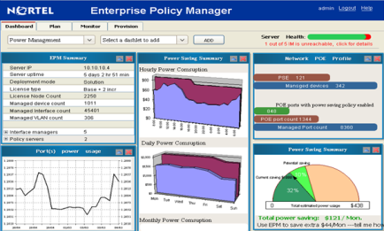
Energy-Efficient Networking
Multi-Faceted Efficiency
Energy Saver
High-priority Phones remain available
Efficient by Design
  Reducing Campus layers & devices; less equipment translates into reduced consumption
Optimised power consumption
  Drives immediate operational savings – up to 40% more efficient than rivals
Service integration & device consolidation
  Reduces equipment levels, optimizes performance, & also streamlines management
Low-priority Phones
set to power-off mode
PC connections
set to power-save mode
ES-enabled Switch
Fully granular or
‘one-click’ configuration
Network stays available, simply in ‘eco-mode’
Enterprise LAN
Detailed views of consumption & savings
Enterprise Policy Manager
Network-wide energy policies & reporting
Notes:
Energy-Efficient Networking
Avaya continues to drive energy efficiency and in order to deliver important cost-of-ownership advantages to our Customers. ENS product design allows Enterprises to build networks that are inherently more efficient and effective through pioneering technology and techniques, energy-efficient hardware, and innovative features – all of which converge to create a truly efficient Enterprise-class network, one that minimizes capital equipment and costs, optimizes all available resources, and reduces operational burden and expense.
Efficiency by Design – Reducing Campus layers & devices; less equipment translates into reduced consumption
Avaya's ERS products provide solutions for both the 2-Tier and 3-Tier design alternatives. However, Avaya's unique feature set allows network architects to implement the first option with routing centralised in the core, and a simplified edge. This translates into the lower cost of ownership (TCO) – fewer and lower cost Access Switches, together with less configuration and management complexity – without sacrificing any other design requirements of the modern Converged Campus network.
Technically-speaking: Currently, there are two major architectural options for building Converged Campus LANs – the 2-Tier design, in which Wiring Closet Switches terminate directly into Core Switches, and 3-Tier design option where Access Switches are aggregated through intermediate Distribution Switches (which in turn terminate on the Core). When utilising the unique feature set available in Avaya's ERS products, which includes Split Multi-Link Trunking (SMLT), Routed Split Multi-Link Trunking (RSMLT) and/or VRRP active-active Backup Master, a 3-Tier architecture is not required and is not normally implemented. It can be used of course, for example in cases where the existing fibre cabling plant can not easily support a 2-Tier design.
Optimised power consumption – Drives immediate operational savings – up to 40% more efficient than rivals
Reducing the costs associated with energy consumption is an objective on the agenda for many businesses. Whilst the per-unit costs vary – seemingly at the whim of OPEC and the energy suppliers – there remains an overriding desire to reduce consumption, particularly in light of the fact that more and more business processes are being ‘electrified’. Significant reductions in consumption has the additional knock-on advantage of lowering a company’s carbon footprint, however the primary goal will always be to reduce costs.
This is an area where Avaya has a proven and significant energy efficiency advantage; ERS up to 40% & Secure Routers up to 29% lower power consumption then rivals. There are a whole series of Tolly and other 3rd Party reports available proving that the vast majority of Avaya products consume significantly less power than equivalent products from the likes of Cisco and HP ProCurve. And this advantage spans the entire infrastructure; not just individual products – Data Centre to Desktop – a where virtually model from every portfolio, ensuring that the difference in the total network consumption profiles is pronounced.
Technically-speaking: an example Ethernet Routing Switch leverages a number of hardware and software features to deliver optimum energy efficiency. To begin with, the majority of our Switches utilise highly-efficient merchant silicon; years of experience and development ensure that these exhibit the best energy and heat management properties, and coupled with low-loss power supplies the underlying hardware is highly energy-efficient.
Avaya's additional value-add comes in the intelligent usage of power within the device and also for external purposes such as Power-over-Ethernet. Avaya is introducing a feature to be known as ‘Avaya Energy Saver’ which will enable network managers to operate their network at reduced power levels during those times when it is typically idle; for example after-hours and over weekends. NES will have both highly granular configuration and ‘one-click’ options and will extend to enabling low-priority IP Phones to be powered-down during these eco-mode periods.
Service integration & device consolidation – Reduces equipment levels, optimises performance, and also streamlines management
Consolidate branch networking functions into fewer integrated devices to reduce network complexity and streamline capital and operational costs.
Technically-speaking: a good example of effective device consolidation is the Avaya Secure Router 4134, a modular, multi-service platform that integrates multiple networking functions, including routing, WAN, Ethernet switching, security and Voice over IP (VoIP) into a single device. The platform's design ensures the consistently high throughput required by voice, data or unified communications applications. The first device of its kind to feature embedded Microsoft intelligence to simplify deployment of unified communications, the Secure Router 4134 can reduce the number of devices needed at the Branch or Regional site, generating substantial operational and capital cost savings for your business.
Proof-Points:
Multivendor – Developing relationships and capabilities with the building management industry to build a real-time, fact-driven holistic capability around the reduction in energy consumption.
Efficiency – More intelligent design, using less & less complex equipment, an extremely energy-efficient suite of products, new capabilities to save even more energy during ‘quiet times’.

Slide 15







Simple, Innovative, & Effective VPNs
IP VPN-Lite & MPLS
Operates over any IP network
  Quickly deployable & easily supportable
Simplified management, administration & maintenance
  Stark contrast with complex, multi-layered MPLS
Provides ultimate resiliency, simplicity, & performance
  Leverages Avaya’s proven resiliency technology
Co-exists & interoperates with MPLS Service Providers
  Maximum flexibility & scalability
IP VPN-Lite
Enterprise-class
simplicity
Metro Network
(Native IP)
Complete flexibility
IP VPN-Lite
End-to-end
connectivity
IP VPN-Lite / MPLS Router
Wide Area Network
(MPLS)
Service Provider-class complexity
*Deployment Options:
- IP VPN-Lite only
- IP VPN-Lite & MPLS
- MPLS
MPLS Routers
Notes:
Simple, Innovative, & Economical VPNs
To facilitate Virtual Private Network (VPN) communications between people, locations and devices, Multi Protocol Label Switching (MPLS) is a widely deployed standards-based WAN transport technology that has been used by service providers for many years.
The technology has proven itself to be reliable, flexible and efficient, but it’s not without its shortcomings. While MPLS might appear simple, it’s actually very complex to implement, maintain and manage. And, as with many complex and sophisticated technologies, MPLS also requires the costly and highly trained IT resources to go with it to ensure smooth set-up, effective management and ongoing maintenance of the system.
Until now, organizations that required IP VPN services in their Metro or Campus environments have been forced turned to MPLS technology – even with its complexity and its associated high costs. However the good news is that there is now an alternative to using MPLS for IP VPN services – Avaya IP VPN-Lite.
Operates over any IP network – Quickly deployable and easily supportable
IP VPNs, generically, are used for inter-office connectivity and also to create trusted connections to partner organizations; they leverage IP as the common carriage, and remove a dependency on specific wide area technologies (e.g., frame relay or ATM) or Service Providers. An innovative, simplified IP-in-IP solution, IP VPN-Lite, uses unique Avaya technology to deliver a solution that does not require the underlying complexity of MPLS.
Technically-speaking: Avaya’s IP VPN-Lite leverages flexible forwarding engines (the ERS 8600’s Route Switch Processor), and reuses all of the signalling and control mechanisms of existing IETF BGP-based IP VPNs, which means that it works with existing BGP/MPLS IP VPN networks.
Simplified management, administration & maintenance – In stark contrast to the more complex, multi-layered MPLS
Avaya’s IP VPN-Lite solution has the additional benefit of being inherently less complex and therefore more cost-effective than MPLS. Managing IP VPN-Lite versus MPLS is much simpler and doesn’t require that IT personnel that are be specially trained on MPLS; which can be difficult to find and costly to hire.
Technically-speaking: IP VPN-Lite uses Standards-based IP Routing technologies, enabling organizations to reuse all existing BGP control plane skill and familiarity without the need for additional training – resulting in significant operational cost savings. IP VPN-Lite is simply ‘IP-in-IP’, making troubleshooting more straightforward and easier, since IT staff doesn’t have to decipher MPLS labels at every ‘hop’ across multiple layers.
Provides ultimate resiliency, simplicity, and performance – Leverages Avaya’s proven resiliency technology
Offers the ultimate in resiliency at the Core and Edge through Routed Split Multi-Link Trunking (RSMLT), eliminating the burden of having to configure backup MPLS transport tunnels and manage resiliency for each on an individual basis.
Co-exists & interoperates with MPLS – Uses standardised extensions for maximum flexibility & scalability
MPLS and Avaya IP VPN-Lite can co-exist in the same system and operate in parallel. If there is already have a Service Provider-operated MPLS WAN in place, IP VPN-Lite can be used to seamlessly extend existing VPNs connections into the Campus or Metro area. By deploying IP VPN-Lite this way, there’s no need to change the WAN and no requirement to deploy MPLS in the Enterprise Campus.
Proof-Points:
Resiliency – Leverages Avaya proven Switch Clustering to ensure fault-tolerant, sub-second recovery.
Performance – Active-active utilisation of all resources – Links and Layer 3 Routing engines, and reduced protocol overhead through the avoidance of MPLS.
Security – Privacy and isolation of traffic and data through the creation of separate communities-of-interest.
Multivendor – Leverages common Standards and is fully interoperable to existing IP Routing topologies.
Efficiency – Simplifies confirmation and management burden.

Slide 16


A Case for Positive Discrimination
Automatic Quality-of-Service
Performance is placed at risk by the chaos of self-regulation
  Business-critical applications contend with everything else
Automatic QoS optimizes application performance, end-to-end
Configuration is simplified
  3rd Party applications are handled as default
Gives tangible benefits to Avaya Customers
  Applications & Networks become synchronized
User Access
Private QoS
Generic QoS
Zero-touch Configuration
AQoS-enabled Switch
Configuration simplified
& automated
QoS honoured
end-to-end
Optimises Avaya Data
for Avaya Voice
AQoS-enabled Core
Private Application
Generic Application
Application Access
Notes:
A Case for Positive Discrimination
Traditionally, the ease way of supporting grow in applications is to simply throw more bandwidth at the network – increasing port speeds and uplink capacity. Indeed, this can work for old style data-centric applications, however modern latency-sensitive applications are a more sophisticated approach: a combination of suitable bandwidth and intelligent Quality of Service.
When considering in the typical Wiring Closet, the reality is that there is more network bandwidth connecting the User PCs then there is in the uplink capacity to the Core. This can often translate into a degree of congestion that will severely impact the performance of Unified Communications and other convergence applications. This simply truth is that additional bandwidth – even assuming that we can afford it, and/or effectively integrate it into the network design – will not always solve the issue. We need a solution which ensures that important application get priority.
Through embedding functionality within its converged networking solutions, Avaya is creating a new operational paradigm built around synergistic, communication-enabled networking and simplicity of design. The ‘Avaya Edge’ focuses on ensuring that the network is easy to deploy and adds an intelligence to reduce the burden of on-going manageability, delivering additional benefits to businesses.
Performance is placed at risk by the chaos of self-regulation – Business-critical applications are forced to contend with everything else
Dependence of new IP-based applications on QoS. The growing need to prioritize new traffic types, such as voice over Internet protocol (VoIP) and real-time video – which require very short latency – in addition to other applications on the WAN is the second key factor shaping consolidation in the application acceleration & QoS technologies market.
Avaya Automatic QoS optimises application performance, end-to-end
Real-time application environments require network intelligence and Quality-of-Service (QoS) which allows the network to understand what to do with high priority traffic in times of network congestion.
Configuration is simplified – 3rd Party applications are handled as default
The configuration of QoS across the network can be time consuming and if incorrectly executed, leads to a sub-standard solution for high-priority traffic. Avaya data, voice, and application products can be enabled for optimised QoS across the network though the Avaya Automatic QoS feature.
Gives tangible benefits to Avaya Customers – Avaya Applications & Avaya Networks are synchronised
Enabling the Automatic QoS functionality seamlessly configures QoS on Avaya IP Phones, Call Servers and Applications, and Ethernet Switches. This allows network managers to easily configure QoS across a Avaya converged infrastructure through a few simple commands or a single click of the mouse, delivering a consistent and optimised QoS configuration. Simple and effective delivery of optimised end-to-end application performance; a tangible manifestation of genuine business benefits of Avaya.
Technically-speaking: An Avaya Automatic QoS-enabled Ethernet switch can identify Avaya applications traffic and dynamically provide the required differentiated services. An Avaya Automatic QoS-enabled Ethernet Switch can operate in two modes: Pure Mode or Mixed Mode. In Pure Mode the Ethernet Switch does not remark the Avaya Private QoS settings (the DiffServ Code Point – DSCP) for Egress. It is used when the Customer network ONLY uses Avaya Automatic QoS-enabled Switches end-to-end.
In Mixed Mode the Ethernet Switch remarks Avaya application traffic for Egress to replace the Private QoS with standard QoS settings. Mixed Mode is used when the Customer network has a mix of Avaya Automatic QoS-enabled Switches: other Avaya Switches and/or 3rd Party Switches (e.g. Cisco, etc).
Pure and Mixed Modes only impact QoS remarking of Avaya application traffic regardless of the type of Ingress port (e.g. trusted, un-trusted), and other types of traffic will be handled by Avaya Automatic QoS-enabled Switches the same way it is currently handled by Avaya Ethernet switches.
In both modes, the Avaya Automatic QoS-enabled Switches will recognise the Private QoS used by Avaya applications. The Switch will map the Private QoS to the corresponding 802.1p/CoS – optimised for Pure, and standard for Mixed – this being used by Switches internally to prioritize traffic.
Proof-Points:
Performance – Guarantees that real-time communications automatically receive optimised performance, all without complex configuration
Multivendor – Supports all existing Applications without modification; interoperates 3rd Party Switches; is extensible for inclusion of other 3rd Party applications.
Efficiency – Provides a ‘one-click’ solution for immediately creating a fully optimised QoS environment for quality-sensitive convergence applications.

Slide 17





Comprehensive, not Complex, Security
Identity Engines
Integrated
Access Control
Improve security with fully granular control
  Role-based control & network compartmentalization
Enhanced Regulatory compliance
  Partitioning of access & comprehensive reporting
Simplicity
  Centralized policy decision, defined in plain language
Reduced costs
  Existing infrastructure & identity stores, virtual appliance option
User Access
Corporate
or Guest
Wired / Wireless / VPN
Consistent &
granular control
Consolidates administration
Centralised &
integrated NAC
Enhances security
& compliance
Simplifies multiple Directories & Databases
Notes:
Comprehensive, not Complex, Security
Avaya delivers proven security solutions including a second-generation network access control solution, with Standards-based support that allows Enterprises to not only securely control who uses the network, but where, when, how and with what type of device.
The Avaya NAC portfolio is about providing a wide range of role-based access options that enhance the security of your network, including a Standards-based solution that integrates with existing network infrastructure, and leverages investment. It centralizes, and thus simplifies, policy decision-making throughout your network, then expresses policies in simple language, removing technology from the equation.
Improve security with fully granular control – Role-based access control & compartmentalization of the network
The key is to access control is in providing only as much access as each user requires, to ensure that user devices are healthy and in compliance with the chosen security policy, and to provide that access in real time. Avaya's solutions facilitate effective NAC by creating a simple-to-deploy multi-dimensional access policy; security is enhanced by the granular nature of access control flexibility.
Reduced costs – Supporting existing infrastructure & identity stores, virtual appliance option
Avaya's solutions allow networks to leverage their existing investment, saving costs and enable additional deployment flexibility. Providing a consistent, centralized access policy eliminates the potential for administrative errors. By putting user information and policy in a single location, policies can be created on a full network-wide basis, supporting LAN, WLAN and VPN consistently.
Solutions such as Identity Engines are easy to deploy, connecting with existing identity system and switching infrastructure. It provides a central policy decision point that streamlines access management, improves security and satisfies reporting requirements. It connects to complex store environments and offers centralized editing of network access policies. It’s also a virtualized solution; no new hardware is required, especially as many organizations have already invested in VMware environments.
Simplicity – Centralized policy decision, defined in plain language
Avaya's NAC solutions are easy to deploy, residing in the Data Centre, providing centralized authentication and authorization for wired, wireless and VPN network devices. They provide centralized integrated security services for Avaya and also third-party Ethernet switching, WLAN and VPN products. And what clearly separates the Avaya Identity Engines solution from rivals is its ability to express policies in plain language.
Enhanced Regulatory compliance – Partitioning of access, & comprehensive reporting & analytics
Many environments are now seeking to apply strict governance to information access, and this can only be enforced and demonstrated through intelligent effective NAC. Avaya's solutions provide the powerful reporting that allows operators to perform in-depth analysis of network activity including ingress and usage. Reporting data is provided by the Avaya Identity Engines Ignition Server, and Ignition Analytics allows for automated data retrieval and report generation.
Proof-Points:
Resiliency – High-availability infrastructure, including virtualised appliances
Security – Granular, multi-dimensional, role-based network access control that encompasses all access technology.
Multivendor – Standards-based, open, and interoperable with existing 3rd Party infrastructure and user identity databases.
Efficiency – Provides a single, centralised, simplified interface for configuration and deployment of access policy; easing administration and reducing errors.

Slide 18
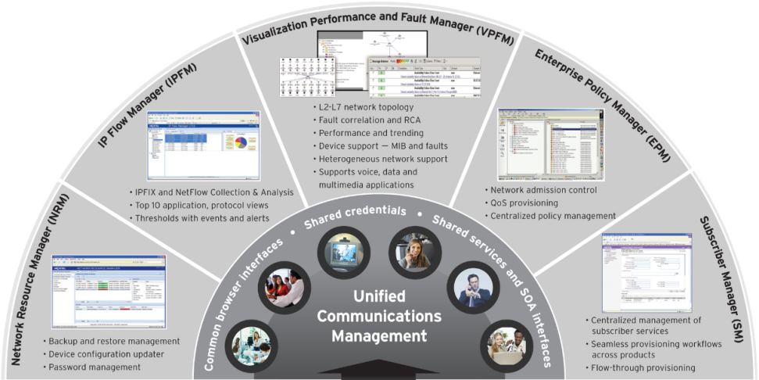











Spanning Voice, Data & Applications
Unified Communications Management
Common look & feel
Navigation to all management applications with single sign-on & centralized authentication
Provides integrated workflows for managing unified communications networks
Decreases the learning curve for IT personnel
Delivers simplified deployment and system administration configuration
Offers deployment flexibility
LAN + Wireless LAN + WAN + Security + IP Telephony
Notes:
Spanning Voice, Data & Applications
Unified Communications (UC) solutions from Avaya remove the barriers between voice, email, conferencing, video and other applications, resulting in a unified communications experience for businesses. Providing a comprehensive management capability across voice, data and multimedia applications, Avaya’s Unified Communications Management (UCM) utilise a set of Common Services that serve as a foundation for unifying management applications. In essence, UCM is the ‘glue’ that binds together distributed components to establish a true unified communications environment.
Offers a common look & feel across applications
To simplify management and improve efficiency, Avaya Unified Communications Management offers users a consistent look and feel, including a standard and easy-to-use web UI that applies to all unified communications-enabled products. Regardless of application, device or what is going on behind the scenes, the UI will always deliver a consistent experience to Users.
Enables navigation to all management applications with single sign-on & centralized authentication
Business scenario: Who hasn’t been frustrated by having to enter and re-enter information over and over again?
By leveraging a common data repository, UCM completely eliminates the need for users to enter important user data multiple times. For customers that have their own directory, such as Microsoft Active Directory, the UCM common data repository can serve as a cache of information for the Avaya applications – and be bulk-loaded and maintained through a convenient LDAP sync utility.
Provides integrated workflows for managing unified communications networks
UCM offers configuration flexibility, including standalone or integrated options, enabling a unified workflow and management experience for administrators as they traverse the network’s call servers and application servers.
Decreases the learning curve for IT personnel
The presence of easy-to-use templates and Wizards allows UCM applications to be managed by network administrators that aren’t necessarily ‘super users’. Rules are easy to define and manage in the Unified Communications Management provisioning tools, lessening the need for expert, highly-paid personal. The implication of this simplification to your ongoing operational expenses is very compelling.
Delivers simplified deployment and system administration configuration
UCM accommodates multiple network management applications on a single server. This co-residency of applications reduces the number of servers required, which can lead to a significant decrease in capital expenses. Leveraging a Single Sign-On (SSO) navigation to all applications, putting an end to swivel-chair management. With SSO, Operators are no longer required to log on to separate systems to perform different management functions. Once an Operator signs on, he or she can navigate to any management functionality, whether it’s network management or management of a specific element, such as a Call Server.
Offers deployment flexibility
An Enterprise’s network management requirements might be simple at first, but can grow quickly as the business evolves. Through UCM, applications can be added easily as required. This means that your organization can start with one management solution, such as the Visualization Performance and Fault Manager or Subscriber Manager, and then add others as business needs change.
Proof-Points:
Resiliency – Enables more consistent configuration creation and execution, empowers Operators to be more proactive.
Efficiency – The common look-&-feel lowers to the ‘TTM’ for new Operators and/or new management applications.
Performance – Provides a toolbox for optimising network performance and delivery; enabling Operators to extract the most from what they’ve already got.
Security – Adds a value of authentication and audit missing from many management solutions.
Multivendor – Although optimised for Avaya ENS products UCM is open-vendor and thus provides the go-to, one-stop-shop application for many heterogeneous solutions.

Slide 19
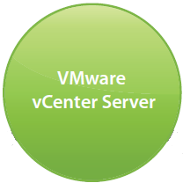



Virtualization Provisioning Service
Creates synergy between Compute & Network
Network provisioning now occurs only at the edge – changes are minimal & instantly propagated
Server provisioning can automatically drive Network provisioning – dramatically improving time-to-service
Virtual Services Fabric
Notes:
Virtualization Provisioning Service
An important component in the evolution to a Virtualized Data Center is to make the network very “efficient” when it comes to managing, troubleshooting, provisioning virtual machines. This includes bringing network level insight and visibility to the virtual machine lifecycle, applying the appropriate network and port level configurations at an individual VM level, dynamically tracking VMs as they move across the Data Center fabric, and enforcing the network attributes of the VMs wherever they migrate in the Data Center.
Avaya VPS is a software application service that acts as glue between VMware’s VCenter & Avaya’s Configuration and Orchestration Manager. VPS provides a relay mechanism to bridge the gap of complete end-to-end provisioning of servers and network devices in fully virtualized Data Center environment. Avaya VPS learns dynamic virtualized server topologies and updates Avaya devices to react to changes in server topologies. It provisions connectivity services (VLANs) on Switch ports based on the actual network connectivity and provisions QoS filter, ACL, i-SID (in case of SPB-based devices) & port profiles (templates) - based on preconfigured rules – to Switch ports.
Provisioning changes can be applied automatically based on a set of predefined rules which are checked and applied to network ports dynamically if the rule applies. They can also be applied manually where there is an alert to the network administrator that there is a change happening within the server environment and then a guided workflow is triggered that would allow them to apply the manual network configuration change. These changes to the network, which can be done in real-time, are critical in ensuring the applications function as they are expected and that moving the VM doesn’t negatively impact end user experience for that particular application,
An area of differentiation for Avaya VPS is its integration with the Avaya Identity Engines portfolio to deliver intelligent rule-based access control for individual VMs. This allows for network administrators to do things like prevent individuals from moving certain VMs in the middle of the day and ensures that specific networks are protected so that only approved VM’s can be connected to them.
Avaya VPS will also provide a wealth of reporting options so that network operators have a clear view of the VM lifecycle and activity (activations, deactivations, changes), it will provide details on what network changes were completed based on user, device, time, type of access etc. Network operators can also customize the alerts that they receive based on the device type, port groups or even server type.
This comprehensive solution is truly brings the virtualized applications together with the virtualized network and ensure that the network constantly is able to adapt to changes in the computing environment, ensuring VM mobility is transparent to the end user utilizing those applications.

Slide 20
Avaya
Ethernet Switching Portfolio

Slide 21
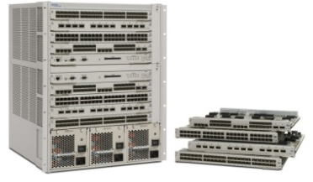
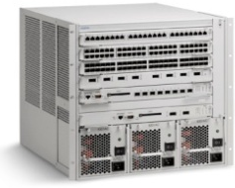
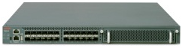
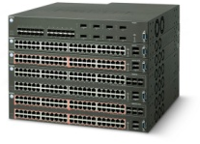
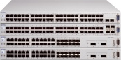
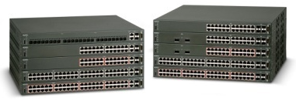
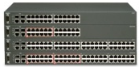
Ethernet Switching Portfolio
Highlights
High-performance plus always-on resiliency
Enterprise-wide Virtualization strategy
Pioneering Switch Cluster high-availability solution
Large Core installed-based
1st to break through the Terabit Stackable boundary
Continuous product evolution
Core
Modular Chassis
Stackable Chassis
Access
Notes:
Ethernet Switching
Avaya’s Ethernet Switching product line provides complete coverage, ranging from entry-level Branch Office, to high-performance Wiring closet and Data Center Server aggregation, through to Network Core applications. The range has been progressively refreshed with new hardware options and software functionality constantly developed; most recently we’ve supplemented with the VSP 7000 future-ready Top-of-Rack offering that delivers the Industry’s leading east-west traffic capacity; up to 5Tbps.
As mentioned earlier, a key feature is “Switch Clustering”, the capability pioneered by Avaya to virtualize the network Core and provide our unique combination of sub-second high availability with optimised performance. Despite attempts by our rivals to imitate, we continue to enjoy clear leadership due to a wealth of experience (hard-earned over the last decade) and our ability to cost-effectively deploy resilient solutions for small, medium and large network sizes. Complementing this is our Industry-leading range of advanced “Stackable Chassis” fixed-format Switches: delivering all of the advantages typically associated with a Modular Chassis Switch, but without the high price.
Further background:
Avaya’s ‘Switch Clustering’ capability is built using technology that is unique to our products (Split Multi-Link Trunking), yet it is fully interoperable with 3rd Party Switches, Servers, Appliances, and Routers. What this delivers is a series of benefits that are genuinely differentiated; whilst it may be possible to simulate certain individual elements, there is no competitive offering that can rival the combined capabilities, particularly in terms of simplicity and efficiency.
Delivers end-to-end application availability
Non-proprietary solution that extends beyond Switches to Servers, etc.
This means that the high-availability is not limited to only the Switching network (the Switches themselves and their direct links), but to the total network; importantly also extended to attached Servers, Appliances, and WAN Routers, etc. All competing offers are based on interaction within the Switch domain, and crucially do not extend to the application hosts themselves.
Technically-speaking: almost every other rival offering is based around variations of the Spanning Tree Protocol; however this is limited to the actual Switches and is not supported by other devices (Servers, etc). By excluding Servers from the active resiliency technology, these solutions cannot extend availability to the applications themselves. Avaya’s Switch Clustering is independent of STP and extends to support any device that utilises Link Aggregation, a technology that is both basic and ubiquitous. Devices that attach to the Switch Cluster create a virtual connection using multiple physical links, this provides resiliency together with additional capacity.
Solutions that scale Enterprise-wide
Cost-effective solutions for every network size; Not limited to top-of-the-range product
Business processes that demand high-availability are typically also deployed company-wide; therefore it is imperative to deliver consistent levels of resiliency across the entire network. Avaya is uniquely positioned in being able to offer the same capability, built using the same technology, in a broad range of platforms that scale in both price and performance matching various requirements across the network. This enables the consistent delivery of a network that is itself consistently delivering end-to-end application availability, regardless of location or size.
Technically-speaking: Avaya’s Switch Clustering to built on the basis of the Split Multi-Link Trunking protocol, and with only minor implementation variations it is a available on four different product families: ERS 1600 Series fixed-format standalone Switches, ERS 5000 Series fixed-format Stackable Switches, ERS 8300 mid-tier Modular Switch, and ERS 8800 premium Campus Modular Switch. The only technology to rival Switch Clustering (Cisco’s Virtual Switching System, which is a direct copy of the underlying philosophy) is only available on the top-of-the-range version of the top-of-the-range Modular Switch, making it economically unfeasible to deploy network-wide.
Simplified solution; hardware, software, configuration, & maintenance
A capability that is not easily replicated, that is simple to deploy, & does not require complex and/or expensive products
The various capabilities and benefits that Switch Clustering provides are delivered without complexity, without the need for expensive hardware or software, and without the need for complex configuration or on-going maintenance. This ensures that the business benefits are not ‘purchased at any price’; indeed Switch Clustering uniquely combines both simplicity with cost-effectiveness. While some of the individual capabilities can be simulated using other techniques and/or a myriad of additional products, this approach only adds cost and complexity.
Technically-speaking: just one example, Switch Clustering delivers User pre-session load-sharing access all Uplinks from the Access Switch to the Core; this capability is automatically enabled without the need for any additional hardware, software, or configuration. To attempt to replicate this level of capability in a STP-based network, it would need to have multiple VLANs with MSTP/RSTP configured, a Layer 3-enabled Switch with Routing and ECMP configured, any even then this solution would be limited to pre-VLAN load-sharing only (not pre-session).
Sub-second failover & recovery
Delivers the necessary availability plus facilitates in-service maintenance and optimised performance
Switch Clustering is probably best known for delivering sub-second failover and recovery, and whilst this remains an extremely important and valid feature it’s not necessarily a feature that is unique to us. What Avaya continues to deliver in this area is a degree of network recovery which also facilitates in-service maintenance. The deterministic nature of Switch Clustering empowers network operators to compartmentalise the network, making essential services even more resilient, and allowing for individual failures to be repaired in real time, without service restoration work impacting on collateral components or applications.
Technically-speaking: enhancements to STP – namely Rapid Reconfiguration – can be aggressively configured to deliver similar levels of failover performance. However all flavours of STP remain tied to the concept of detecting and acting upon changes to the network topology. This makes a network extremely sensitive to the reliability and availability of particular devices (Root Bridges, etc). Avaya’s Switch Clustering is built around the concept of mirrored devices and virtualised capabilities, such that an entire Switch can be removed (through failure, or for emergence or routine maintenance) without any loss of overall application availability.
Stackable Ethernet Switches have become increasingly popular in the Wiring Closet, and are often selected in preference to Chassis-based alternatives. Price will often have a significant influence on decisions, especially when the multiplying factor of numerous Closets translates into the potential for a very large delta. However not all ‘Stackable Switches’ are created equal. Not all provide a genuine alternative option to the Chassis, and not all deliver the performance, resiliency, and ease of operations crucial in an Enterprise environment; some are not even truly Stackable.
Avaya’s portfolio of Stackable Switches is the result of the progressive evolution of a number of historically innovative products. A common thread that links the portfolio is a truly resilient, high-performance Stacking architecture – Flexible Advanced Stacking Technology (FAST) – this is what makes Avaya genuinely unique, and genuinely different to competitive offerings.
Virtual hot-swap capability
Enables in-service maintenance & restoration
This crucial serviceability and operability feature ensures that any unit failure can be quickly and easily rectified. It is a hot-swap capability pioneered in Modular Switches, and now also available on Avaya’s Stackable Switches, made possible by virtue of intelligent virtualisation of the Stacking connections. Enabling immediate like-for-like unit replacement without impacting the remaining Stack functionality and traffic, and without complex engineering intervention empowers Operators to deploy our Stackable solutions just as they would a Chassis.
Technically-speaking: When a failure occurs the neighbouring Switches will automatically wrap their Stack connections ensuring that collateral Users are not impacted. The failed unit is simply disconnected from the Stack and a like unit – without any pre-staging of software or configuration – can be inserted, cabled, and powered-up. The Automatic Unit Replacement (AUR) process then self-manages any necessary downloads to the new Switch and then brings it online; all of this without the need for an Engineer to configure or manage a thing.
No single point-of-failure
Distributed power and forwarding
With a Chassis solution this has meant N+1 Power Supplies and even redundant Switching Fabrics. With our Stackables it is much the same but without the cost penalty: each unit has an independent Switching Fabric, and as each ‘Switching Module’ has an independent power supply it means that there is no one single point-of-failure. Adding a Redundant Power option further enhances the overall resiliency of the solution. Any individual element failure is equivalent to the failure of a single Module within a Chassis.
Technically-speaking: Frame Forwarding decisions are distributed across each independent Switching Fabric. When a frame forwarding decision results in the need to forward the frame to another Switch in the Stack, the Stack forwarding algorithm determines whether the frame will traverse the up or down Stack link, or possibly both.
More general Stack management functions are performed by a ‘Base Unit’ (BU), which selected as part of initialising the Stack. Once normal operations have been established, if the BU (Unit 1) fails or is rebooted, the next Switch (Unit 2) will take over as Temporary BU (TBU) and remain as such until either it is reset or the entire Stack is reset. If only Unit 2, as TBU, fails or is reset (but entire Stack is not reset), then the TBU status will transfer to the Unit 3, the next downstream unit in the cascade.
High-capacity virtual backplane
Industry-leading, pay-as-you-grow scalable capacity
With a Chassis solution it’s been a given that performance comes as a natural function of design and price. With our Stackables we’ve been able to combine non-blocking internal switching fabrics with high-speed stacking architectures to deliver a truly high performance solution. The Avaya FAST architecture is not bound by the limitations and constraints facing other Vendors (such as Token Sharing/Passing systems, or basic Cascading), and has been specifically designed to scale proportionally as new member Switches are added to the Stack; as more ports are added and the requirement for more bandwidth grows.
Technically-speaking: A Di-Directional Shortest-Path Traffic Forwarding capability is at the heart of our resilient Stacking architecture, ensuring that the shortest, most optimal forwarding path is selectively chosen for each unique data flow. There is none of the unwieldy logical Ring or Token technology that Competitors use, but a star-based distributed forwarding topology that allows traffic to flow either ‘upstream’ or ‘downstream’ simultaneously from every Switch in the Stack, optimising both performance and resiliency.
The various implementations of FAST scale capacity according to the market positioning of the different product lines. Ranging from 4Gbps per Switch and up to 32Gbps per Stack for the entry-level ERS 2500 Series, and on up to 144Gbps / 1.152Tbps for the premium ERS 5600 Series. Avaya delivers Industry-leading Stacking capacity in all market segments.
Simplified implementation & management
Automatic software & configuration control, and centralised management
With a Chassis solution it is simply a case of adding a new Module, adding configuration, and connecting devices. With our Stackables it is much the same: simply cable-in a new Stack member, extend the appropriate configuration – the Stack is managed as a single network entity.
Technically-speaking: The Automatic Unit Replacement (AUR) feature is the process that delivers the Agent Image software, the Configuration file, and the Diagnostic Image software to any additional or replacement Switch; it self-manages any necessary downloads to the new Switches and then brings it online. The entire Stack operates, appears, and is managed as a single network entity, with specific Stack IP and MAC Addresses.

Slide 22
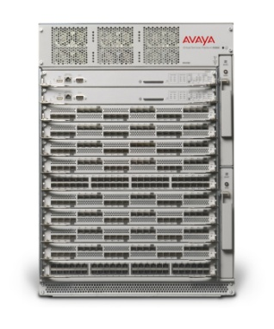
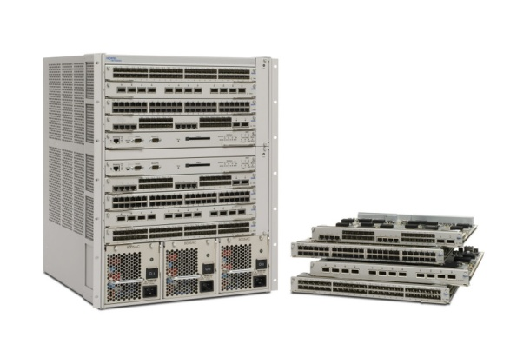
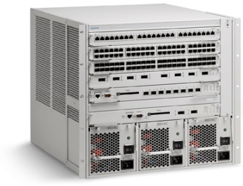
Modular Switch Positioning
Core Switch for large/very large Enterprise Campus and Data Center
High performance & high 10GbE port density
Ultra-resiliency, scalability & 40/100GbE future-ready
Where there is a need for sophisticated IP Routing & Network Virtualization
VSP 9000
Core Switch for large Enterprise Campus & mid-sized (GbE-centric) Data Center
Environments that value high-availability & high-performance
Where there is a need for sophisticated IP Routing & Network Virtualization
ERS 8800
Core Switching solution for mid-sized network
Access Switch for large Enterprises: high-performance Gigabit-to-the-Desktop
Aggregation (Distribution) Switch in multi-tier networks
Where there is a need for straightforward IP Routing & Device Virtualization
ERS 8300
Notes:
Modular Product Positioning
Avaya’s Modular product line consists, today, of the Ethernet Routing Switch 8000 Series – including the 8300 and the new 8800 – and the Virtual Services Platform 9000 which will be introduced in the second half of (calendar year) 2010. Therefore, today, we are able to deliver highly-resilient and high performance solutions for the medium and large-scale Enterprise Campus Core and the mid-sized Data Center requirements. VSP 9000 will enable us to attack the large-scale Data Center market and also allow device consolidation in the largest Campus Core networks.
The ERS 8800 is a development from the field-proven ERS 8600; leveraging a new generation of feature-rich software and new hardware elements to create an ever-green solution for highly-virtualized environments that also value always-on reliability and real-world performance abilities. This remainder of this presentation will focus on the ERS 8800
The ERS 8300 entered service primarily as a high-density and high-performance Modular Switch for the high-end Enterprise Wiring Closet. It has since evolve to also provide an effective option for the mid-sized network Core; supporting Switch Clustering and mainstream IP Routing and device virtualisation.

Slide 23
Virtual Services Platform 9000
Overview & Benefits
Core networking for transparent Cloud Computing
  high-density 10G & 1G
  high availability L2 & L3
  full device Virtualisation
Switch Clustering
  creates a virtual core
  simplifies configuration & deployment
  extends availability end-to-end
  reduces equipment costs
Enables 99.999% reliability
  Deterministic millisecond failover
Future-ready performance
Hardware-assisted resiliency
Simpler design options
Interoperable for end-to-end service delivery
Highlights

Slide 24
Ethernet Routing Switch 8800
Overview & Benefits
Delivers 99.999% reliability
  Deterministic sub-second failover for any IPv4 & IPv6 failure
  Creates a virtual core
  Simplifies configuration & deployment
  Availability extended end-to-end
Convergence-friendly Core networking
  High-density 10G & 1G
  Full device & network virtualisation
  Integrated, automatic quality of service
  Future-ready technology empowers evolutionary capabilities
High-performance resiliency
Simpler design options
Integrated QoS & security
Interoperable for end-to-end service delivery
Highlights
Notes:
Ethernet Routing Switch 8800 (overview & benefits)
The ERS 8800 is currently the flagship product in the portfolio, providing the high level of performance – the most switching and forwarding capacity, and high I/O speeds – and the broadest software feature-set.
It incorporates hardware-level robustness together with enhanced fault-tolerant Switch Fabric and CPU functions, and of course supports the Split Multi-Link Trunking protocol to allow for resilient Switch Clustering; simplifying network design, equipment requirements, and delivering superior performance and reliability.
Background:
What is the Ethernet Routing Switch 8800..?
The ERS 8800 is a new solution that consolidates the field-proven reliability of the ERS 8600 with the enhanced virtualized functionality and improved scalability that a new generation of software delivers
The ERS 8800 solution has been developed to match the transition occurring in Customer networks: the progressive move to emerging, highly-virtualized networking infrastructures from what was largely a single dimension environment
The ERS 8800 is simply the latest evolution of the venerable ERS 8000 Series: which has already delivered the ERS 8100 Edge Switch, ERS 8300 Edge/Core Switch, and of course the ERS 8600 Core/Edge Switch on which the ERS 8800 is based
The ERS 8800 is the go-forward solution for new Customers seeking the most reliable and versatile Campus LAN Core Switch, additionally new software ensures high levels of investment protection and continuity of service for returning ERS 8600 Customers

Slide 25
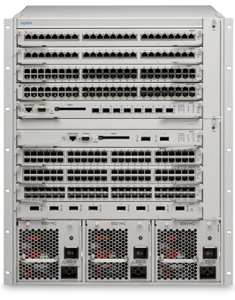
Ethernet Routing Switch 8300
Overview & Benefits
Versatile & reliable Medium Core
  Core option for medium-size performance requirements
  Sub-second failover
  device Virtualisation
Convergence-quality Access
  10/100/1000 to the Desktop
  Power-over-Ethernet, QoS, & integrated Access Control
  Modular advantages
Delivers high-reliability to the Network Core and/or Access
Cost-effective performance
High-density 10G & 10/100/100 with PoE
Enhanced network admission control
Highlights
Notes:
The ERS 8300 is the high-density, high performance wiring closet product within the portfolio. It others a full range of Access Switch features and functionality, including quality of service, access control (802.1X and Avaya's Secure Network Access) matched excellent port density for 10, 100, 1000 Ethernet with no- compromise PoE options.
It incorporates hardware-level robustness together with fault-tolerant Switch Fabric and CPU functions, and includes support for SMLT, thereby making the 8300 an option for the Network Core in certain design scenarios.

Slide 26
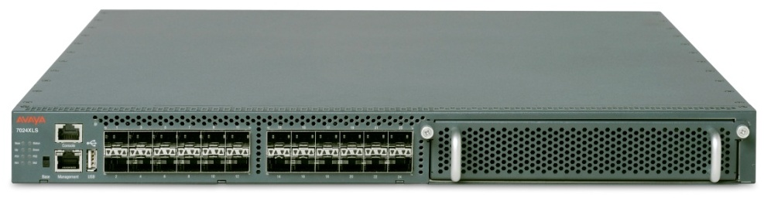
Virtual Services Platform 7000
Overview & Benefits
Fit-for-Purpose for Today
  Versatile dual-mode 1 or 10 Gigabit Ethernet support
  Lossless architecture
  Front-back or back-to-front cooling options
  Small form-factor & energy-efficient
  High-capacity Fabric Interconnect, up to 5.12Tbps
Future-Ready for Tomorrow
  Brings Virtualized Services directly to the Server
  Architected for seamless integration of 40 and/or 100 Gigabit
  Data Centre Bridging-ready to integrate Fibre Channel
Lightning-fast performance with flexible connectivity options
Delivering mass 1/10 Gigabit today
Future-ready for 40/100 Gigabit, Lossless, & Storage convergence
Lifetime Warranty
Highlights
Notes:
The Avaya Virtual Services Platform 7000 is ideally suited to delivering today’s pressing need for flexible, high-speed Ethernet connectivity in the high-performance Data Center Top-of-Rack (ToR) role; additionally it provides a cost-effective 10 Gigabit Ethernet fan-out capability for existing Core Switch deployments and it also has application in the Campus distribution layer, delivering flexible connectivity and consolidation options. Featuring a hardened physical architecture of dual, hot-swappable AC or DC power supplies and fan trays, the Virtual Services Platform 7000 (VSP 7000) is an important addition to a network manager’s toolkit for creating always-on high-performance solutions.
In addition to the versatility afforded by the integrated MDA, the VSP 7000 boast a host for strategic innovations that ensure it will continue to deliver cutting-edge performance and services throughout an extended life cycle. Chiefly amongst the future-ready features is the advanced fifth generation application-specific integrated circuit (ASIC) chipset that has been optimized for sophisticated network operations.

Slide 27
Campus Stackable Switch Positioning
Access Switch for Large Enterprises: high-performance Gigabit-to-the-Desktop
Aggregation (Distribution) Switch
Core Switching solution for small Enterprises
Top-of-Rack/Horizontal Stacking for the Data Centre
Where 10 Gigabit density is required today
ERS 5000
Access Switch for mid-to-large Enterprise
Environments with either FE or GbE connectivity at the Edge, or both
Where 10 Gigabit connectivity is required today
ERS 4000
Access Switch for Branch Office or smaller Enterprise Campus: when Fast Ethernet-only is acceptable
Low intensity convergence deployments
ERS 2500
Notes:
Fixed Product Positioning
To ensure that we’re starting from the same level of understanding it’s a good idea to correctly position each of the product lines within the Stackable part of the portfolio.
The 5000 Series, featuring the new 5600 models. These products can be used in a number of demanding applications:
The Wiring Closet – for high-performance Gigabit-to-the-Desktop
As fibre aggregation Switch when there’s a need for the Distribution Layer
To be the cost-effective option for the Core Switch in smaller networks
And as a high-performance 1GbE/10GbE Top-of-Rack Switch in the Data Centre, integrating into a Horizontal Stacking/Switch Cluster solution
The 4000 Series is the primary focus of the Stackable portfolio in terms of the Wiring Closet role – the default option that should satisfy 80% of the typical Enterprise requirements. It’s an extremely versatile product line, with a total of 17 different models available with options for Fast Ethernet – both Copper and Fibre, and Gigabit Ethernet, with additional options for 10GbE Uplinks, and of course a full PoE capability to support the high-intensity Convergence requirement.
And to the 2500 Series are really focussed on the Branch Office or smaller Enterprise requirement where only Fast Ethernet if required and if PoE is needed it’s a fairly simple, low-intensity deployment scenario.

Slide 28
Ethernet Routing Switch 5000 Series
Overview & Benefits
Scalable solution to empower Convergence
  High-availability Stackable Chassis, virtual backplane up to 1152Gbps
  10/100/1000, Advanced QoS, & Power-over-Ethernet
  High-speed local switching
Integrated Access Control
  Extended & enhanced 802.1X
  Standards-based & identity-driven access control
  Delivers 99.999% reliability to the Network Edge
Enable the Converged Desktop
Comprehensive access control
Switch Clustering for the small Core
Pay-as-you-grow scalability & Lifetime Warranty
Highlights
Notes:
The ERS 5000 Series is the premium of the three Stackable solutions currently available from Avaya; it offering the highest levels of performance, the most sophisticated feature-set, and the greatest flexibility in terms of hardware form-factor. The high-availability Stackable Chassis capabilities have always provided the greatest degree of protection at the Edge, and the support for Switch Clustering (using the Split Multi-Link Trunking) the 5000 Series is the best option for deployment into the Core of small networks.

Slide 29
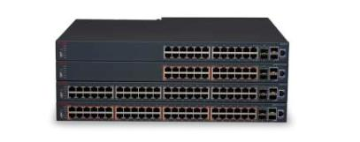
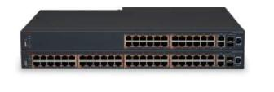
Ethernet Routing Switch 4000 Series
Overview & Benefits
Scalable solution to empower convergence
  GbE & 10GbE Uplinks
  PoE, PoE+, & QoS
  High-availability Stackable Chassis, virtual backplane up to 384Gbps
  High-speed local switching & Dynamic Layer 3 Routing
  Avaya Energy Saver
Integrated Access Control
  Extended & enhanced 802.1X
  802.1AB auto discovery for plug and play of Avaya end-points
Delivers 99.999% reliability to the Network Edge
Versatile converged Desktop connectivity – 17 models
Advanced edge feature set, high-availability power, PoE/PoE+
Pay-as-you-grow scalability & Lifetime Warranty
Highlights
Notes:
The Ethernet Routing Switch 4000 Series is a very broad portfolio we currently have 17 models in the portfolio - including the 6 new models which will be generally available at the end of November. With the new model variants we now have a massive variety of port combinations including, PoE, non POE and PoE+, copper, SFP and SFP+ in every variety and port count that you could ever need in an edge closet switch. All products offer advanced QoS, high speed switching and dynamic Layer 3 routing, integrated security, integrated access control and huge reliability at the network edge.

Slide 30

Ethernet Routing Switch 2500 Series
Overview & Benefits
Workhorse solution to empower Convergence
  10/100 to the Desktop
  Power-over-Ethernet & QoS
  High-speed local switching & Layer 3 Routing
  High-availability Stackable Chassis, virtual backplane up to 32Gbps
Integrated Access Control
  Extended & enhanced 802.1X
  802.1AB auto discovery for network & devices
Delivers flexibility to the Network Edge
Enable the Converged Branch
Enterprise-class QoS & Access Control capabilities
Pay-as-you-grow scalability & Lifetime Warranty
Highlights
Notes:
The ERS 2500 Series is the new addition to the Stackable solutions currently available from Avaya; slotting in above the 425 and below the 470. It offering entry-level performance for Convergence networking, a rich feature-set, and the good flexibility in terms of hardware form-factor. The fail-safe Stacking capabilities have always provided the greatest degree of protection at the Edge, and this will be introduced onto the 2500 via a future software update (no hardware change or addition required).

Slide 31
Summary & Value Statements

Slide 32
Business-centric Value Proposition
Uninterrupted Business Operation
Deterministic sub-second network resiliency
Traffic monitoring, filtering and security capabilities to protect against malicious attacks for maximum application uptime
Sophisticated QoS capabilities for the converged network that ensures high user experience and productivity
Simplified Network Virtualization
Simple, resilient and cost-effective virtual infrastructure with logical separation to support M&A and network consolidation
Efficient & optimized virtualized services across the Enterprise
Future-ready Scalability
10 Gigabit Ethernet port density & diversity in future-ready architectures
Clustering of Switches enables effective scaling: supporting business, network and application growth

Slide 33
Development Priorities
Ethernet Switching Portfolio
Introduce PoE+
Perfect ‘Stackable Chassis’
Introduce next generation core platform: VSP 9000
Introduce next-gen 10G Top-of-Rack: VSP 7000
IPv6, 2nd Generation I/O, & Virtual Fabric for VSP 9000
Stackable Chassis, Virtual Fabric, & MDAs for the VSP 7000
Next-Generation ERS 3500 entry-level platform
PoE+ pervasive at the Edge
Introduction 40G & 100G
Interface with Security, CCTV, & Environmental systems
Today
Near-Term
Beyond
Notes:
Investment Strategy for Ethernet Switching
Avaya’s award winning Ethernet Switching product line has been progressively refreshed with new hardware and software functionality and most recently introduced the ERS 5600 series that delivers the Industry’s first and only Terabit-capable Stacking solution. This is an important industry inflection point at the network edge where customers can realize the performance of a Modular Switch, but enjoy the pay-as-you-grow benefits of the Stackable form-factor. Avaya calls this solution a ‘Stackable Chassis’. Avaya will complement this investment direction by embedding PoE+ into its edge portfolio.
You’ll see an exciting new product release during 2010, the brand new Virtual Service Platform 9000: providing both Industry-leading Switching scalability and 10 Gigabit Ethernet port densities. Importantly, although the hardware is new (and takes advantage of the latest developments in terms of silicon, etc) the software is firmly based on the tried and tested ERS 86/8800 platform. The hardware will deployment-ready for 40G and 100G capacities supporting the largest of Enterprise deployments.
Today:
Introduction of PoE+ Standard – the new 802.3at PoE+ Standard will provide the additional power required for devices such as 802.11n Wireless Access Points
‘Stackable Chassis’ model for edge – this is an Avaya key differentiator: our FAST (Flexible Advanced Stacking Technology) Switches offer the advantages typically associated with higher-priced Modular Switches
Introduction of next generation core platform: VSP 9000 – the new VSP 9000 will redefine capacity and scalability for the high-end Data Center: up to 27Tbps and 240 10GbE ports per Chassis (up to 720 per Rack)
Tomorrow:
Introduction of a new, VSP-class Top-of-Rack Switch for high density 10GbE with uplinks options for multiple 10GbE, 40Gbe, and 100GbE
Continued shift of R&D to Stackable Chassis at the Edge – we’ll see further transition away from Modular Chassis; it simply makes much more sense to leverage our FAST-enabled Stackable Chassis solution rather than a classic Modular Switch
Beyond:
PoE+ at the Edge – there could be further use made of PoE+ at the edge – beyond just 802.11n Access Points – and we’ll have the power budget to support this increase
Application VPN and integrated Wireless Services into VSP 9000 – the VSP (the Virtual Service Platform) will provide a highly-efficient platform for advanced services.
Introduction 40G & 100G – the next evolution of Ethernet will be 40G and 100G interfaces, and this is the rationale behind the huge scalability that has been built into the VSP (as 240 x 10GbE only requires 2.4Tbps, but 240 x 100GbE requires 24Tbps)
Interface with Security, CCTV, & Environmental systems - there is a drive to port Security and Facilities systems from proprietary infrastructure to IP/Ethernet, and therefore these will increasingly be directly connected to the Wiring Closet Switch; there's obvious advantages in this, but also certain responsibilities that we will take on.

Slide 34
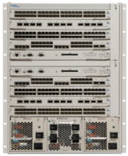
Roadmap
VSP 9000
v3.2
v3.3
ERS 8800
v7.2
v7.3
ERS 8300
4Q11
1Q12
2Q12
3Q12
4Q12
VSP 7000
v10.1
v10.2
ERS 5000
v6.3
v6.4
ERS 4000
v5.6
v5.7
ERS 3500
v5.0
v5.1

Slide 35

Enabling Services for Avaya VENA solutions
Delivered by Avaya Professional Services
Full turnkey & standalone service models to provide Customers & Partners with the best possible solution
  Level of expertise only available from the vendor
  Extensive Data Center & Campus experience driving best practices
  Fixed Price, Fixed Scope services for ease of doing business
  Financial models to help demonstrate ROI/TCO and gain buy-in
Notes:
Enabling Services for the Avaya VENA solution
The APS portfolio of service offers includes turnkey solutions, packaged services with fixed scope & fixed price and standalone service elements where we can work in conjunction with our business partners or customers to deliver a complete Data Centre or Campus solution. Either way, customers and/or partners will have access to these key elements that drive business value:
The deepest level of expertise direct from the manufacturer
Extensive expertise in Data Centre and Campus solutions
Very strong best practices that are being deployed in several key industries, including financial services, healthcare, state and local government
Fixed Priced and Fixed Scope suite of services for both direct customers and partners enabling Ease of Business through simplified quote, simplified ordering and simplified presentation of services.
Financial models are certainly designed to demonstrate ROI/TCO for the customer.
When it comes to ‘Go to Market’ Models, Avaya Professional Services are presented in such a way that Customers or Partners can purchase services from Avaya that provide a full turnkey deployment or purchase services to augment their existing capabilities.

Slide 36
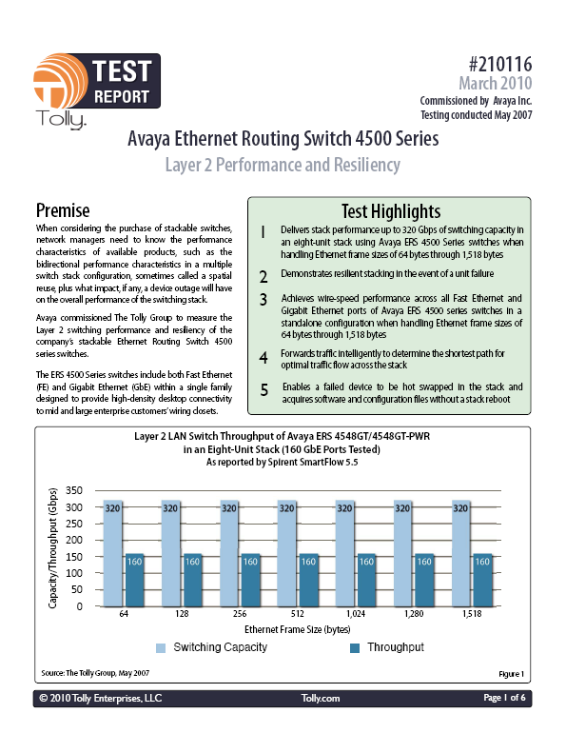
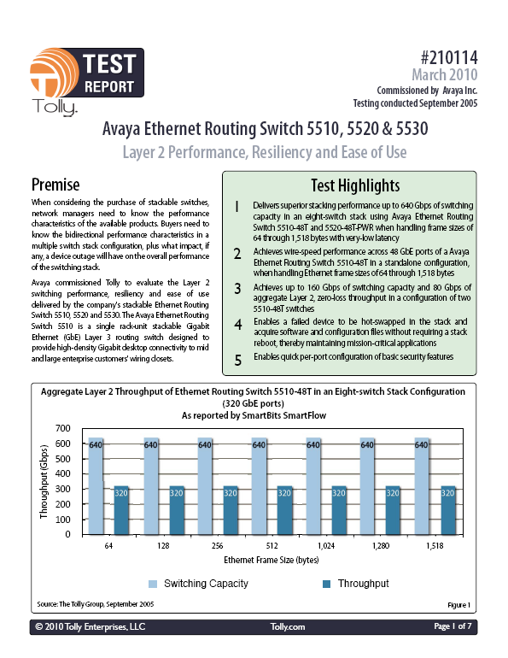
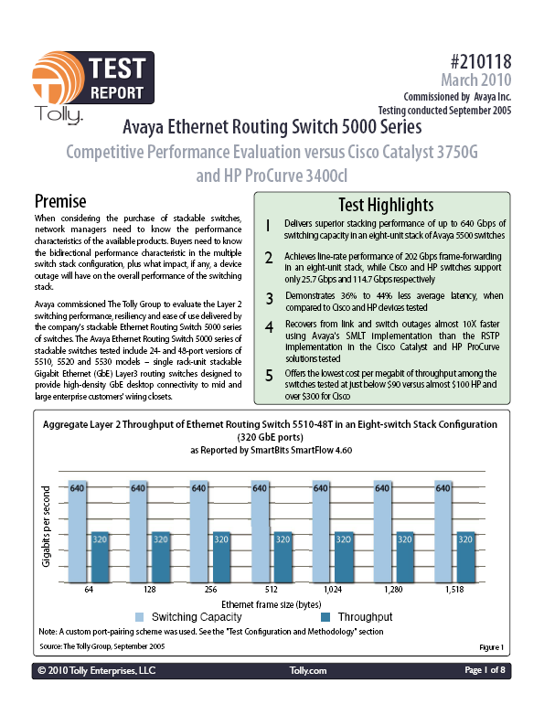
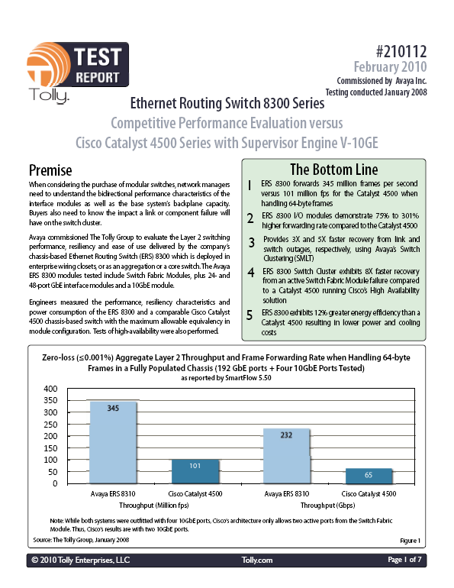
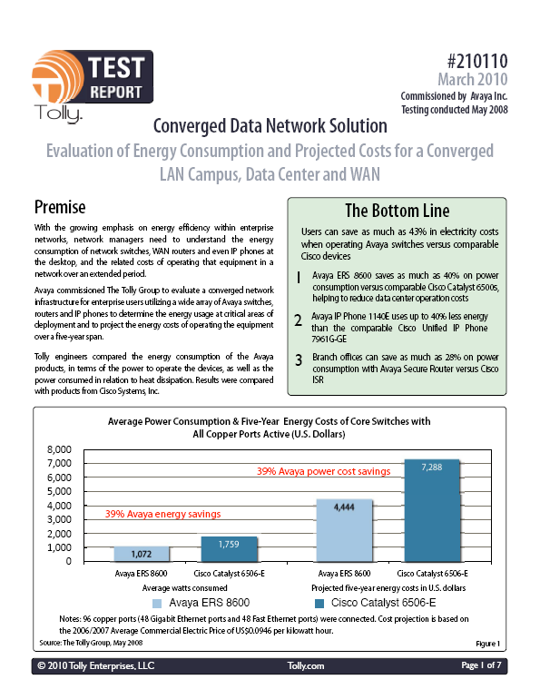
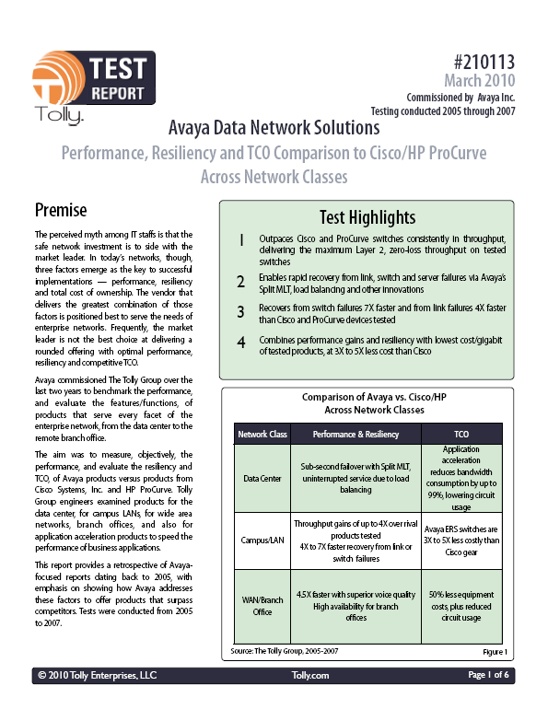
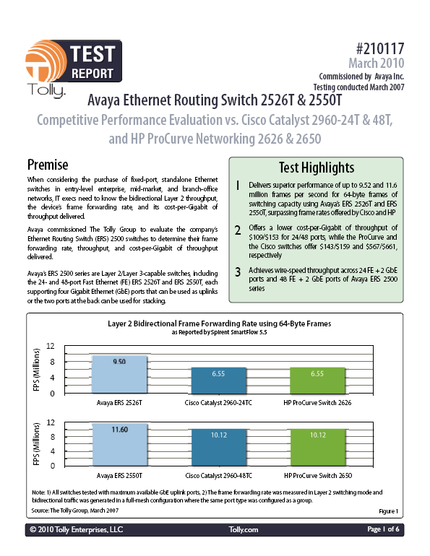
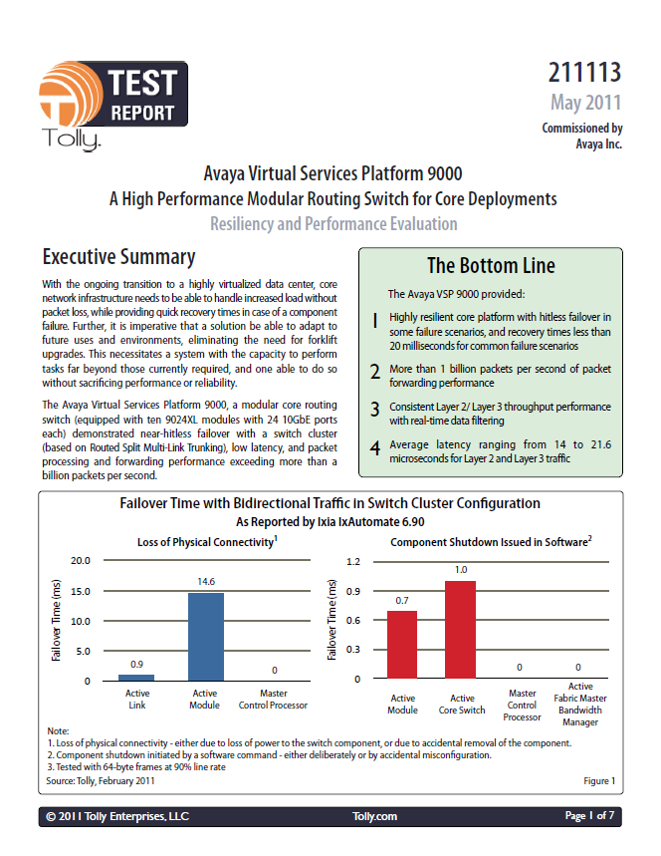
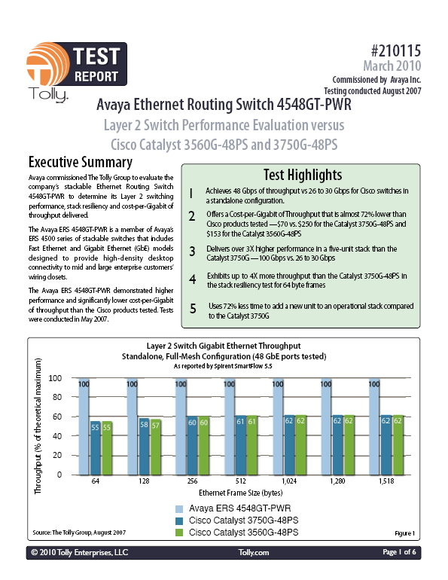
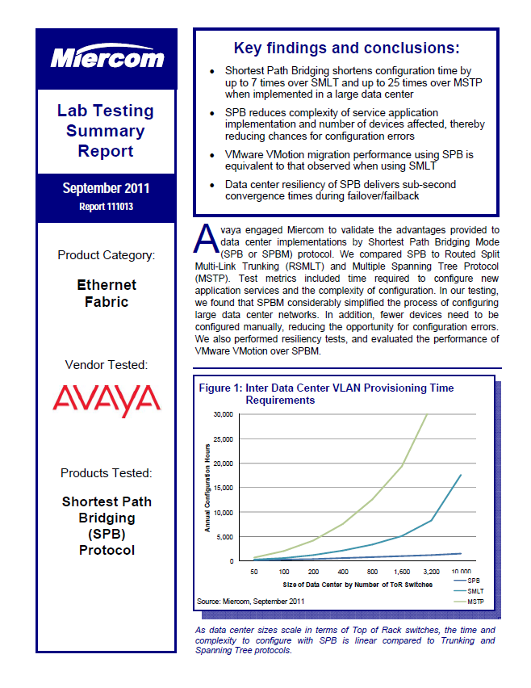
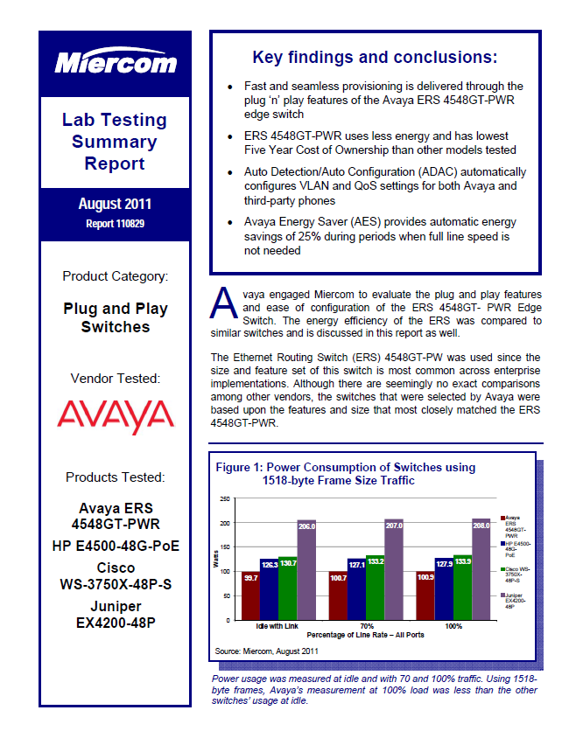
Tested & Verified
Commitment to Standards & Interoperability
  Avaya Core & Access
  Avaya Core & 3rd Party Access
  Avaya Edge & 3rd Party Core
Independently testing Avaya’s claims & Competitors
Open and transparent, real testing & real performance numbers
Ongoing program of validation
Notes:
Tested & Verified
Avaya appreciates that End Users are often bombarded with the market claims of all the different Vendors, hence we have concentrated on independent testing of all of our key differentiators and technical claims-to-fame. This way, End Users do not have to take our word for it, they can go and see for themselves how we stack-up against the opposition (and their marketing machines).
Note: these Reports are freely available from avaya.com.

Slide 37


Trusted & Valued
Consistently winning business where Convergence is being leveraged for strategic advantage
The most challenging & demanding verticals:
  Healthcare
  Media
  Education
  Banking & Finance
  Retail
  Utilities
  Public Sector
“We chose Avaya because it could deliver a solution that was technologically superior, higher in performance and simply more cost-effective than anything offered by its competitors.”

Slide 38

Driven to Succeed
Leveraging historical success for future growth
Understanding the market & business needs
Compliments our leadership in Unified Communications
Focussed on being a leader, not just a bit player
Partnering with Business for the journey ahead

